Slide 1

Business Inclusion & Advancement
Mission: The Office of Business Inclusion & Advancement promotes economic vitality and opportunity for all citizens of Winston-Salem by attracting, creating, and retaining jobs, and augmenting the tax base. Through engagement, collaboration, and education our office increases opportunities for local companies and minority and woman-owned firms interested in doing business with the City.

Slide 2
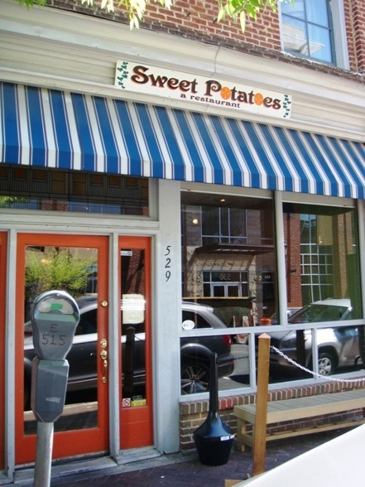
Business Inclusion & Advancement
Staff:
  Ken Millett – Director
  Steven Harrison – Small Business Development Specialist
  Jakira Westbrook –Business Inclusion Manager
  Two Diversity Compliance Specialists
  Hannah Hernandez – Administrative Assistant

Slide 3

Minority & Women Business Enterprise Program (M/WBE) Program

Slide 4
M/WBE Program Policy
Provides minorities and women an equal opportunity to participate in all aspects of City contracting and purchasing programs.
Prohibits the discrimination against any person or business in pursuit of these opportunities on the basis of race, color, sex, religion, or national origin.

Slide 5

M/WBE Program Overview
Works to build close relationships with local minority and women-owned businesses in the Winston-Salem area and to increase their opportunities to do business with the City.
Tracks the participation, payment, and treatment of M/WBE’s on formal construction projects.
Provides workshops and seminars for M/WBE’s and assists with the resolution of problems and complaints related to payment, contracts, etc.

Slide 6
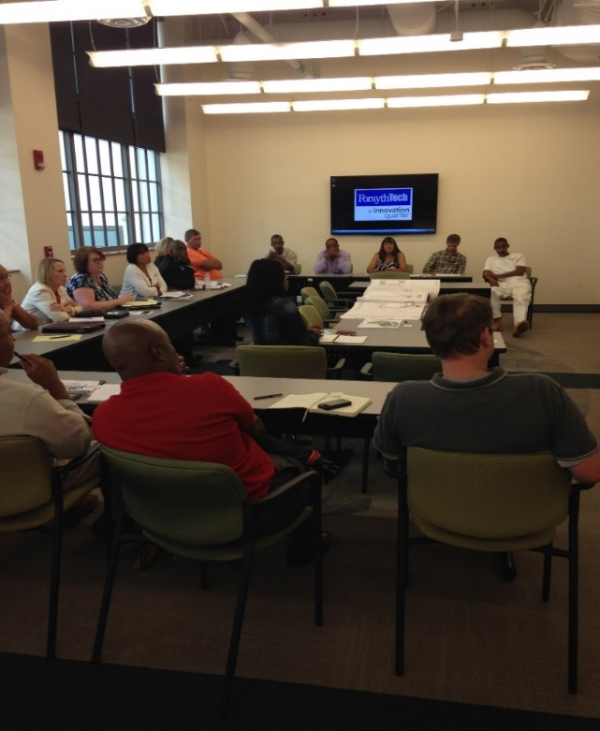
M/WBE Program Benefits
Electronic notification of upcoming bidding opportunities
Access to training seminars, workshops,
and outreach sessions
Assistance with Historically Underutilized Business (HUB) certification process
Increase awareness of your firm’s product
or service and desire to do business with
the city
Assistance with the resolution of problems and complaints regarding non-compliance with the M/WBE program

Slide 7

City Vendor Registration
Weekly notification of upcoming city projects
H.U.B. Certification
Accepted across the State of N.C.
City Departments
Goods and Services purchased in an average year
Pre-Bid Meetings
Notification of workshops, mailings, event calendars
Opportunity to establish relationships with general contractors for potential business.
Local Preference
Learn about project details
Networking opportunity
Ways To Become Involved

Slide 8
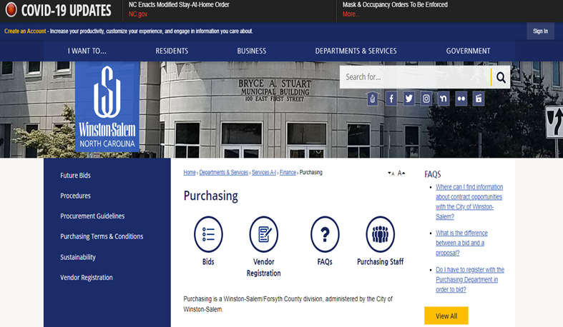
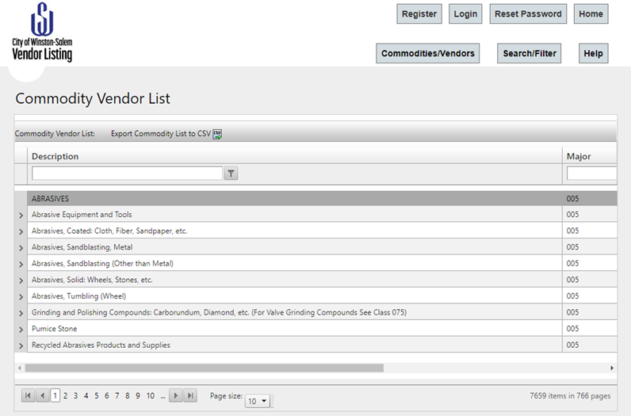
City of Winston -Salem Vendor Listing
Accessible from City’s main webpage
Tutorial on Registration process
Utilized by City departments and Prime Contractors to solicit bids and quotes

Slide 9
NC HUB CERTIFICATION
Must be at least 51 percent owned and managed by someone who is African-American, Hispanic, Asian- American, American Indian, female, or socially and economically disadvantaged
The HUB Office makes determinations concerning whether individuals and firms have met the burden of demonstrating operational status, group membership(or disability, or social and economic disadvantage), ownership, and control considering all the facts.
Listed in the Vendor Link System, which is widely used by state agencies, universities, community colleges, local schools, local governments, etc.
M/WBE participation goals shall be satisfied by an entity that qualifies as a Minority Business Enterprise under N.C. General Statue 143-128, and that has been certified by the State of North Carolina’s Office for Historically Underutilized Businesses

Slide 10
How We Buy
A purchase is initiated by one of several types of solicitations:
Invitation for/to Bid
Evaluated for compliance to bid specifications
Lowest responsive, responsible bidder
Project Specific M/WBE participation goal
Request for Proposal (RFP)
Price considered in evaluation
Catch all category
Common examples for services: consulting, banking, janitorial, accounting services, etc.
10% M/WBE participation goal
Request for Qualification (RFQ)
firms are based upon their ability to provide services without regard to fee.
Engineering, Architectural, Surveying, Construction Manager at Risk
10% M/WBE participation goal

Slide 11
What the City Buys by Type
Construction, Repair, and Maintenance
  Building & road work
  Utility Construction (water/Sewer)
  Paving & concrete work
  Related trade industries
  Curbs, gutter, sidewalk
Supplies, Equipment, Materials and Services
  Chemicals
  Ammunition
  Firearms
  Printing & publishing
  Catering
  Uniforms
  Oils & lubricants
  Office supplies, furniture, office equipment
  Motor vehicles & vehicle parts
  Heavy Equipment
  Hand & power tools
  Technological equipment
  Temporary personnel services
  Janitorial services
  Pest control services
  Security services
  Painting Services
  Employee Benefit services
  Various consulting services
  Landscape & mowing services
Catering services
Professional Services
  Architectural
  Engineering
  Construction Manager at Risk
  Surveying

Slide 12
Goods and Services Purchased in an Average Year
The City of Winston-Salem actively seeks and identifies qualified M/WBE's to offer the opportunity to participate as providers of goods and services to our various departments.
We accomplish this by:
  Requiring local vendors to be used, if available, for all discretionary spending under $20,000.
  Local M/WBE vendors must also be given the opportunity to bid/propose on the project.
  Obtain the best price available from local vendors for comparable quality items considering time, delivery, pick-up costs, and other fees.
  Goods and Services List: mwbe.cityofws.org

Slide 13
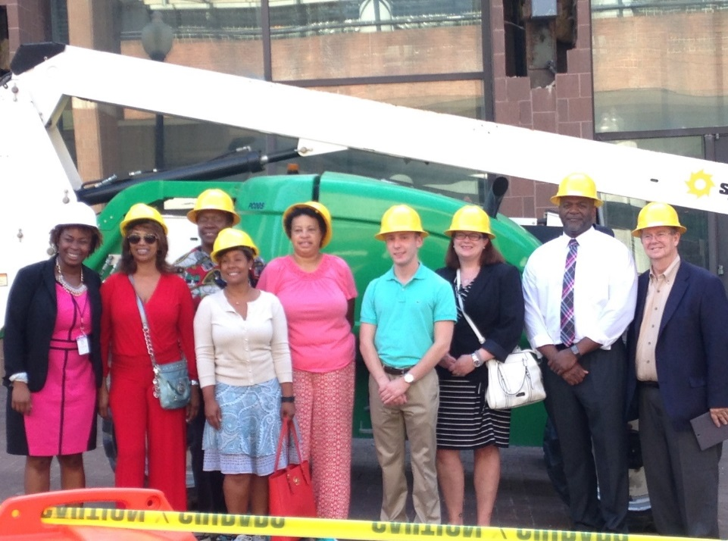
M/WBE Advisory Committee
Charged with reviewing the City’s M/WBE program by:
  Making periodic reports and recommendations to City Council regarding program enhancements
  Evaluating the good faith efforts of contactors
Appointed by City Council upon the recommendation of the Mayor

Slide 14
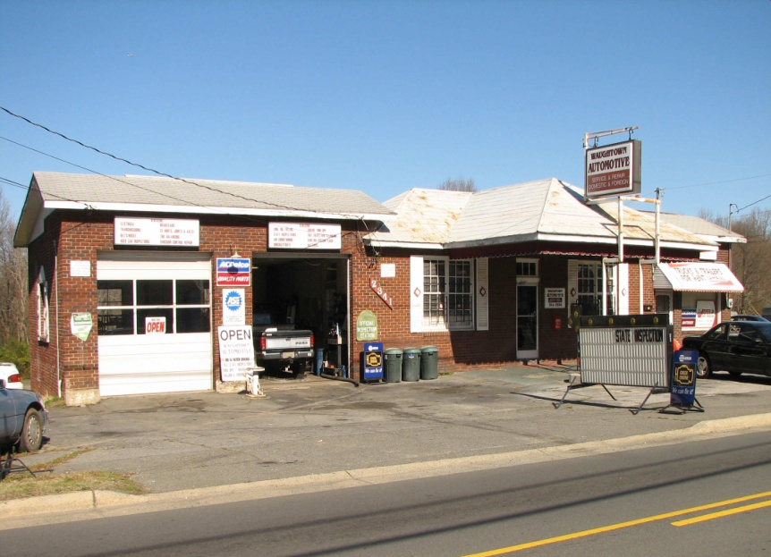
Small Business Liaison -
Technical Assistance
Concept of the role
Business Planning
Licenses & Permits
Resource Guide
Funding Sources
Navigation Through the Process

Slide 15
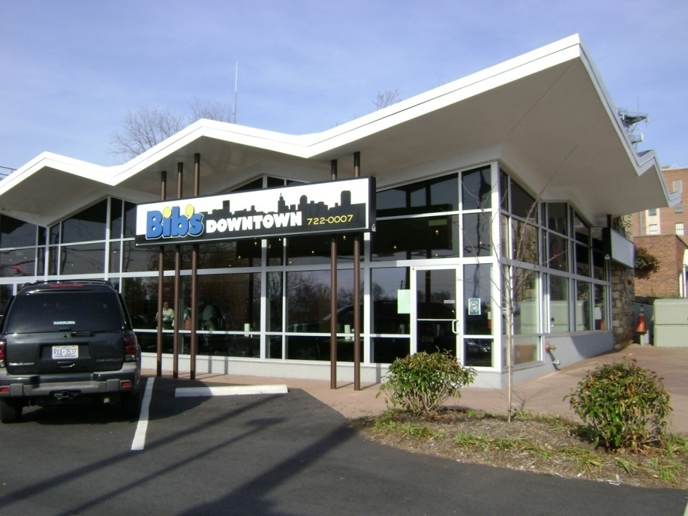
Financial Assistance Programs
Small Business Loan Program
Eligibility
Use of Loan Funds
Amount & Terms
Collateral
Credit History
Job Creation/
Retention
Business Plan
Loan Committee

Slide 16

Small Business Plan Contest
Winners Receive:
  Two contest winners again in FY18-19
  $5,000 grant and $5,000 micro-loan
  Technical assistance
  Four previous winners
Business Plan Components:
  Executive summary
  Product/Service/Business Idea
  Management
  Market Analysis
  Marketing Plan
  Operations
  Financials
  Opportunities & Challenges

Slide 17
Financial Assistance Programs
NRSA and Downtown Building Rehab Programs
  Qualifying Area
  Application Process
  Criteria for Qualification
  Use of Funds
  Is this a GRANT?
Revitalizing Urban Commercial Areas (RUCA)
  Struggling urban commercial areas throughout the city
  Public/Private Partnership
  Do I pay the $ back?

Slide 18
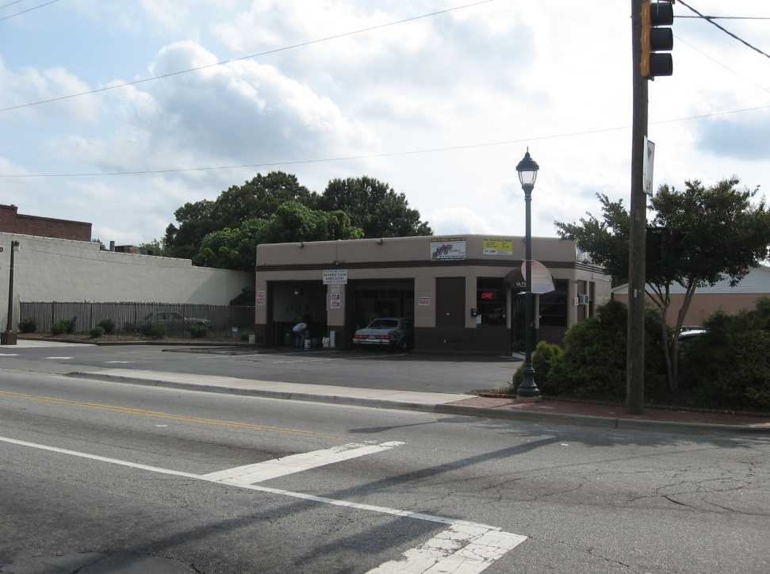
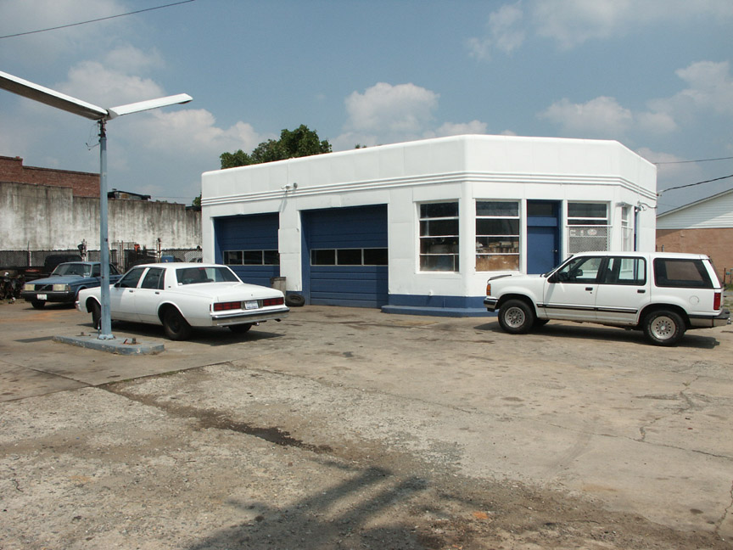
NRSA Building Rehabilitation Program
After
Before
Dangerous curb cut closed
Building Improvements
Storage yard screened and landscaped
Landscaping added

Slide 19
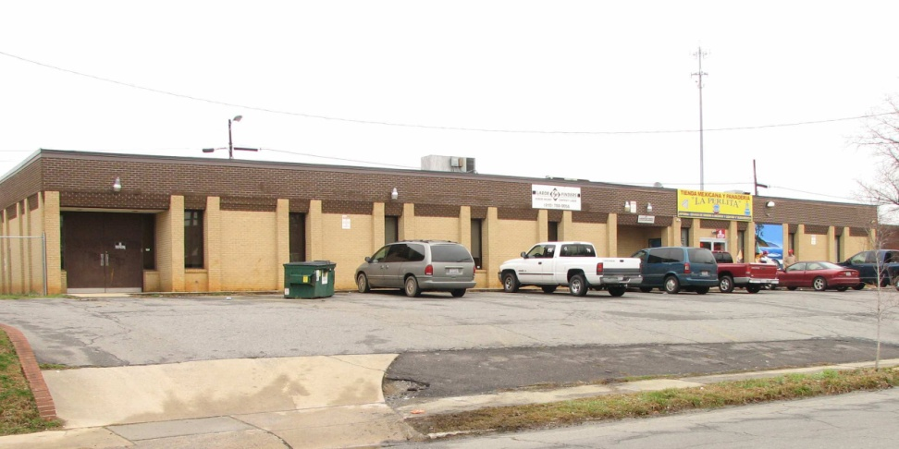
NRSA Building Rehabilitation Program

Slide 20
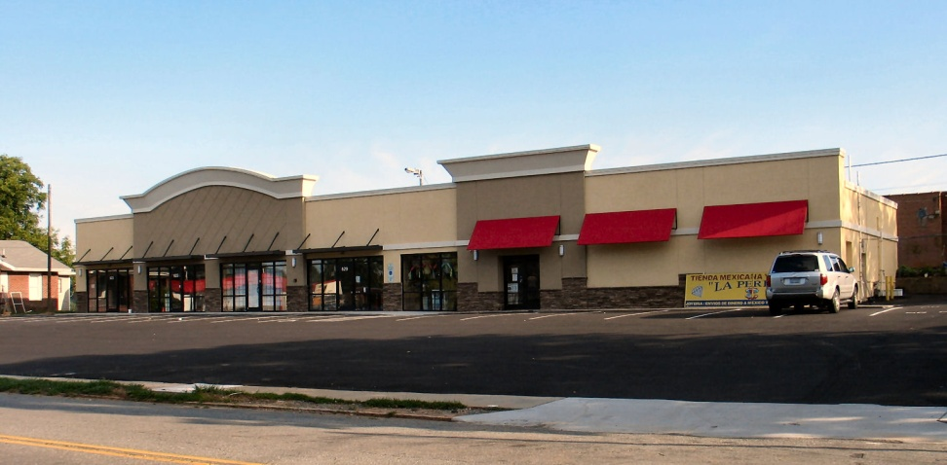
NRSA Building Rehabilitation Program

