Slide 1

Field
Operations

Slide 2
Streets Division 93 Employees
  Street repair
  Construction maintenance
  Drainage maintenance
Stormwater Division 12 Employees
  Capital improvement projects
  Construction and post construction site runoff
  Community outreach & education
  Water quality
Erosion Control Division 5 Employees
  Commercial construction
  Residential construction
  Flood plain management

Slide 3
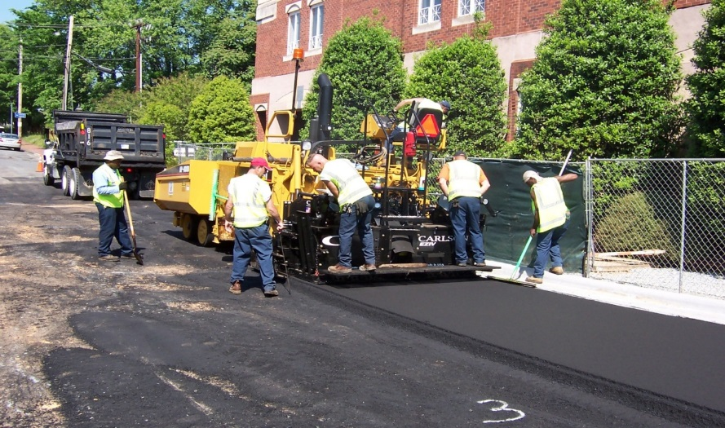
Streets Division
Maintains approximately 1,020 miles of roads, including:
Storm water maintenance
Street repair
Curb and gutter repair
Resurfacing
Pavement preparations for resurfacing
Snow and ice control

Slide 4
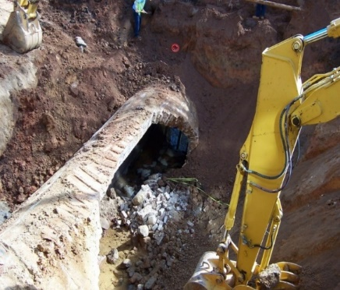
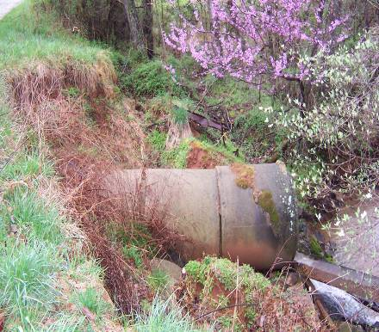
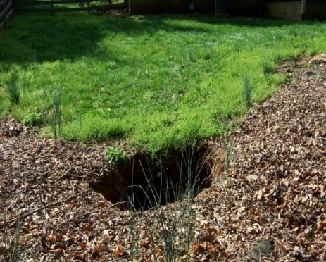
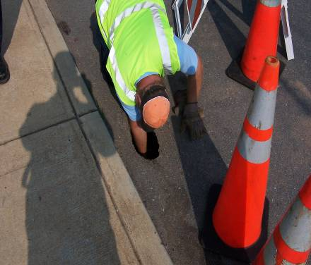
Drainage Maintenance
Drainage maintenance crews install new pipe, replace existing pipe, build storm boxes, etc.
Separating Pipe
Under a City Street
Street Sink Hole

Slide 5
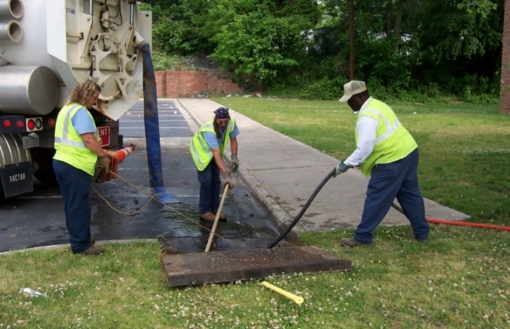
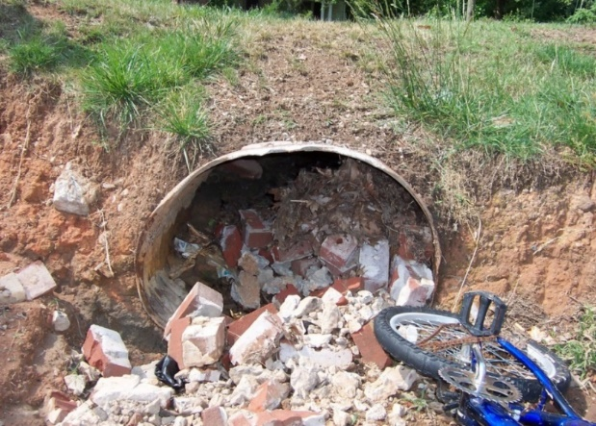
DRAINAGE MAINTENANCE
The Vac-All crew follows routes throughout the city along city maintained streets and vacuums out clogged drainage pipes within the right-of-way.
The Jetter crew uses high pressure water to dislodge debris, sediment and other materials that may be blocking a pipe.

Slide 6
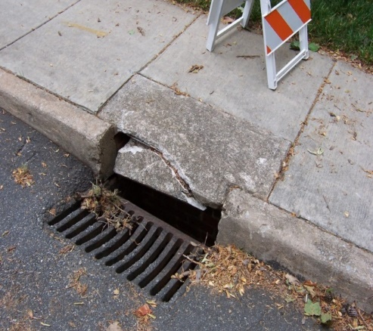
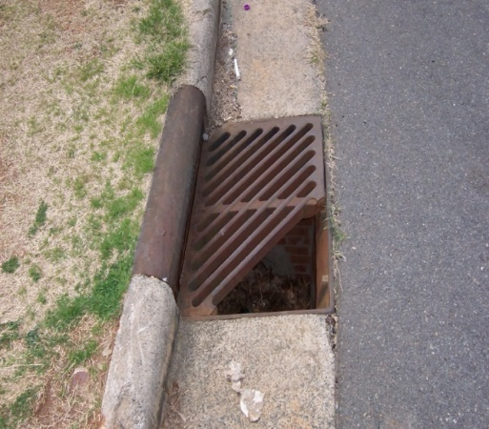
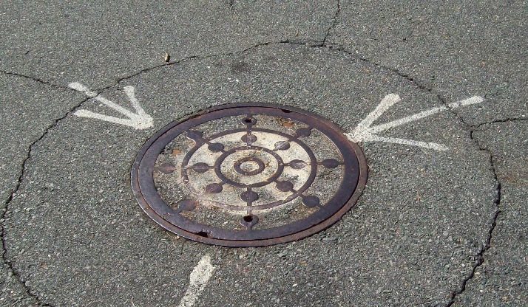
DRAINAGE MAINTENANCE
The Slab/Grate crew replaces:
Broken and missing concrete slabs
Metal grates
Manhole covers

Slide 7
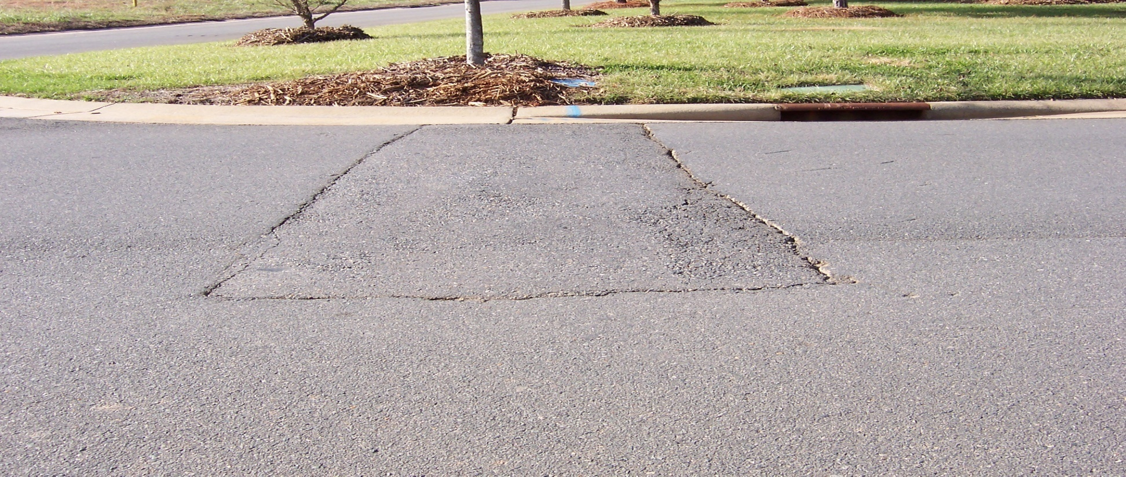
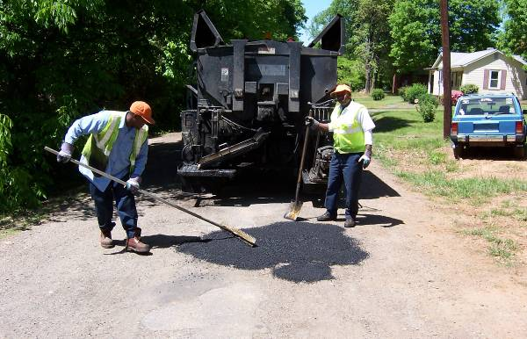
Street repair
Street Cut Repair
This crew travels throughout the city and county repairing cuts in the asphalt made due to repair or install of utilities.
Pothole Repair
This crew travels throughout the city and repairs potholes on city maintained streets.
Base Repair
This crew excavates and places new asphalt on city maintained streets that have subgrade failure.

Slide 8
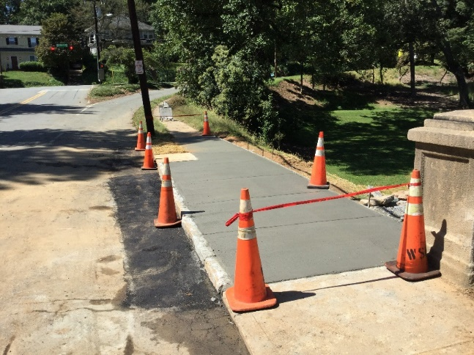
Sidewalk and
Curb & Gutter Policy
The Streets Division will install or replace sidewalk at the property owners request if the property owner agrees to pay 1/3 of the cost which is $54/square yard.
The Streets Division will install or replace concrete curb and gutter at the property owners request if the property owner agrees to pay $25/lineal foot.

Slide 9

STREETS DIVISION Paving Policy
Repaving schedule:
  Streets and roadways given fresh pavement in periodic intervals
  Road may be milled down
  Utility structures adjusted
    Manholes
    Valve boxes
    Curb grates
  Asphalt gravel treatment applied to seal the old street
  Paving with a smooth layer of asphalt to finish the surface
  The entire process takes approximately 2-weeks to complete depending on weather events, location, project size, etc.

Slide 10
Snow & Ice Policy
Snow and ice control policy - designed around priority road arteries.
  Major routes receive top priority for road clearing followed by collector streets.
  The city maintains a stockpile of de-icing salt and sand to assist with making roadways passable
  Two assigned shifts working 24 hours per day to clear the streets.
  Snow and Ice Removal Equipment
    5 Motor Graders
    30 trucks with push plows
    25 salt spreaders
    3 Brine Storage Tanks & Brine Pumps for Trucks

Slide 11
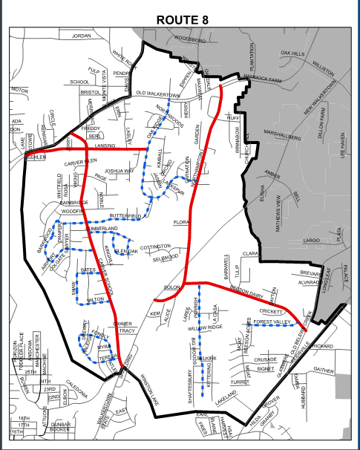
Snow Route Map
Major Street
Collector Street
Snow Route Area

Slide 12

Snow & Ice Operations
https://www.youtube.com/watch?v=CCDBTDcBADg

Slide 13
STORMWATER AND EROSION CONTROL DIVISIONS

Slide 14
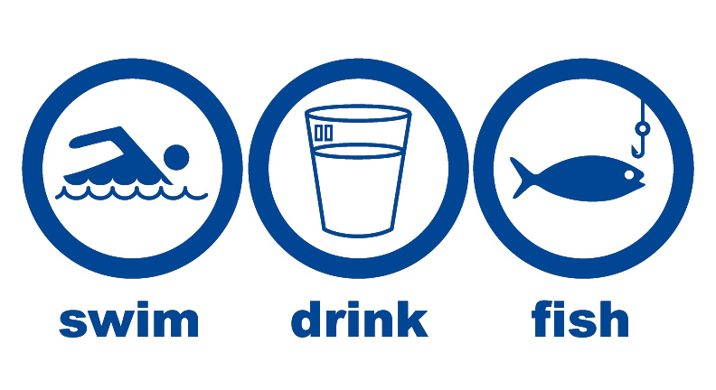
The Federal Water Pollution Control Act
Amendments of 1972
(AKA The Clean Water Act)
“To restore and maintain the chemical, physical and
biological integrity of the nation’s waters.”

Slide 15
Stormwater Division
Six Minimum Measures
Public Education and Outreach
Public Participation and Involvement
Illicit Discharge Detection and Elimination
Construction Site Run-Off Control
Post Construction Management
Pollution Prevention and Good Housekeeping for Municipal Operation

Slide 16
How Does Stormwater Pollute?
Stormwater drains flow directly to the nearest waterway.
Unlike sewage, stormwater runoff does not go through a treatment plant.

Slide 17
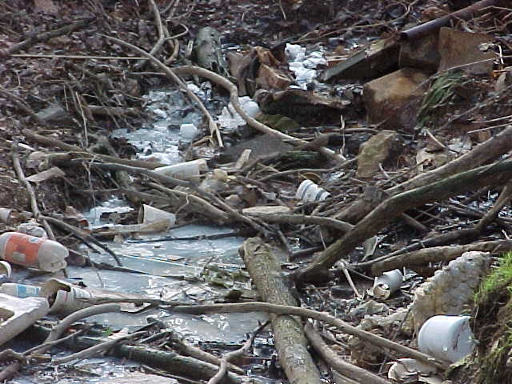
STORMWATER RUNOFF
TRANSPORTS POLLUTANTS
Degrades water quality and habitat
Kills aquatic life
Increases the cost to remove pollutants at the water treatment plants

Slide 18
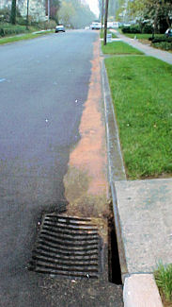

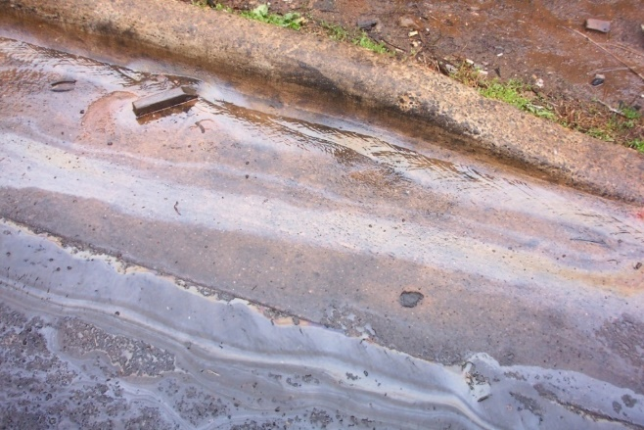
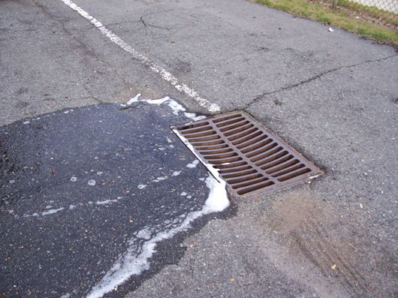
POLLUTANTS FOUND IN STORMWATER RUNOFF
Motor oil
Fuel
Antifreeze
Solvents
Pesticides & fertilizer
Bacteria
Animal Waste
Detergents
Trash
Sediment
Yard Waste
Construction debris

Slide 19
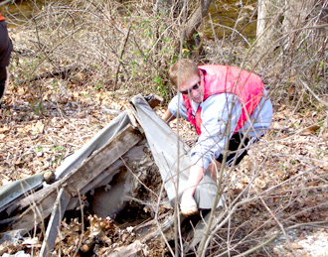
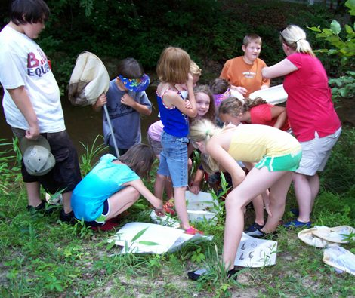
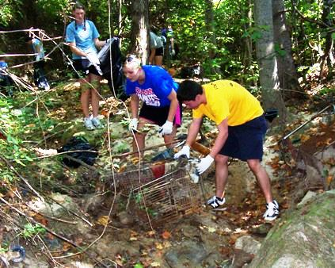
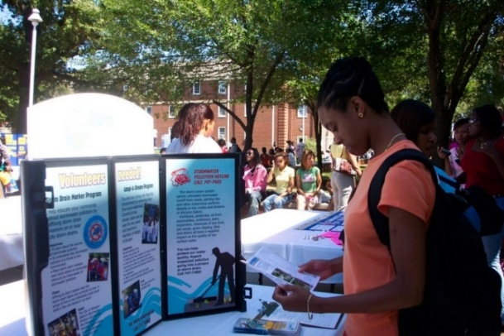
PUBLIC INVOLVEMENT, EDUCATION & OUTREACH
Forsyth Creek Week
School Presentations
Community Events and Presentations
Business Stormwater Education
Creek Clean-Ups
Volunteer Opportunities
Report a Polluter Hotline - City Link 311

Slide 20
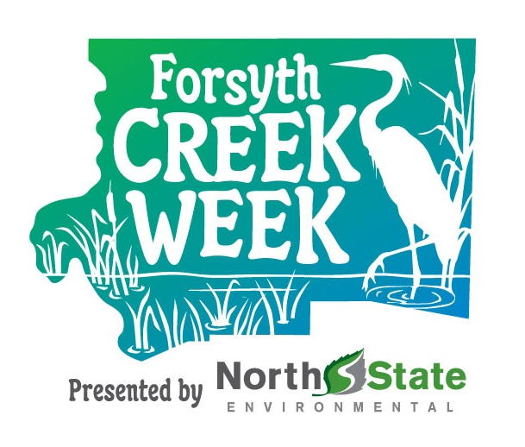
FORSYTH CREEK WEEK
MARCH 19-27, 2022
A collaborative week long celebration of the water ways in Forsyth County!
Keynote Speaker and Reception
Guided Walking Tours and Creek Crawls
Lunch & Learn Workshops
Library Programs for Kids
Trivia Contests
Family Fishing
Professional Development and Community Workshops
The Great American Clean-up
And much, much more!
www.forsythcreekweek.org

Slide 21
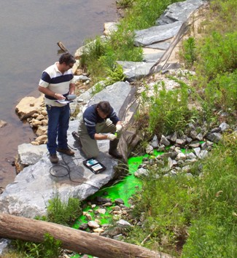
ILLICIT DISCHARGE DETECTION AND ELIMINATION
Illicit discharge: any discharge to the municipal separate storm sewer system not composed entirely of storm water.
Causes of non-stormwater discharges:
Illegal connections
Spills to the storm drain system from business, commercial establishments, and even residences
The purpose of the program is to prevent contamination of ground and surface water by monitoring and inspection of our local waterways

Slide 22
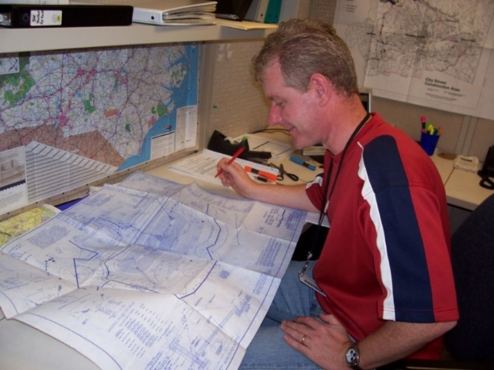
POST-CONSTRUCTION SITE PLAN REVIEW
The stormwater engineer determines whether management is required on any given development.
Typical stormwater management plans include Best Management Practices (BMPs) for quality (pollution or excess nutrients) and quantity (downstream flooding control or erosion). Examples include:
Detention Basins
Oversized underground piping
Wet Ponds
Bio-retention cells

Slide 23
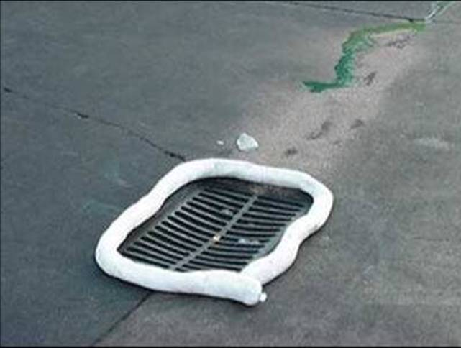
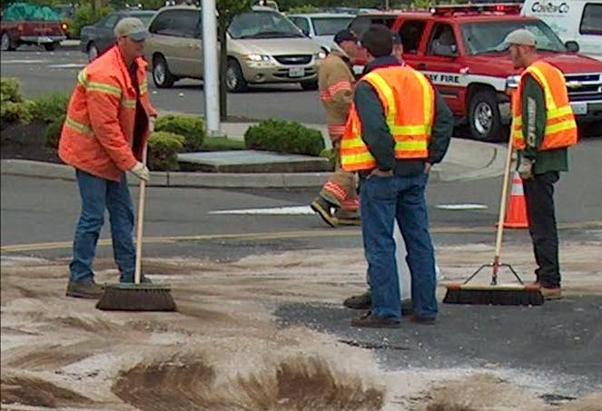
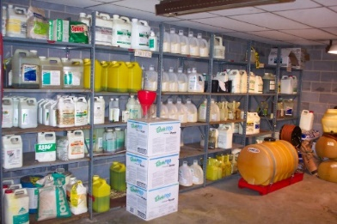
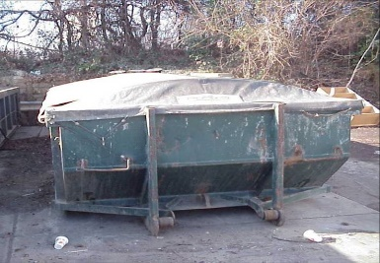
Municipal Good Housekeeping and Pollution Prevention
The city must examine and subsequently alter their own actions to help ensure a reduction in the amount of pollutants that:
Collects on streets, parking lots, open spaces, and storage/vehicle maintenance areas and is discharged into local waterways
Results from actions such as environmentally damaging land development and flood management practices or poor maintenance of storm sewer systems

Slide 24
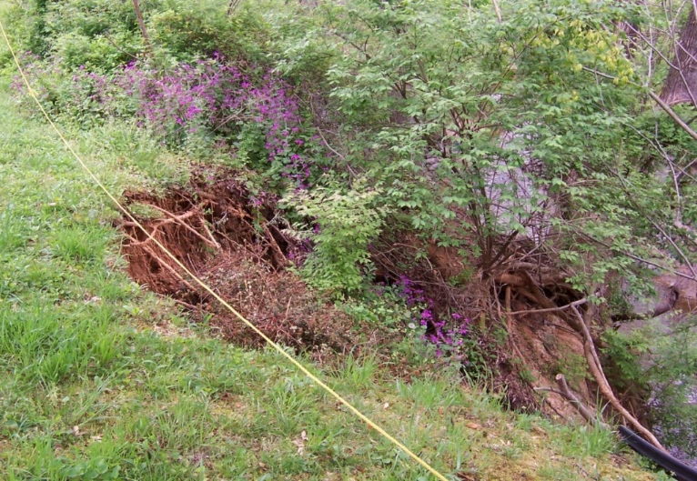
Storm Drainage Improvements on Private Property
The City of Winston-Salem maintains a 70/30 policy related to drainage and ponding maintenance on private property.
Allows for a maximum $35,000 City contribution per affected homeowner to repair private storm drainage problems.
Projects can be single- or multiple-property owner repairs depending on the issue.
Streets drainage crews perform the work that is done on the citizen’s property.
An overview of items related to the 70/30 policy (Section 75-35 of the municipal code) can be found at the following web address: http://www.municode.com/resources/gateway.asp?pid=10054&sid=33

Slide 25
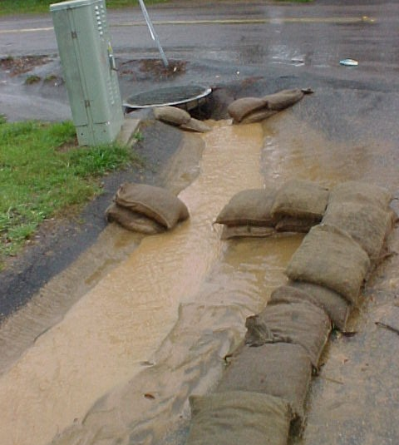
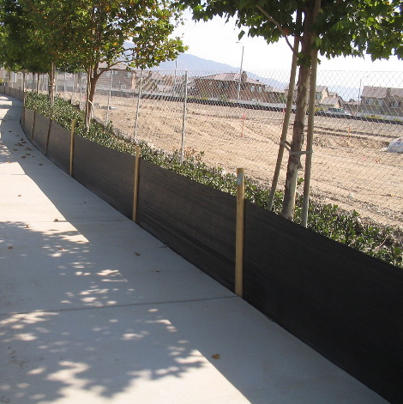
EROSION CONTROL
Construction site runoff can impact all surface waters. Sediment in water bodies from construction sites can:
Reduce the amount of sunlight reaching aquatic plants
Clog fish gills
Smother aquatic habitat and spawning areas
All Erosion Control regulations are adopted & amended by local elected bodies
Some Erosion Control regulations are mandated by the state
Must comply with requirements of applicable state or federal regulations

Slide 26
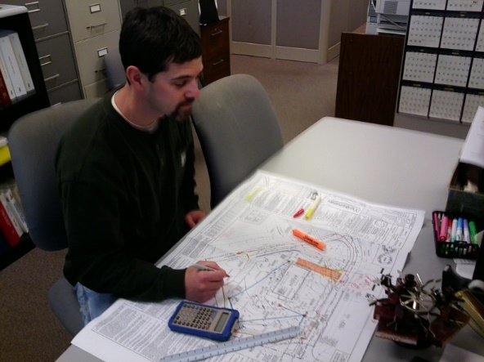
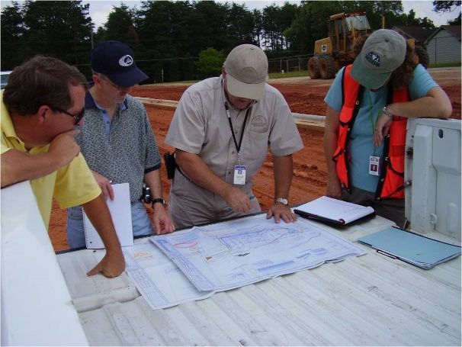
EROSION CONTROL
Review permit applications & plans of proposed work
Issue permits for the work
Conduct inspections of the work in progress
Provide final inspection & approval of work
Provides final approval before the issuance of certificates of compliance or occupancy

Slide 27
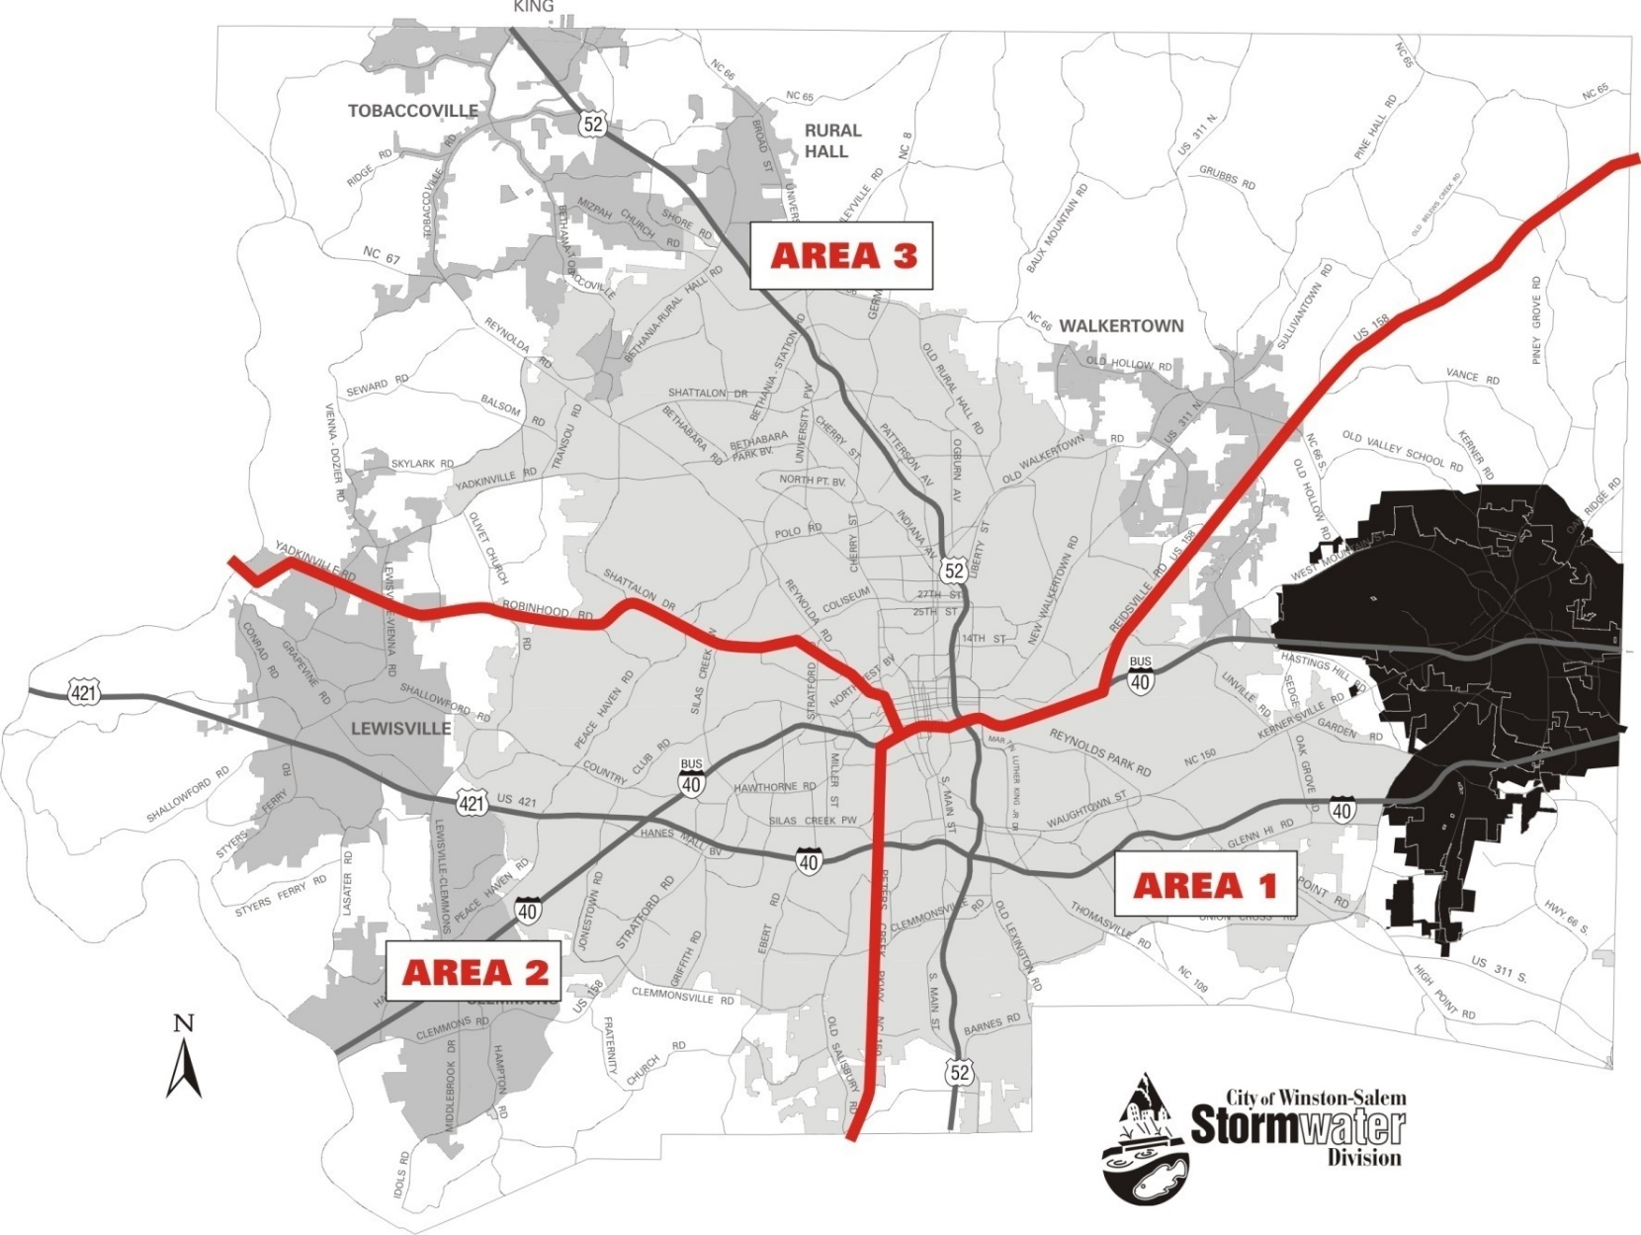

Slide 28
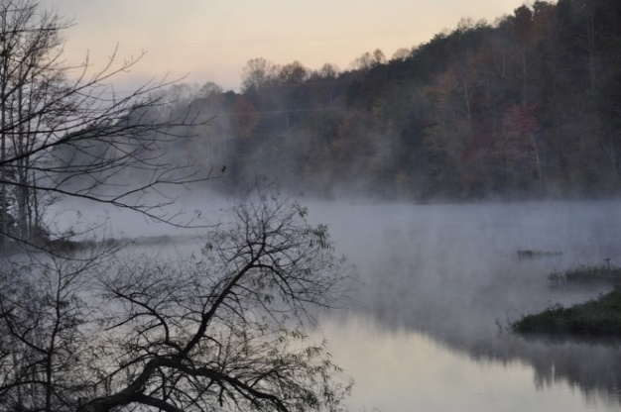
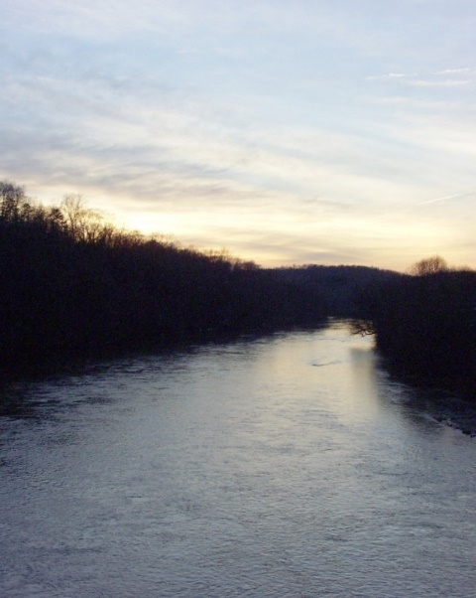
WATER SUPPLY WATERSHED
PROTECTION REGULATIONS
The State mandates localities to adopt and enforce a water supply watershed management
and protection program
Salem Lake
Yadkin River

Slide 29
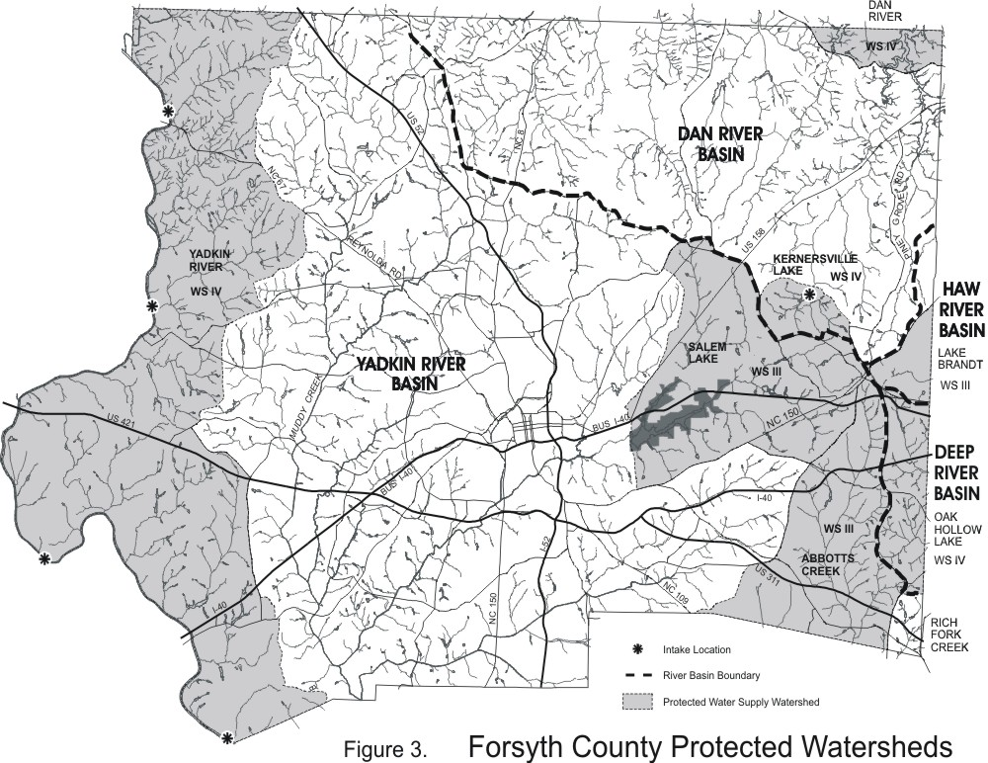

Slide 30
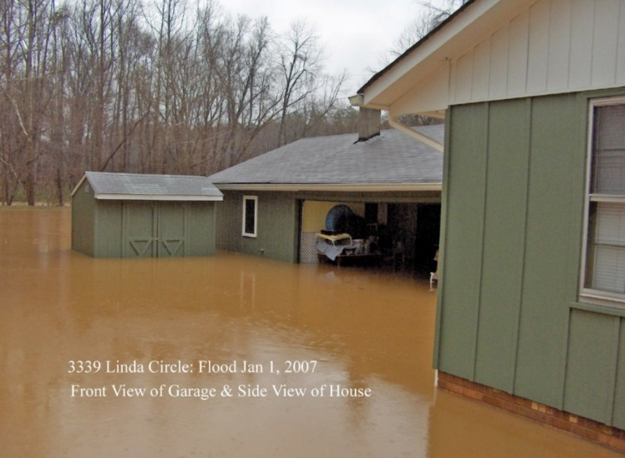
  FLOODWAY AND FLOODWAY
  FRINGE REGULATIONS
    Localities must adopt and enforce regulations for eligibility for National Flood Insurance Program
    See the Unified Development Ordinance (UDO), Section 8.1

Slide 31
QUESTIONS?

