Slide 1
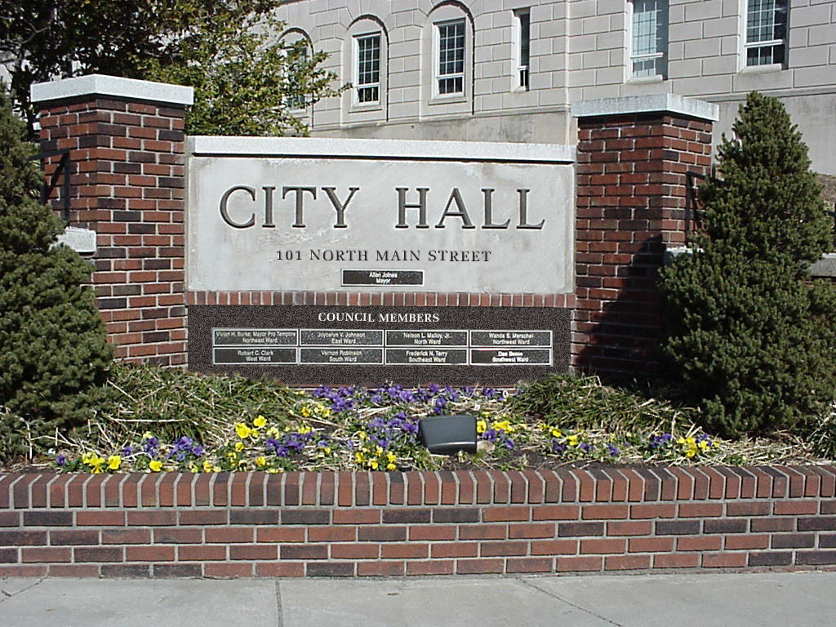

City of Winston-Salem
Government 101

Slide 2
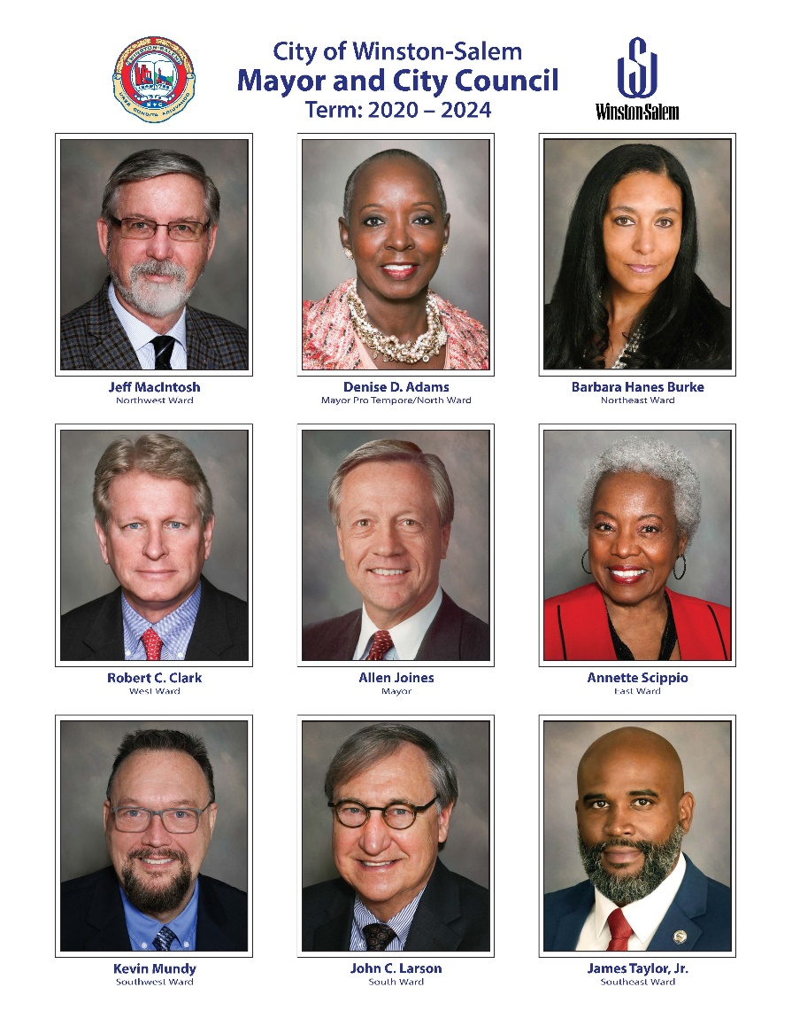

Winston-Salem City Government
Chief Elected Official
  Mayor
Form of Government
  Council - Manager
Governing Body
  City Council
Council Size
  Eight Members
    partisan elections
    by ward

Slide 3
Forms of Municipal Government
Council-Manager
  Manager hired by Council
  Manager controls day to day operations
  Most common in cities with populations over 100,000
Strong Mayor – Council
  Mayor controls how city operates, can hire and fire personnel.
  Second most popular form of government.
  Usually found in older, larger cities.
Notes:
The mayor may appoint and remove departmental heads.
The mayor drafts and proposes a budget to city council.
The mayor possesses veto or line-item veto power.
The mayor officially represents the city on the state, national and international levels.
The mayor exercises oversight of the city’s day-to-day operations.
The mayor enforces city laws and ordinances.
The mayor is not a member of city council.

Slide 4
Council-Manager Form of Government
VOTERS
ELECT
ELECT
CITY COUNCIL
(makes policy)
MAYOR
HIRES
CITY MANAGER
DEPARTMENT HEADS
(carry out policy)
HIRES

Slide 5
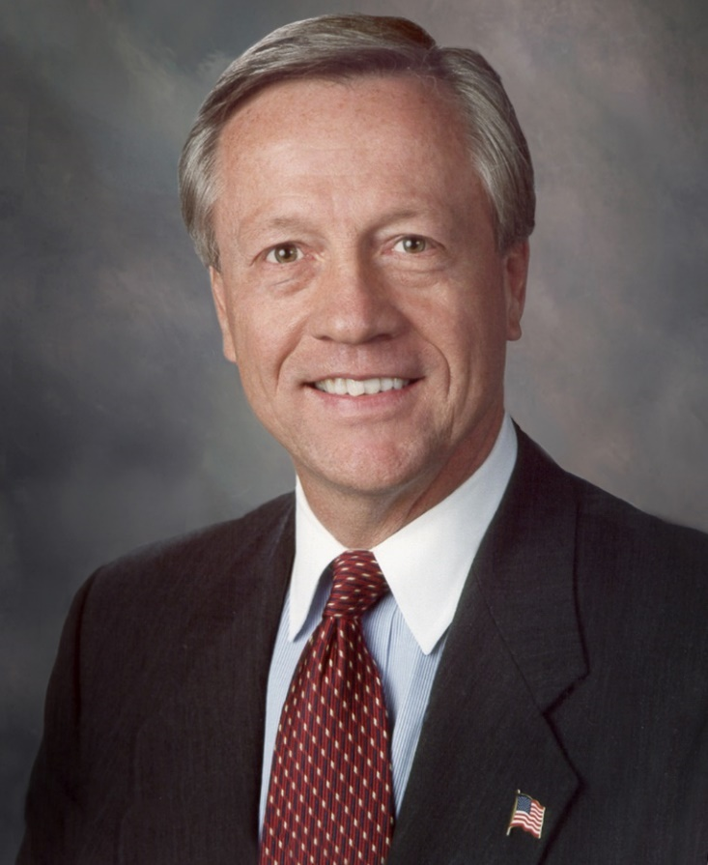
City of Winston-Salem Government Duties
  Mayor’s Duties
    Presides over council meetings
    Votes only in case of a tie
    Nominates council members to
    chair or serve on committees
    Nominates citizens to serve on
    advisory boards or commissions
    Works with council to set policies
    Officially represents city
    Declare a state of emergency
Mayor Allen Joines

Slide 6
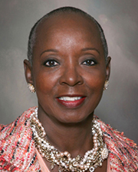
City of Winston-Salem Government Duties
  Mayor Pro Tempore Duties
Elected by city council
In the absence of the mayor, the mayor pro
tempore will preside over council meetings
If the mayor becomes incapacitated, the mayor
pro tempore will act on his/her behalf.
May appoint members to a board or commission
Mayor pro tempore Denise D. Adams

Slide 7
City of Winston-Salem Government Duties
  City Council’s Duties
    Review and approve the annual budget;
    Serve on committees-Public Works, Public Safety, Finance, and General Government;
    Establish long- and short-term objectives and priorities;
    Establish tax rates;
    Pass ordinances and resolutions;
    Regulate land use through zoning laws;
    Exercise the power of eminent domain;
    Respond to constituent needs and complaints

Slide 8
City of Winston-Salem Government Duties
City Manager Duties
  Hired by City Council
  Oversees implementation
  of policies
  Manages day-to-day operations

Slide 9
