Slide 1
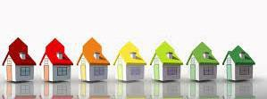
WELCOME
to Community Development

Slide 2
Agenda
Welcome to Community Development
Mission Statement; Vision Statement; Core Values
Who are we?
Division Introductions:
  Code Enforcement
  Housing & Community Services
  Lending/ Housing Finance Rehab Assistance
  Neighborhood Services

Slide 3
Mission Statement
The mission of the Community Development Department is to support residents and community-based organizations in making Winston-Salem neighborhoods attractive, welcoming, equitable, and stable.
We do this by providing public services and opportunities to enhance neighborhoods and encourage citizen accountability to care for and maintain their neighborhoods with resources and education that we can provide for them.

Slide 4
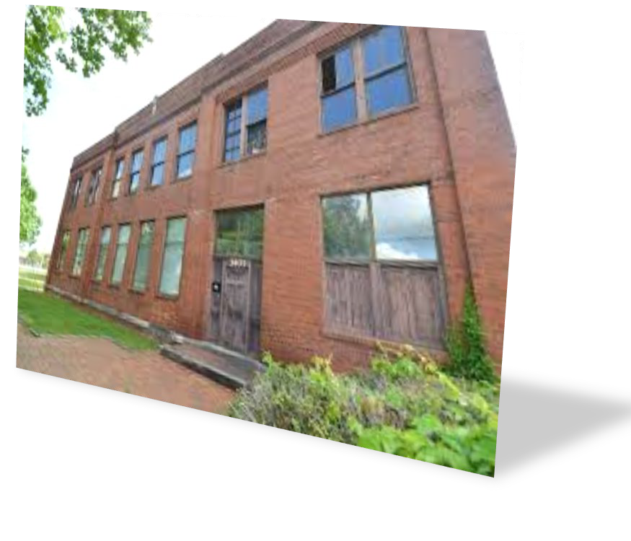
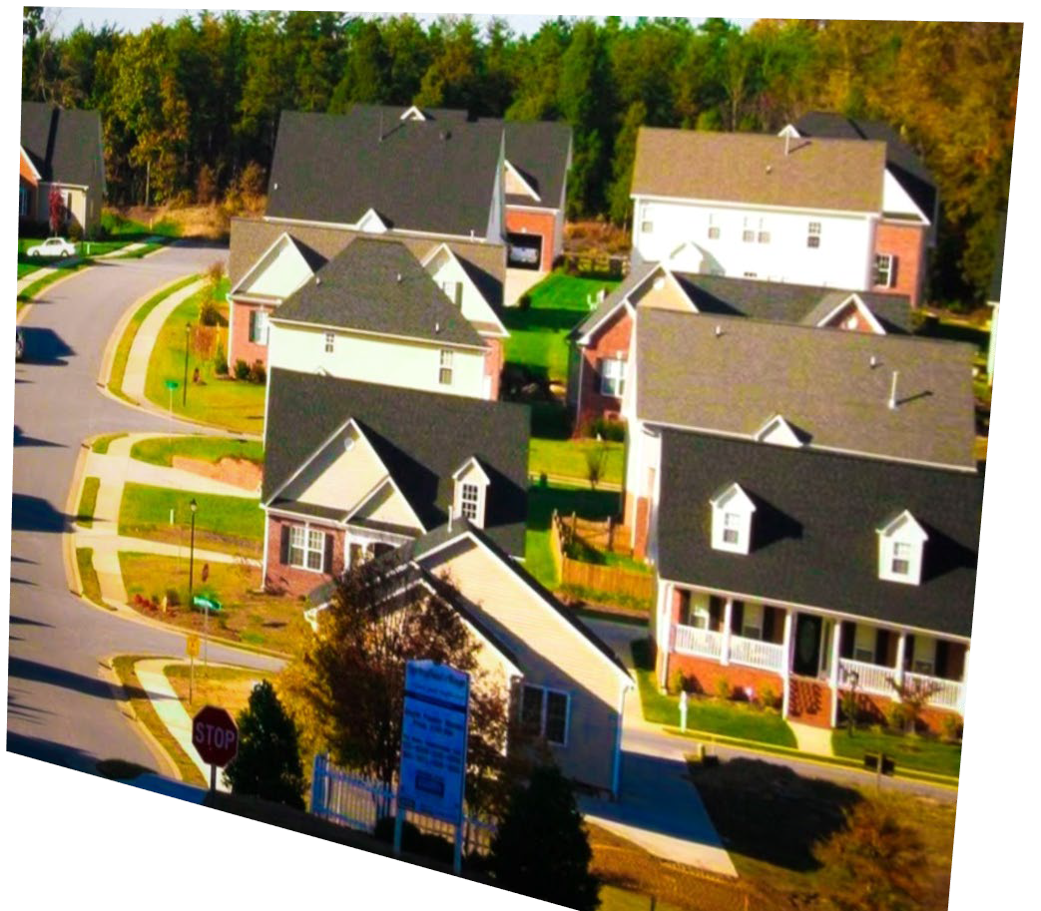
Vision Statement
All Winston-Salem neighborhoods are great places to call home

Slide 5
The City’s Values are Community Development’s Core Values
Collaboration
Accountability
Trust
Responsibility
Respect

Slide 6
Who else Governs Community Development?
City Government: thru the adoption of local ordinances by City Council
State Government: for example the Minimum Housing Code for living standards for rentors and the building code for rehabilitating property
Federal Government: for example HUD an Agency of the Federal Government that provides grants to assist developers to provide housing affordability

Slide 7
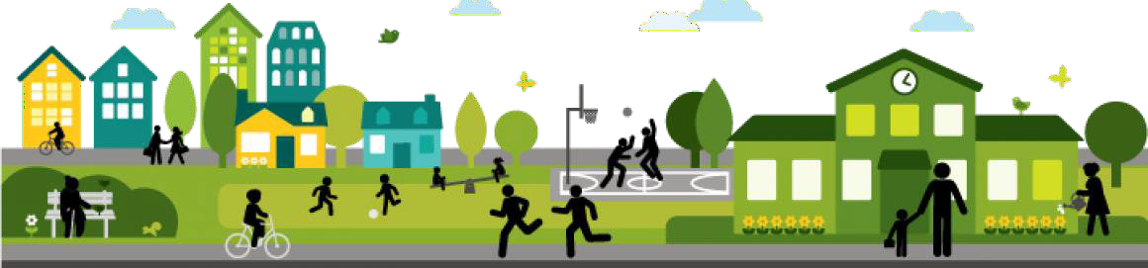
Our Core Functions and Services

Slide 8
Our Core Functions & Services
Code Enforcement
Housing & Community Services
Lending Services Neighborhood Services

Slide 9
Code Enforcement
Enforces the minimum housing code to protect citizens and require safe living conditions, to promote the general welfare, and ensure the safe and proper maintenance of residential structures for residents and their families
Enforcement of nuisances and environmental violations, including overgrown lots, shrubbery, solid waste in yards and illegal dumping, graffiti and curbside trash
Enforces certain signs and car lots under the Zoning regulations
Abandoned vehicles, including identification & removal of abandoned vehicles on private property
All of these issues affect the way we live and the quality of our streets and neighboods. Informational material is available to help prevent citizens from receiving violations.

Slide 10
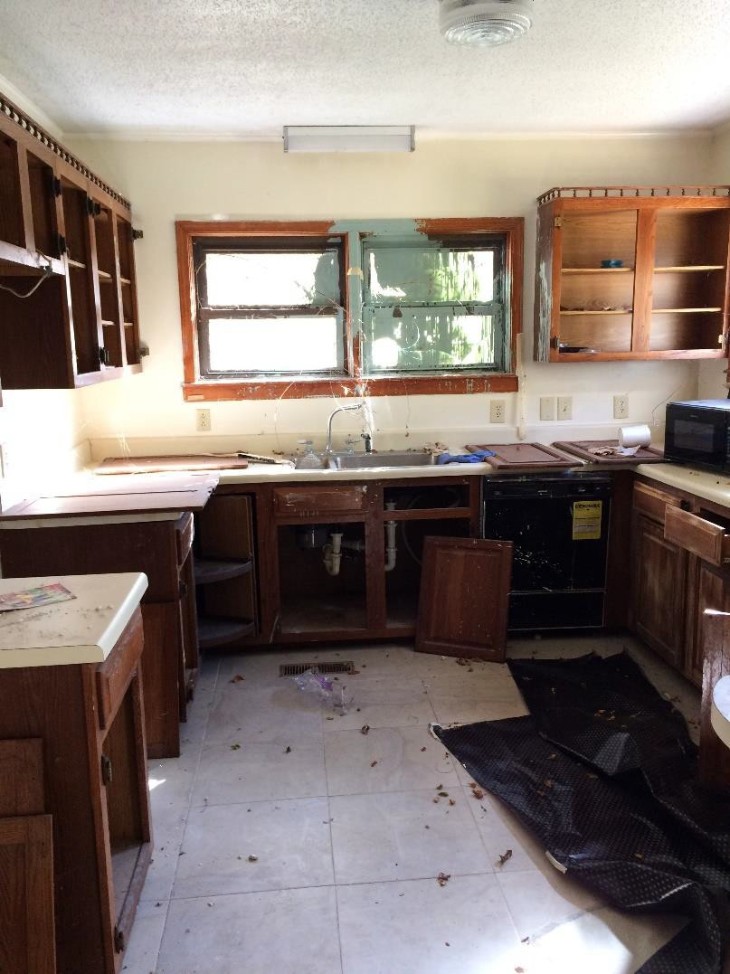
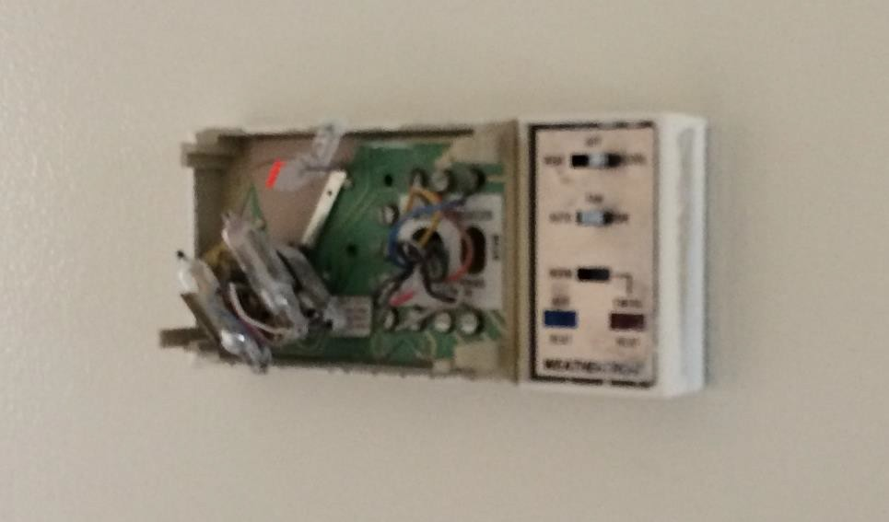
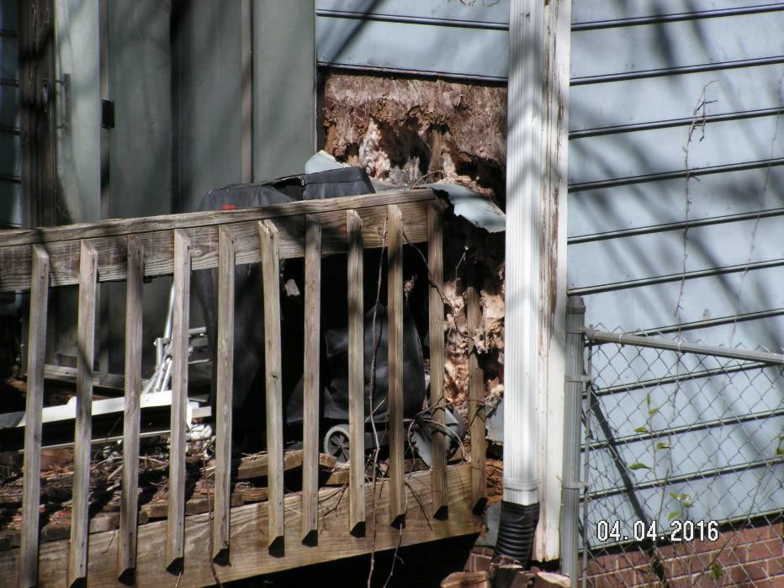
Examples of housing violations:

Slide 11
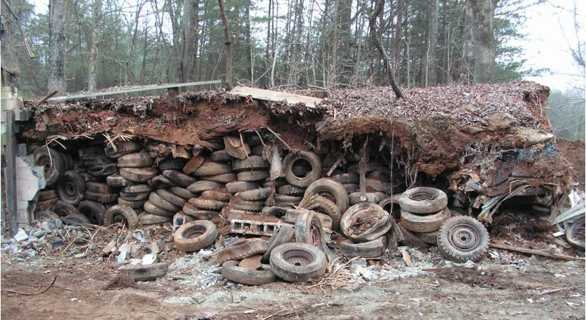
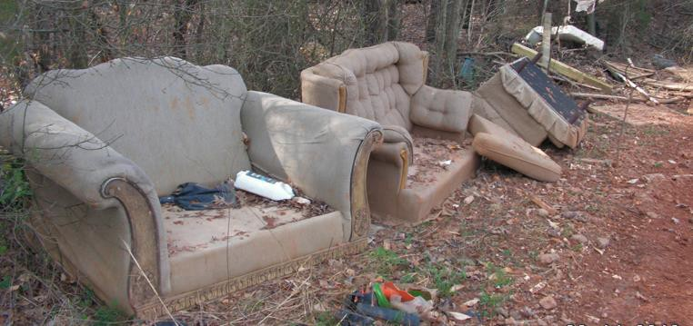
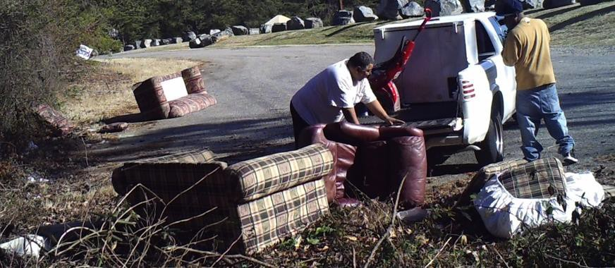
Examples of environmental violations & illegal dumping:

Slide 12

Housing & Community Services
Coordinates housing development programs under Federal, State, and local guidelines that benefit low and moderate income residents
Completes & submits annual reports to the US Department of Housing and Urban Development to ensure that funding going toward
Funds programs ranging from home ownership to summer youth employment
This Division also serves the Homeless & assists agencies that serve the homeless population

Slide 13
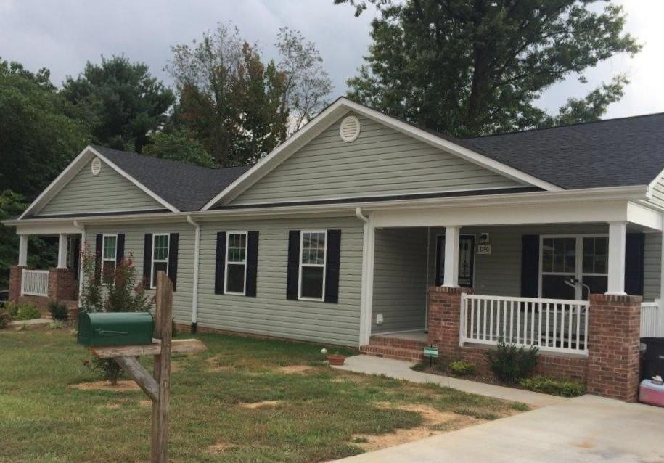
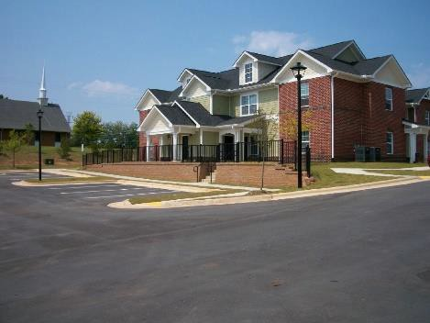
Examples of a multi-family and single family project:
Orchard Creek
North Cherry Street

Slide 14
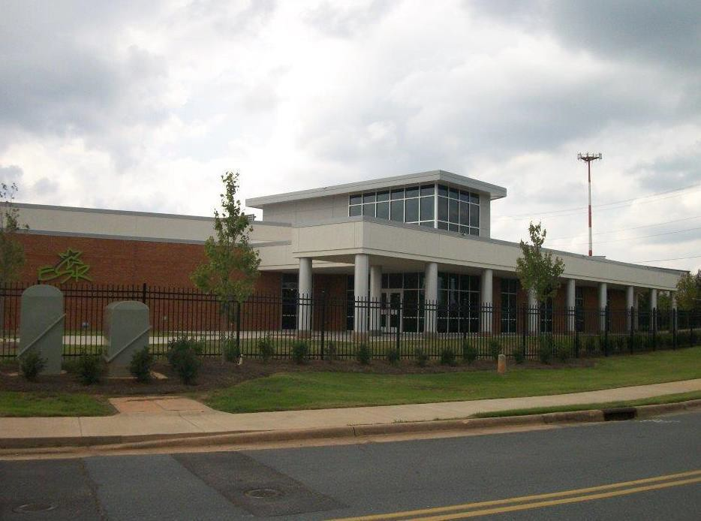
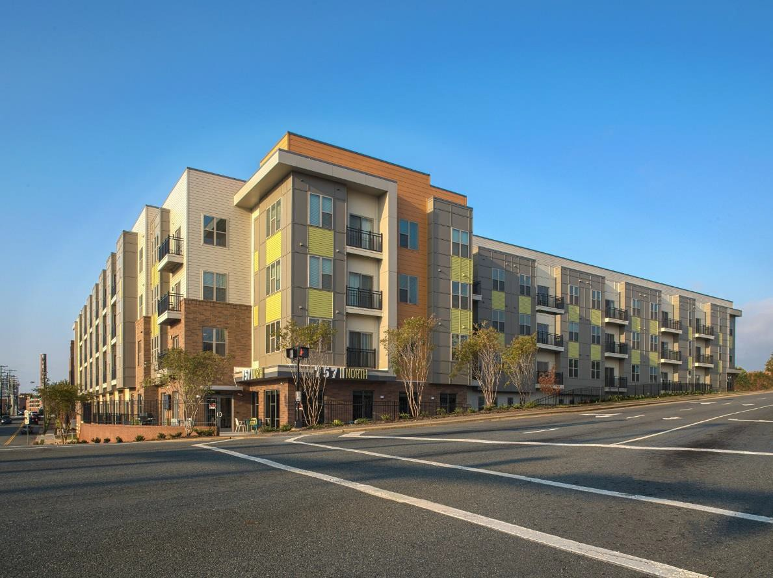
Examples of supportive housing project:
757 North Apartments
Experiment In Self Reliance

Slide 15
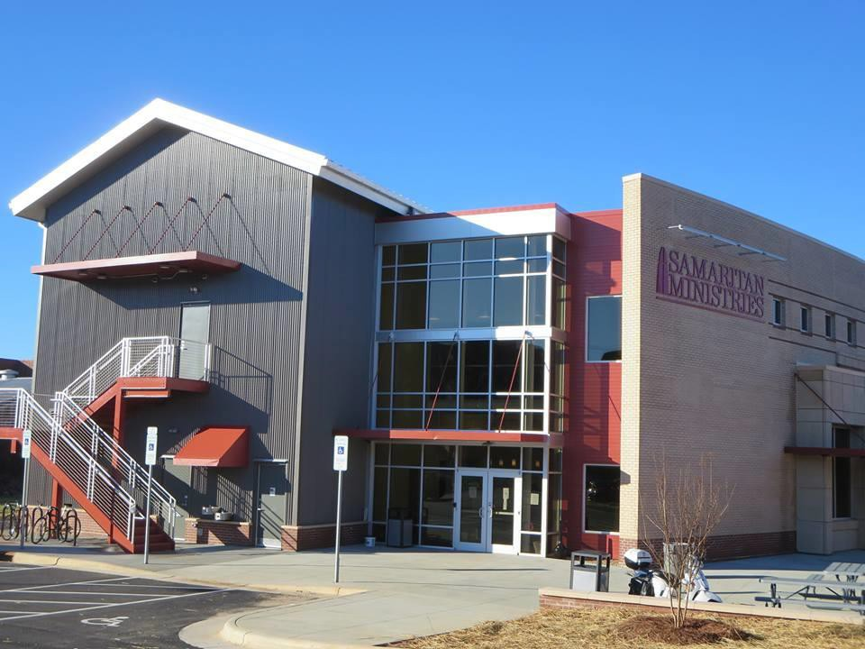
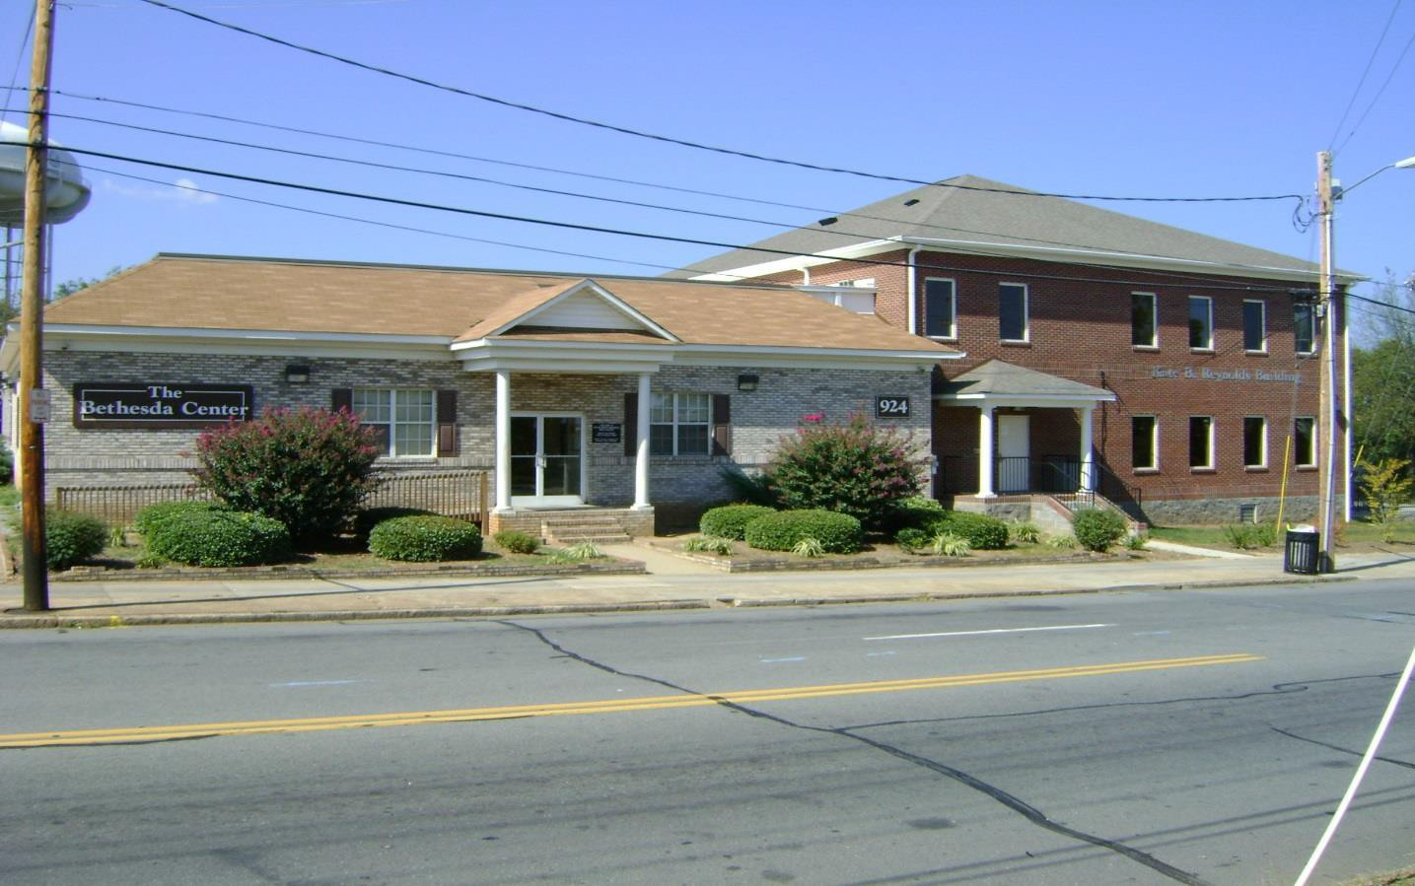
Examples of short & long term housing for the homeless:
Samaritan Ministries
Bethesda Center for the Homeless

Slide 16
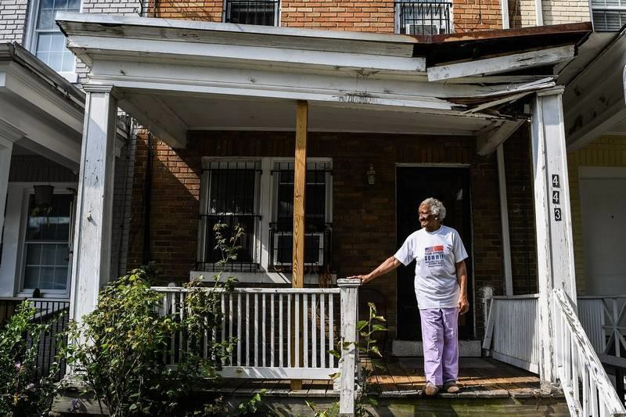
Lending Services
Provides 1st-Time Homebuyer Assistance
Provides financial and technical assistance to qualified owner occupants and investors to repair substandard properties
Emergency Repair Assistance
Architectural Barrier Removal Assistance (Handicap Assistance)

Slide 17
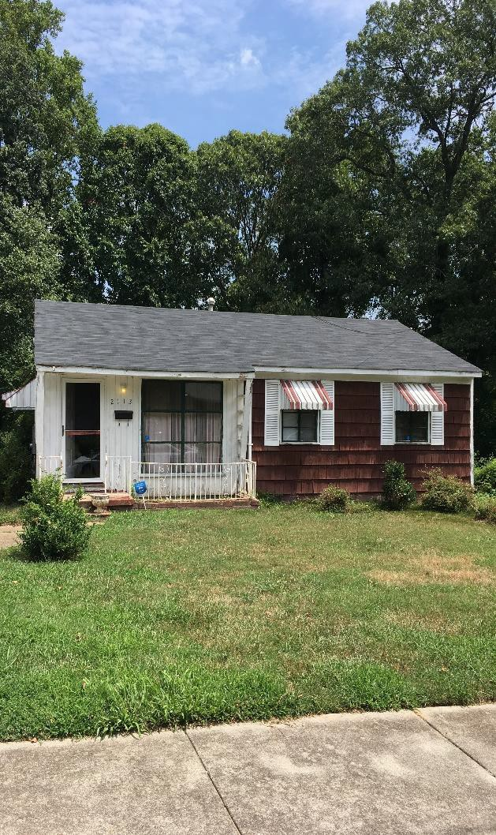
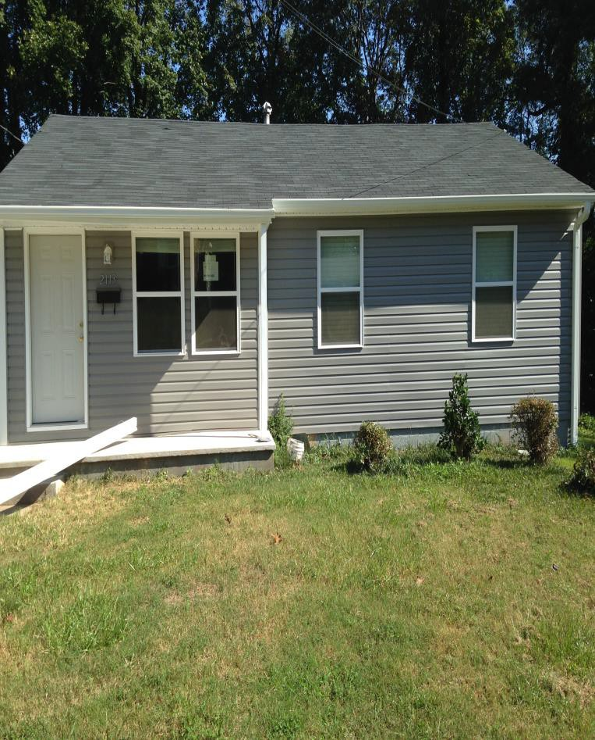
Examples of a rehabilitated home:
New Windows
New Vinyl Siding
After
Before

Slide 18
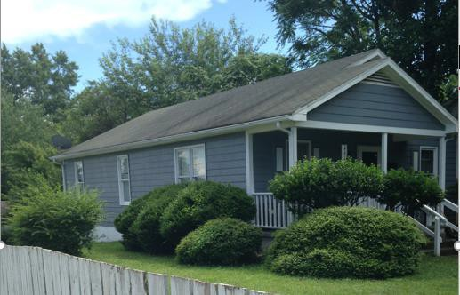
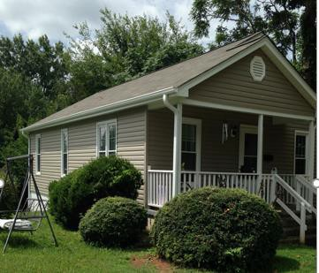
Examples of a rehabilitated home:
Before
New:
Roof
Siding
Railings
After

Slide 19
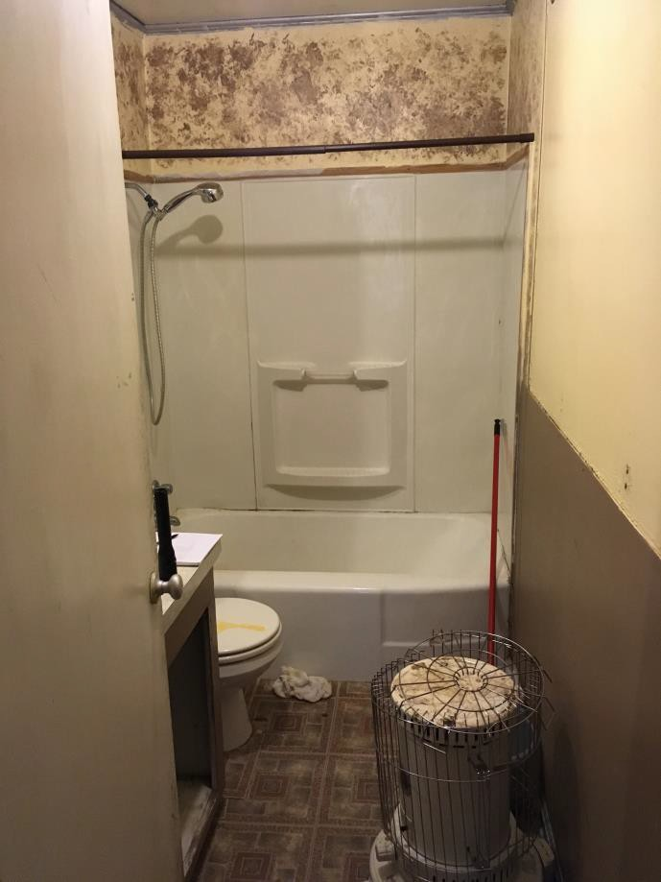
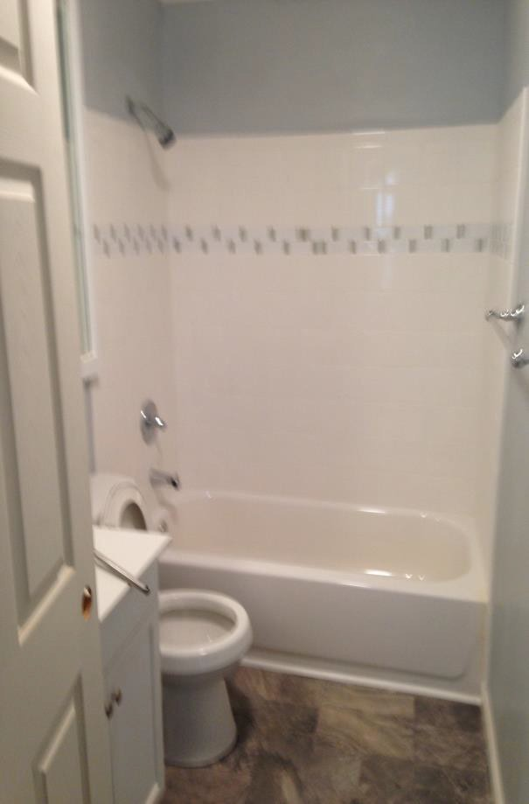
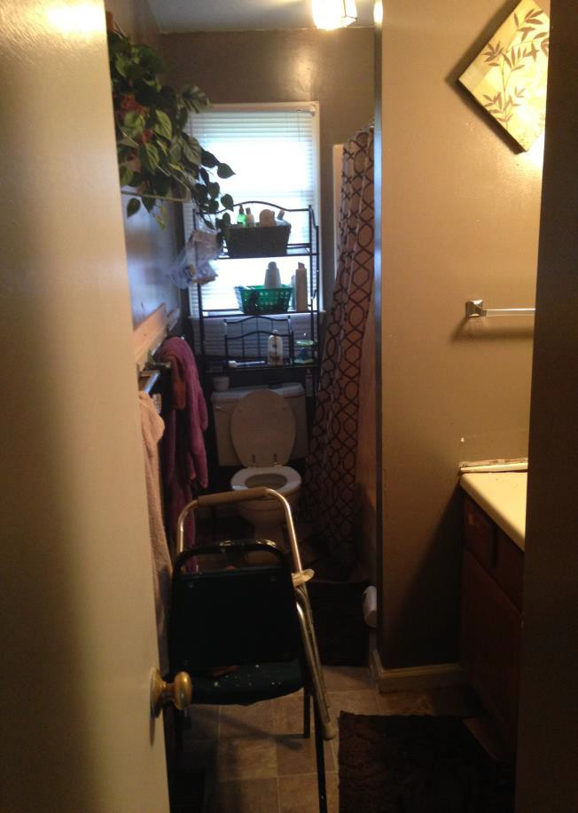
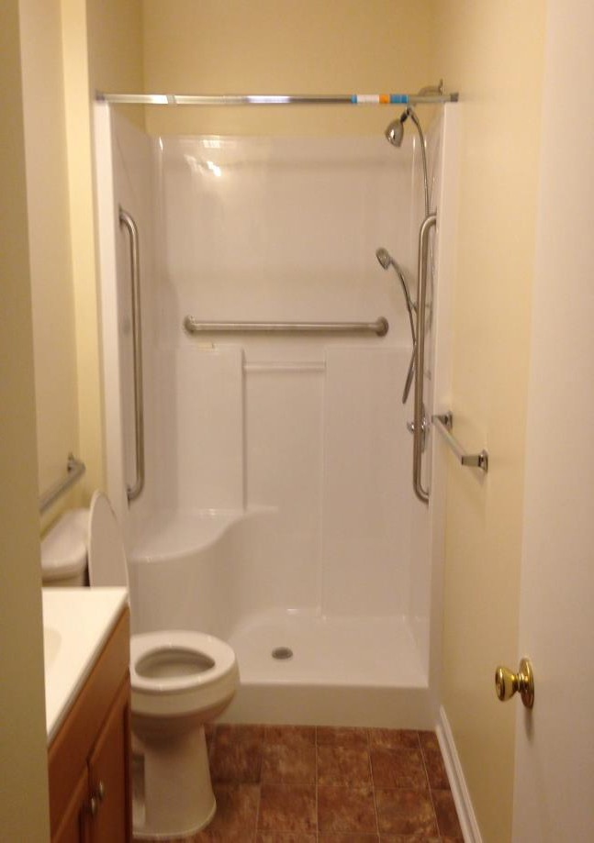
Examples of a rehabilitated home:
Before
After
Before
After

Slide 20

Financial Services (In-House Support)
Provides support by: Processing payment requests
Securing funds (via Purchase Order)for projects, cases, invoices, etc.
Processing travel requests
Conducting research on various budgeting accounts
Creating reports
Assisting Auditors

Slide 21
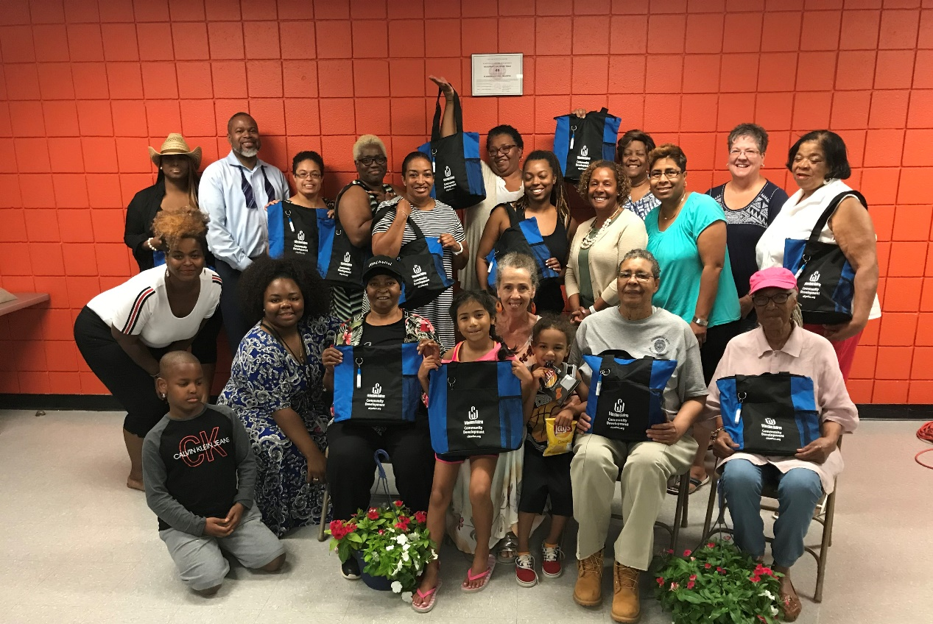
Neighborhood Services
Assists neighborhoods with:
Outreach programs and neighborhood events
City-wide Neighborhood Conference to help neighborhood associations organize and share ideas on common issues, concerns and opportunities

Slide 22
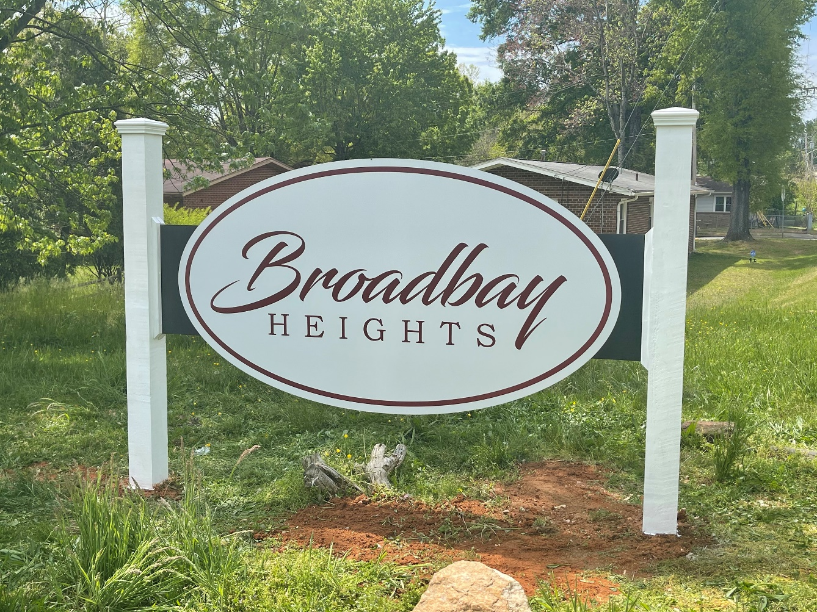
Neighborhood Services
Planning and implementing neighborhood improvements, such as neighborhood gardens or neighborhood entrance signs

Slide 23
Questions?
Thank You!

