Slide 1


Wanda Allen-Abraha, J.D., SHRM-SCP
Director
Alex Bohannon
Equity Inclusion Coordinator
Adolfo Briceno
Human Relations Specialist/Investigator/Hispanic Outreach Coordinator
Karlyn Duncan
Administrative Assistant/Intake Specialist
Iris McKnight
Human Relations Specialist/Investigator
Brittane Pitts, J.D. MPA
Equity Assurance Administrator
Mayra Ramirez-Manriquez
Administrative Intern
Jayme Waldeck
Outreach Specialist

Slide 2

Overview
History/Mission
Services
Enforcing Fair Housing Law
Nondiscrimination Ordinances
Diversity, Equity, and Inclusion
Boards and Commissions
TV Programs
and Newsletters
Outreach Programs

Slide 3
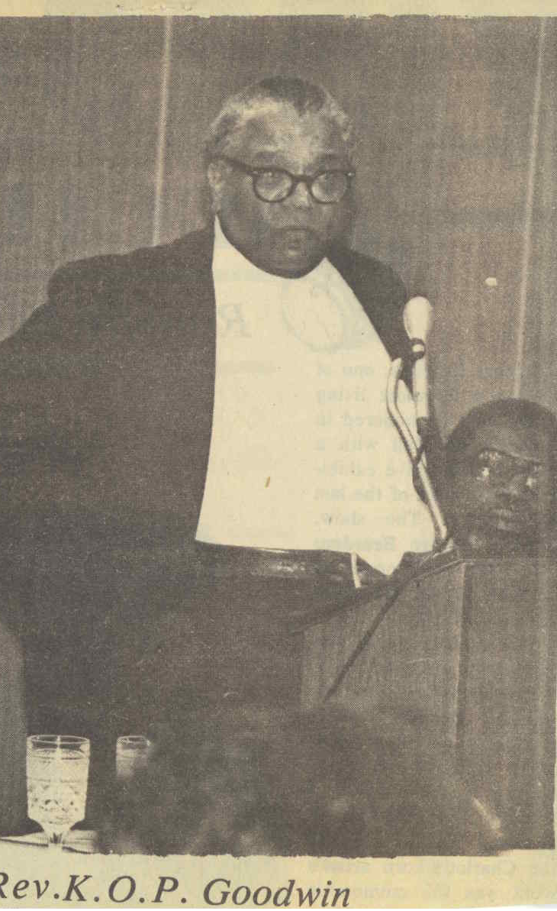
History
1968 Title VIII of Civil Rights Act
1978 Human Relations Commission
1980 Human Relations Department
1990 Winston-Salem Fair Housing Ordinance
2021 City Council approves Non-Discrimination Ordinances in regard to Employment and Public Accommodations.
2021 The Human Relations Department adds the Diversity, Equity, and Inclusion (DEI) Department
2022 The Human Relations/DEI Department starts enforcing Employment Discrimination and Public Accommodation Discrimination Claims
Reverend K.O.P. Goodwin Original Chair of the Human Relations Commission 1978
Notes:
-In 1968: Title VIII of the Civil Rights Act established the Fair Housing Act.
-Then, in 1975 the Winston-Salem Human Relations Commission was established as an advisory board by city ordinance by the Board of Aldermen (now the "City Council"). The Commission was originally established to study race relations and forms of discrimination.
-And in 1978: the Board of Aldermen approved salaried staff for the Commission, creating the Human Relations Department. (See above: the first Chair of the HRC in 1978).
-Finally, in 1990: the Board of Aldermen adopted the City of Winston-Salem Fair Housing Ordinance. This local ordinance parallel the Federal Fair Housing Act, which is administered by HUD (U.S. Department of Housing and Urban Development)

Slide 4
Mission
The Human Relations /DEI Department educates, creates, facilitates, promotes, anticipates, studies, and recommends programs, projects, feedback, and actions for the elimination of discrimination in any and all fields of human relationships.

Slide 5
Services
Fair Housing and Landlord/Tenant Investigations and Training
Mediation/Conciliation
Diversity, Equity, and Inclusion
Cultural and Race Relations Training
Legal Compliance on Residential Leases
Community Outreach
Employment and Public Accommodations Discrimination Investigations and Training
Notes:
-The Human relations department offers the following services to residents in Winston-Salem:
1. Fair Housing and Landlord/Tenant Investigation (this also includes Mediation/Conciliation between landlords and tenants, as well as investigating legal compliance on residential leases)
2. Building Integrated Communities Program (this also includes seminars and training on cultural and race relations)
3. Monitoring English and limited English proficiency in the community

Slide 6
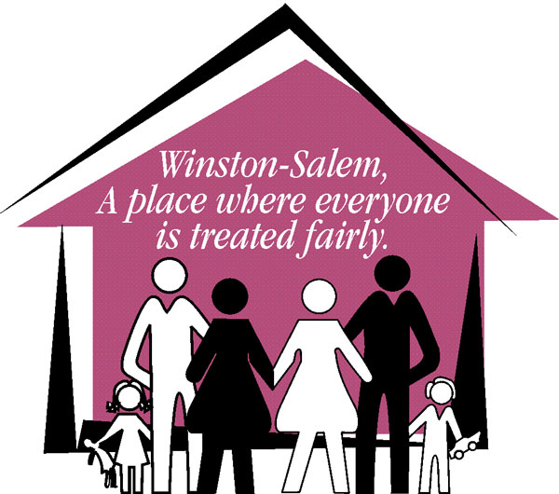

Fair Housing: Overview
Seven Protected Classes
  Race
  Color
  Religion
  Sex
  National Origin
  Familial Status
  Disability
Notes:
The federal Fair Housing Act established seven protected categories that landlords and other property managers cannot legally discriminate against.
These classes are:
Race, color, religion, sex, national origin, familial status, and disability.
-The Fair Housing Act must be complied with in the case of property sales and rentals, leasing agreements, advertisements, brokerage services, and in property availability.
**There is more information provided in the FH/LT Powerpoint. You may want to mention Fair Housing/Landlord-Tenant Training provided by HRD, and visiting the HRD city website online if the audience wants more information.

Slide 7

Steps for Fair Housing Investigation
Formally Initiate Investigation (HUD 903 Form)
Conciliation (On-going)
Continuing Investigation (Comparative Data/Analysis, Evidence, Witnesses, Interviews, Documentation)
Determination (Cause or No-Cause)
Right to Legal Remedies (Private Legal Counsel, Court)
Notes:
Fair Housing investigations, as an overview, revolve around these considertations:
Advise (NCGS 42- NC Residential Rental Agreement Act)
Mediate (Free, Voluntary)
Refer (Private Attorney, Other Agencies)

Slide 8

NC General Statute Chapter 42:
Governance for Landlord/Tenant Law
Your Rights as a Landlord
Rent to whomever you choose as long as it does not violate state or federal laws
Evict a tenant who violates any provision of agreement
Have property returned in the same condition as it was when occupancy took place
Your Rights as a Tenant
Be provided a safe and sanitary environment
Complain to landlord
Join with other tenants to secure your rights without fear of eviction
or retaliation

Slide 9
Landlord/Tenant Investigations
Advise
Advise (NCGS 42- NC Residential Rental Agreement Act)
Mediate
Mediate (Free, Voluntary)
Refer
Refer (Private Attorney, Other Agencies)

Slide 10

Nondiscrimination Ordinances
Starting in January 2022 – Discrimination within Winston-Salem city limits will be enforced in the following areas:
Public Accommodation Investigation and Mediation (Sec. 38-119)
Employment Discrimination Investigation and Mediation (Sec. 38-120)

Slide 11

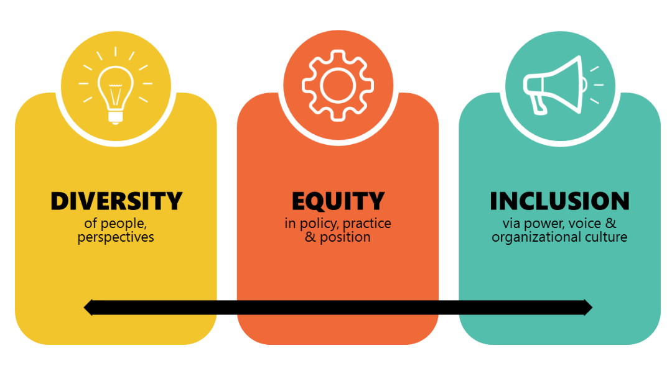
Diversity, Equity, & Inclusion

Slide 12
Diversity, Equity, & Inclusion
Inclusive Excellence
Embed equity and inclusion throughout our organization.
Create cultural sensitivity.
Implement strategies that create equal access to opportunity.
Work collaboratively with city departments to examine existing internal policies, procedures, and programs that may perpetuate systemic inequities and institutional racism.

Slide 13

DEI Framework
…Who/What supports our work?
People
Collective strength derived from people of diverse identities, abilities, and perspectives.
Paradigm
Pluralistic orientation reflected in practices programs and policies.
Praxis
Positive and empathetic cross-cultural engagement.

Slide 14

People
Equity Core Team
Employee Resource Groups
Programs & Events
Recruitment & Retention
Community Works

Slide 15

Paradigm
Government Alliance on Race & Equity (GARE)
Applying an equity lens to city practices, programs, and policies.
Development and Implementation of the City Equity Action Plan.
Build capacity for all staff to become more equity minded.
Limited Language Proficiency
  The City of Winston-Salem is committed to improving the accessibility of services to persons with Limited English Proficiency (LEP) and to developing and implementing a system that gives LEP persons “meaningful access” to programs and services.

Slide 16

Praxis
Develop cultural competence of city staff through Cultural Awareness, and Equal Employment Opportunity trainings, and workshops.
Create opportunities for employees to engage with each other across lines of difference.
Bridging the diversity gap.

Slide 17



Advisory Boards & Commissions
Human Relations Commission (HRC)
  Created by City Council in 1978
  Administered by HRD since 1980
College Advisory Board (CAB)
  Created by City Council in 2010
  Administered by HRD since 2010
Youth Advisory Council (YAC)
  Created by City Council in 1989
  Administered by HRD since 2010
African-American Heritage Initiative (AAHI)
  Created by City Council in 2019
  Administered by HRD since 2019

Slide 18
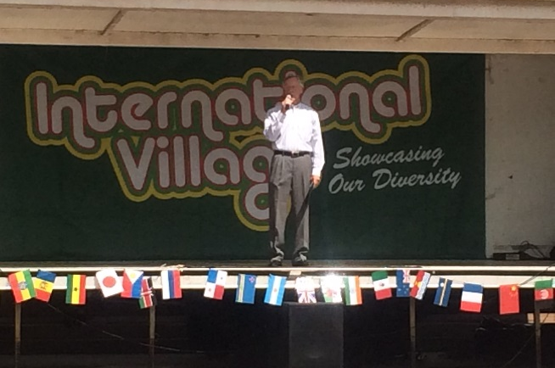
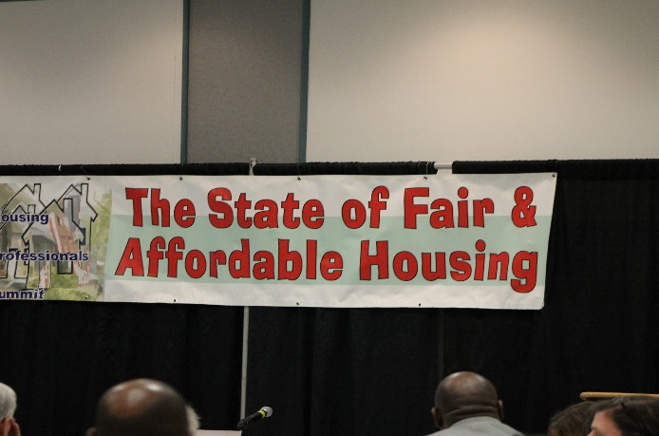
Human Relations Commission
Mission: To educate, create, facilitate, promote, anticipate, study, and recommend programs, projects, feedback, and actions for the elimination of discrimination in any and all fields of human relationships.
Committees: Community Relations, Executive Committee, Hearing Board, Multi-Cultural Relations, New Horizons Fair Housing, Student Relations
Major Annual Programs:
  Dr. MLK, Jr. Young Dreamers Awards
  Human Relations Student Awards Banquet
  Black History Month Showcase of Song
  Fair and Affordable Housing Summit
  International Village Food and Music Cultural Festival
Notes:
-HRC holds a vision of creating a citywide environment that is a place where everyone is treated fairly.
-other major annual programs include Human Relations Open House and High School Race Relations Forums

Slide 19
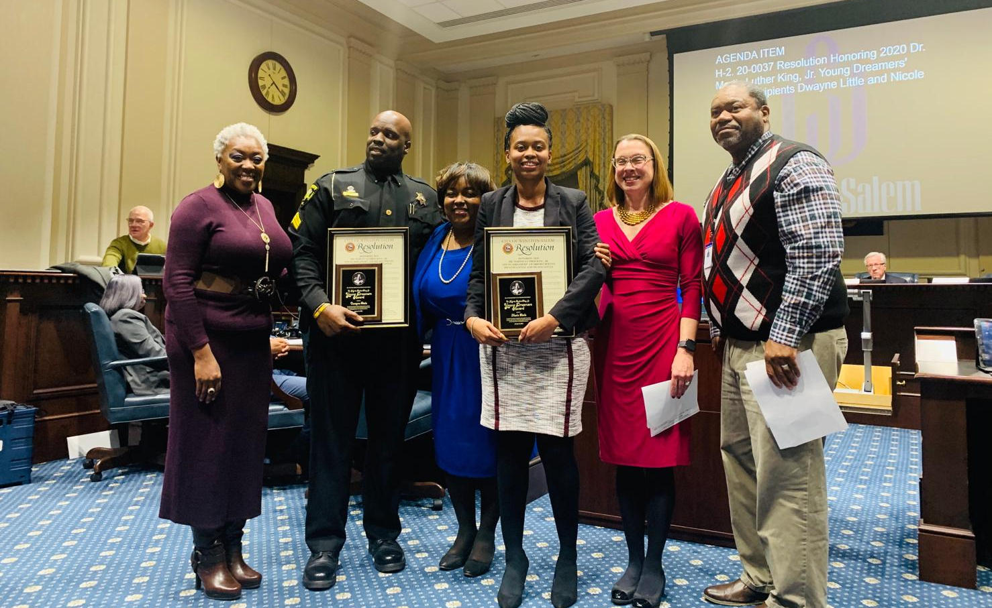
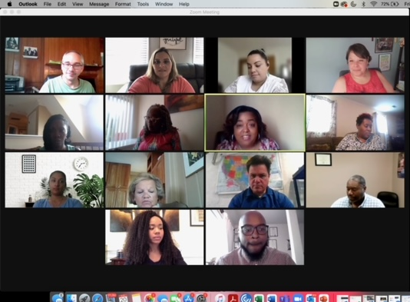
Human Relations Commission
Chair: Robert Leak III
  Vice Chair: Kerry Wiggins
Commissioners
  Jeffrey Bloomfield
  Sonny Haynes
  Michely Preble
  Joshua Price
  Ruth Sartin
  Fred Taylor
  Melissa Thomson
  Patrick Usher

Slide 20
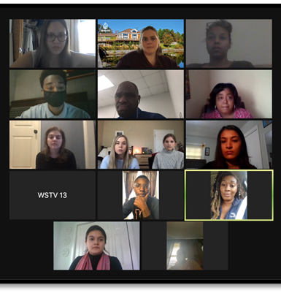
College Advisory Board
Mission: Serves as a body that represents the needs, interests, and concerns of college students and recent college graduates by engaging them in relevant community projects, programs, and issues.
Student representatives & board members from:
  Forsyth Technical Community College
  Piedmont International University
  Salem College
  UNC School of the Arts
  Wake Forest University
  Winston-Salem State University
Notes:
CAB: Advises City Council regarding areas such as economic development projects, transit advocacy, and student housing issues (and other issues the group may suggest) that will encourage students to remain in Winston-Salem post graduation.
Programs: Mediation Program, Campus Acceptance Survey, Internship Advocacy, College Summit

Slide 21
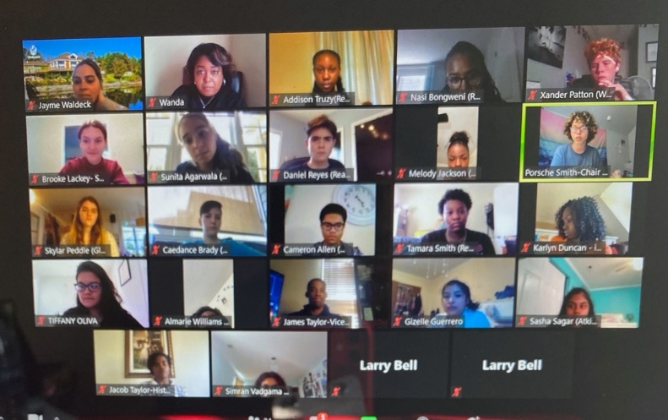

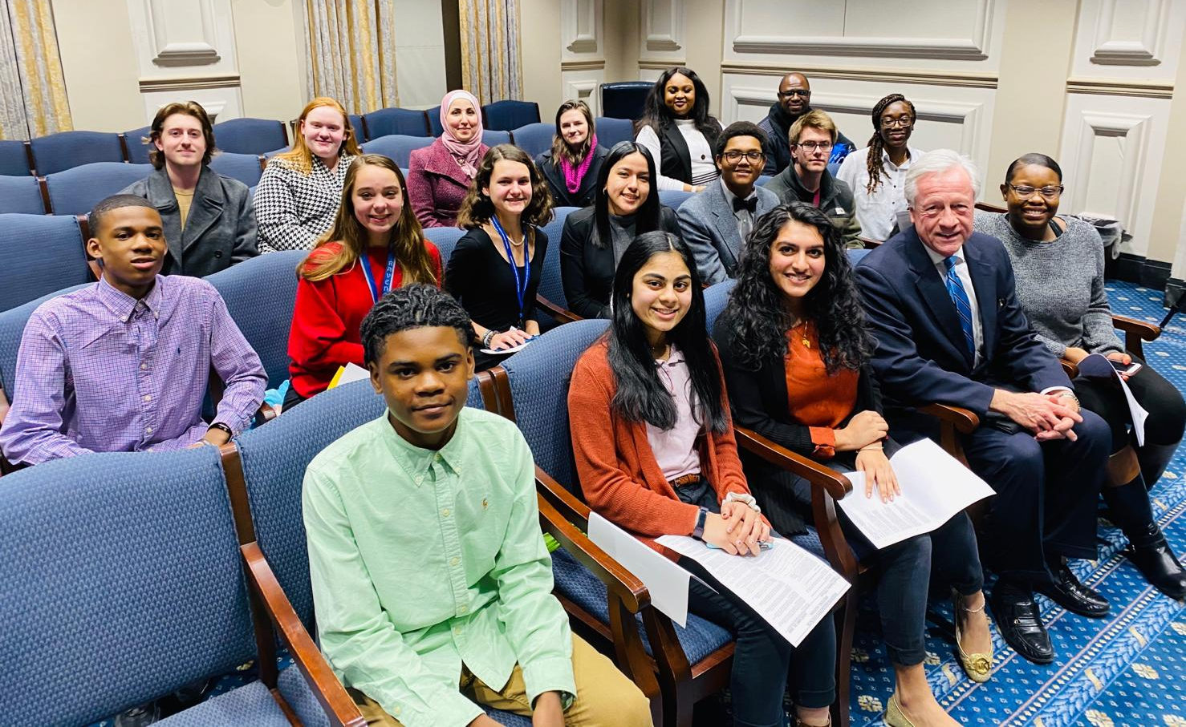
Youth Advisory Council
Mission: To serve as a conduit between city government and younger constituents.
  Youth civic engagement by way of community programming, youth-oriented activities
  Advise the City Council and the Human Relations Dept. on matters related to the community’s youth
Annual Projects: Youth Expression Wall, YAC Garden, YAC Packs for Children, YAC Hunger PSAs, YAC Mental Health Pact
Notes:
-YAC's mission also includes spreading information to the community regarding topics that are important and relevant to the youth in our community
-YAC allows for a contribution of at least 40 volunteer hours per school year to government-related initiatives, projects, and programs
-YAC contributes to the following Committees: Community Projects, Government Affairs, Public Relations
-Other YAC programs include: YAC Community Garden, YAK Packs for Underprivileged Youth

Slide 22

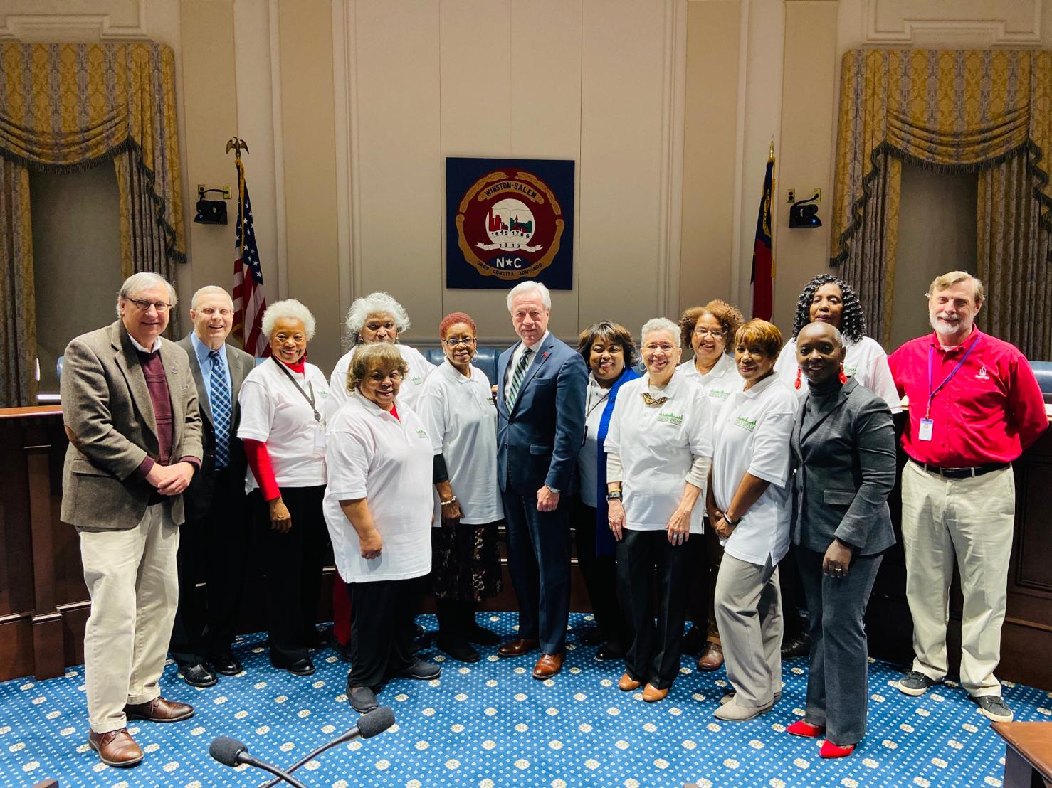
The African American Heritage Action Initiative (AAHI) is an endeavor to convey that, while African-Americans have performed a significant role in the development of the historical cities of Salem and Winston, their legacy has continued to remain unrecognized in modern-day Winston-Salem.
The goals of the initiative include connecting all sectors of the African-American community and creating a vision for incorporating African-American contributions into the ongoing history of the City.
Purpose-To mobilize all sectors of the African American community to participate in uncensored sharing of life as an African American during segregation and the efforts of desegregation.
Seeks to coordinate the partnerships of individuals, agencies, and organizations, public and private, to frame a vision for the preservation and melding of African American contributions.
Partnerships provide various community input opportunities.

Slide 23

TV Programs and Newsletters
NEXUS TV publicizes upcoming events in the community and educates on fair housing/landlord tenant issues
NEXUS Newsletter recaps previous events and gives tips for landlords/tenants
College Advisory Board (CAB) Newsletter focuses on CAB activities
Yakety YAC Newsletter focuses on YAC activities
Tu Comunidad TV provides information on City services in Spanish and English
Tu Comunidad Newsletter provides information on City services in Spanish and English in a text version

Slide 24
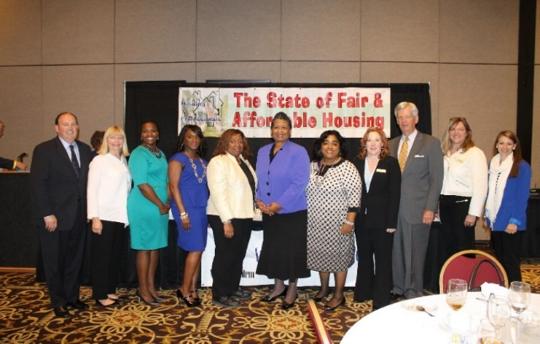
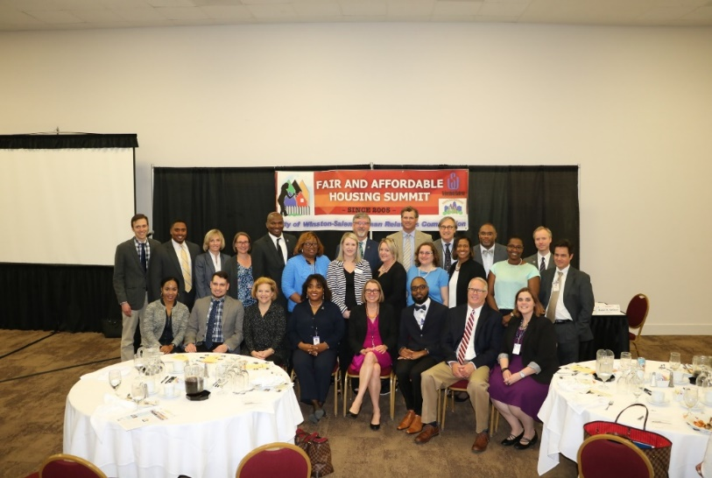
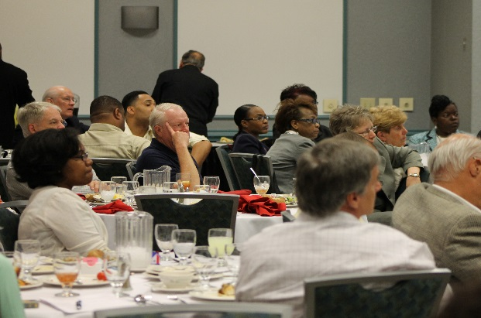
Fair and Affordable Housing Summit
A community reinvestment program developed by and for mortgage lenders, REALTORS©, property managers, banking professionals, non-profits, and governmental agencies in Winston-Salem/Forsyth County.
Information covered:
Annual housing industry updates and trends
Issues in fair and affordable housing
Notes:
The summit aims to provide a venue for sharing annual housing industry updates, trends, and emerging issues in fair and affordable housing.

Slide 25
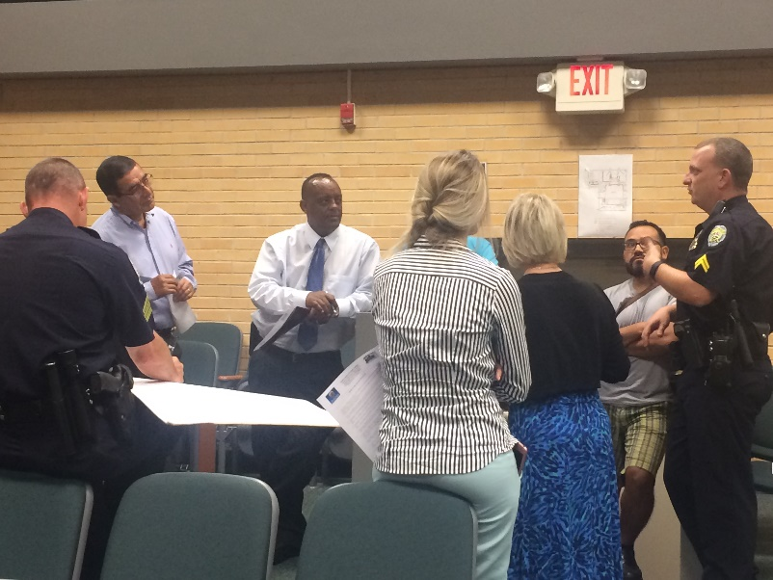
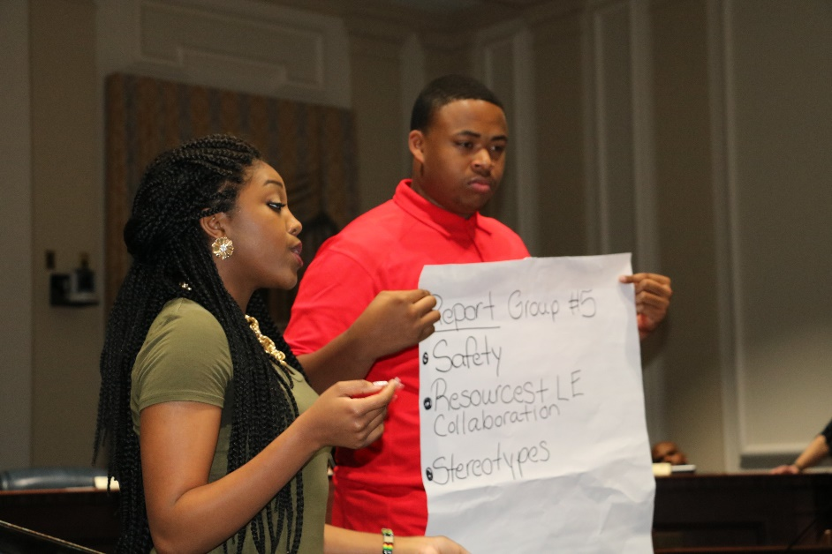


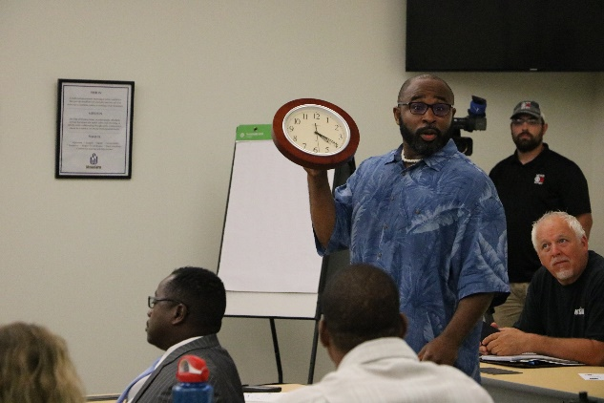
Trust Talks
Facilitate Police-community open dialogue, in a safe space, addressing:
Concerns in community and police relations
Promoting an authentic community policing culture
Practice dignity, understanding, trust, and respect in police/community interactions
Notes:
Trust talks are in partnership with the Winston-Salem Police Department.

Slide 26

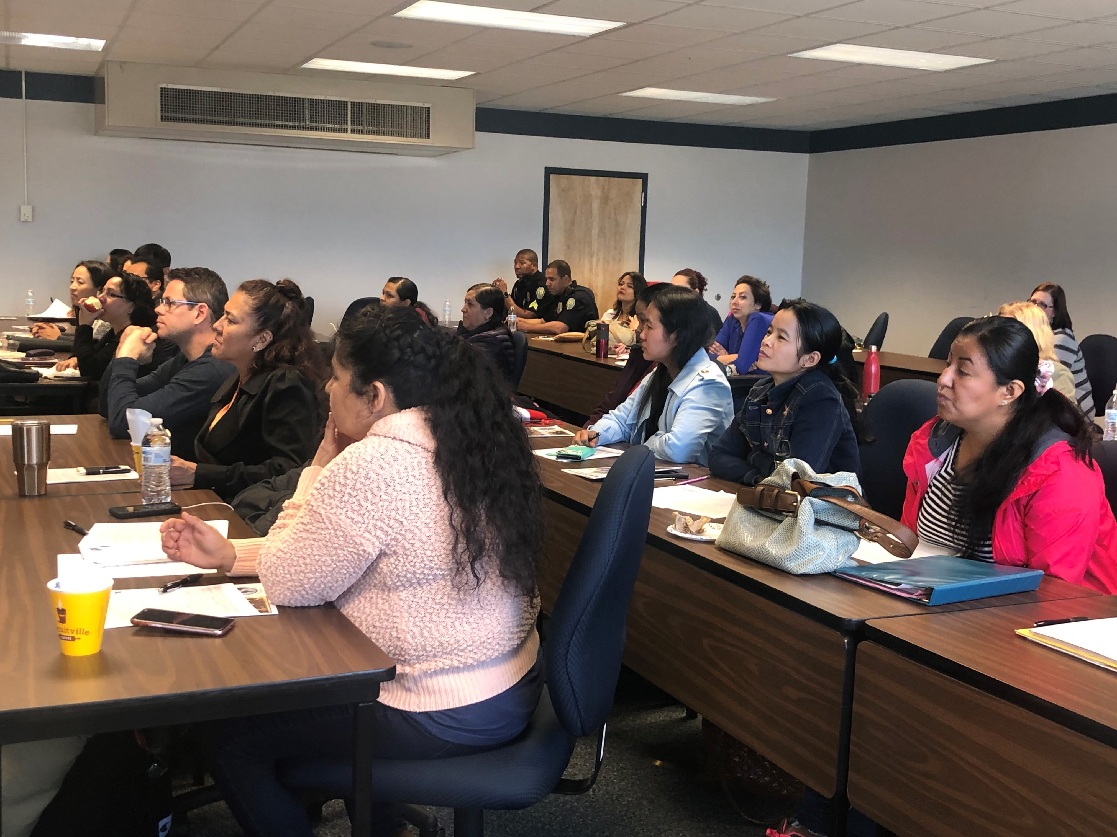
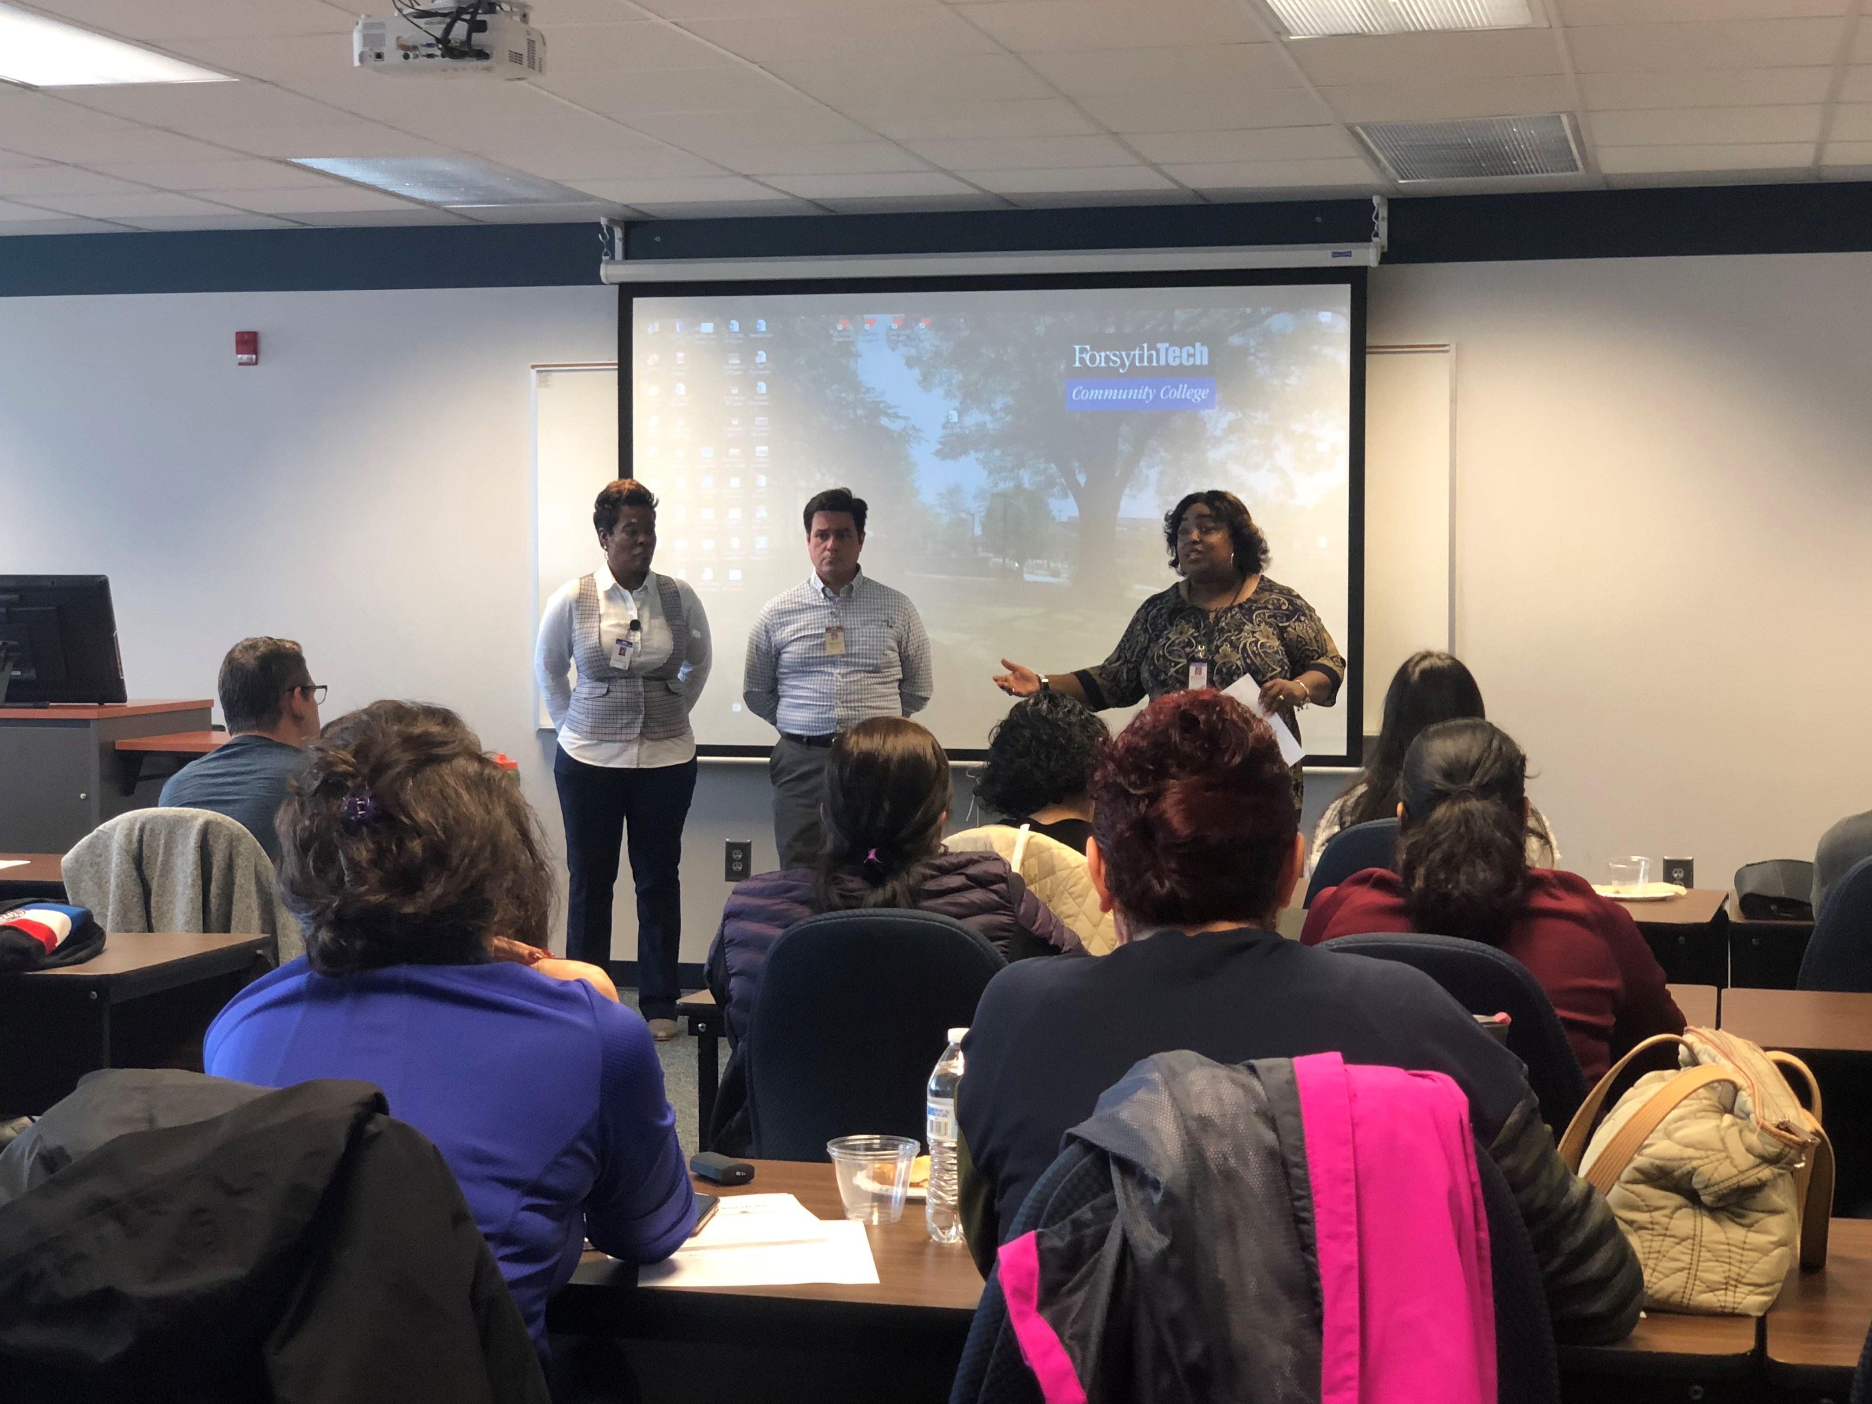
Building Integrated Communities
In 2014, the Winston-Salem Human Relations Department competed for and was awarded a two-year partnership with UNC-Chapel Hill.
Goals & Outcomes:
Sharing resources and services for the betterment of foreign-born populations for whom English is a second language, residing in Winston-Salem
Emphasis in high-impact lifestyle areas, such as fair and affordable housing choice, education, health care, food insecurity, and transportation.
Notes:
UNC Chapel Hill began the initiative, with an aim to strengthen civic engagement, linguistic achievement, and economic and educational advancement for immigrants in NC urban areas

Slide 27
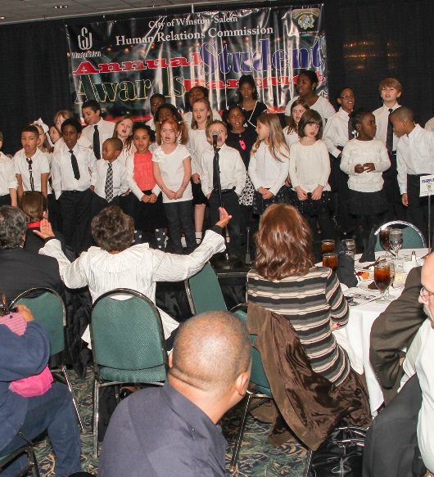
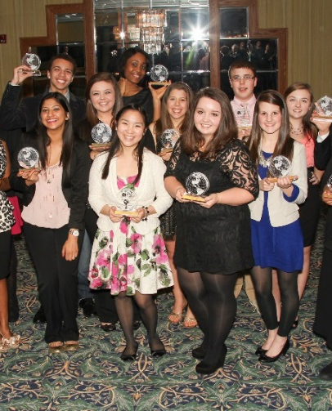
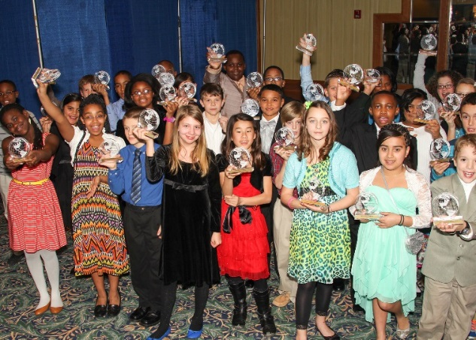
Student Human Relations Banquet
Honoring 80+ students from public and private schools in the Winston-Salem/Forsyth County area for demonstrating compassion and community service.
Students recognized excel in breaking barriers among their peers and community.

Slide 28
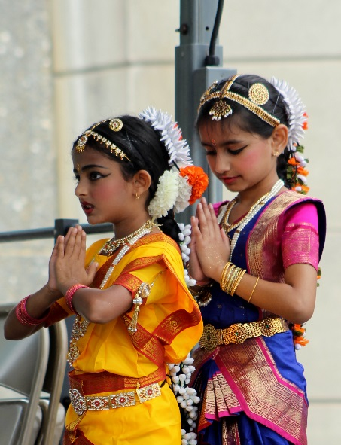
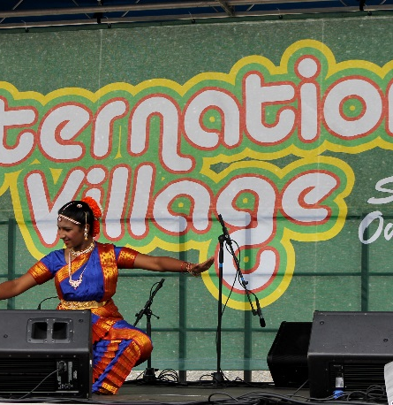
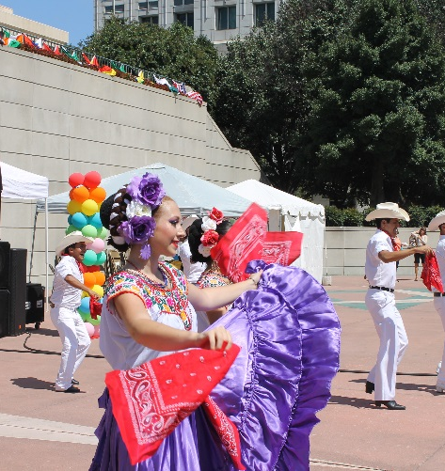
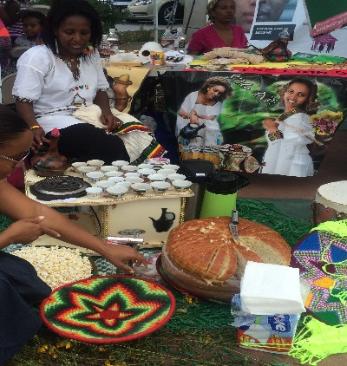
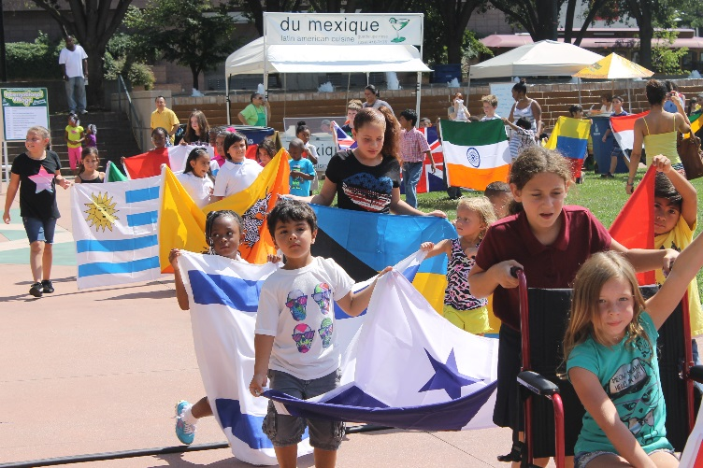
International Village Food and Music Festival
The international backgrounds and heritage of Winston-Salem’s local residents will be showcased, featuring global cuisine, cultural entertainment, international crafts-for-purchase, and educational information about our international community.
We proudly invite you to come out and enjoy the different cultures in Winston-Salem, North Carolina!

Slide 29
Winston-Salem Human Relations / DEI Department
City Hall, Suite 109
101 North Main Street
Winston-Salem, NC 27102
Call City Link 311
Wanda Allen-Abraha, J.D., SHRM-SCP
Director
Alex Bohannon
Equity Inclusion Coordinator
Adolfo Briceno
Human Relations Specialist/Investigator/Hispanic Outreach Coordinator
Karlyn Duncan
Administrative Assistant/Intake Specialist
Iris McKnight
Human Relations Specialist/Investigator
Brittane Pitts, J.D.
Equity Assurance Administrator
Mayra Ramirez-Manriquez
Administrative Intern
Jayme Waldeck
Outreach Specialist

