Slide 1
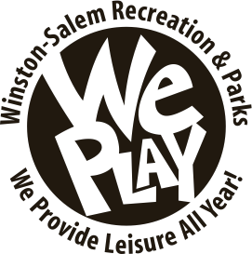
Recreation & Parks Department
William L Royston, Recreation and Parks Director
Leah Friend, Assistant Recreation Director

Slide 2
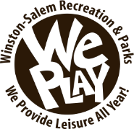
Organizational Chart
Recreation & Parks Commission
Assistant City Manager
Recreation and Parks
Director
Administration/Park Rangers
Recreation Centers
Special Facilities
Historic Bethabara
Lakes
Therapeutic Recreation
Athletics
Adults
-Youth/teens
Aquatics
Golf Course
Tennis
Parks Maintenance
Notes:
Have list of people over everything?

Slide 3
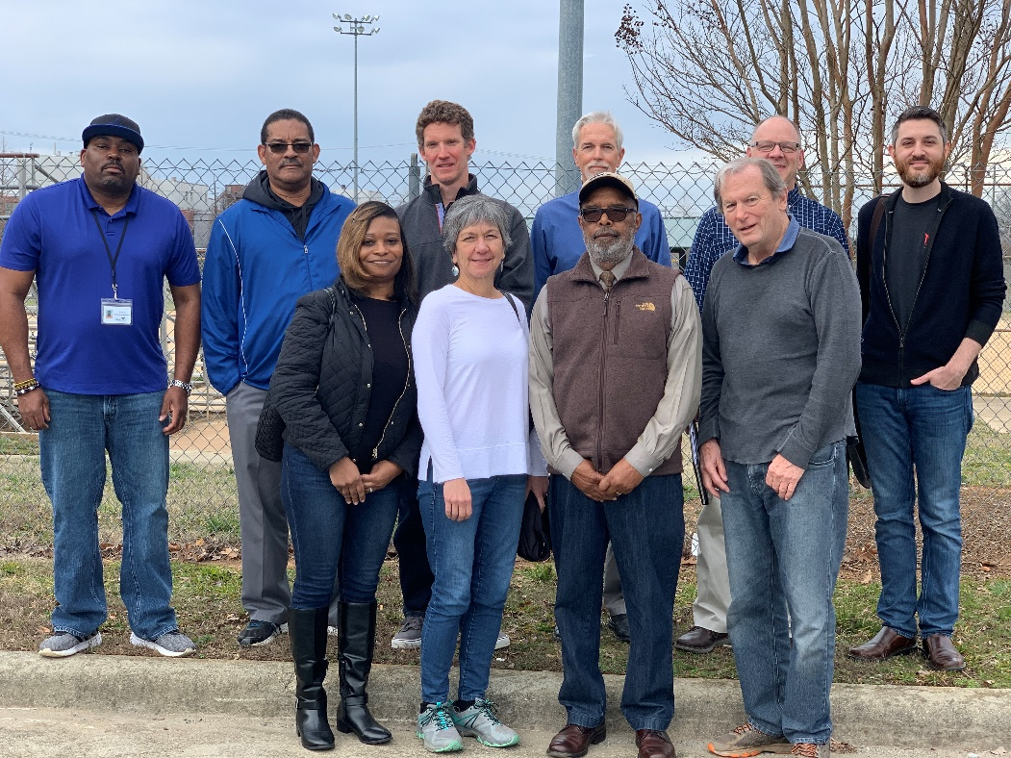
Recreation & Parks Commission
Eleven members appointed by the Mayor and approved by the City Council.
Serves as an advisory board which, sets policy and provides direction for the department.
Notes:
Monthly meeting to discuss updates within the department

Slide 4
Divisions
One hundred and two (102) full time staff enhance the quality of life for citizens while delivering a variety of indoor/outdoor leisure and cultural activities throughout the City.
Department consist of ten (10) units:
Athletics
Aquatics
Golf Courses
Public Lakes
Park Maintenance
Historical Parks
Therapeutic Recreation
Recreation Admin
Recreation Centers
Tennis Center

Slide 5
Operate & Maintain
3800+ Acres of Land
80+ Parks
26 Miles of Greenway
17 Recreation Centers
51 Picnic Shelters
48 Playgrounds
43 Soccer Fields
47 Softball Fields
1 Historic Park, 2 Golf Courses
1 Skate Park
109 Tennis Courts
23 Fitness Trails
8 Pools
11 Spraygrounds
6 Volleyball Courts
25 Basketball Courts
2 Recreational Lakes
3 Dog Parks
1 Tennis Center (Joe White)
1 Football Field
Notes:
Is the number of parks accurate? William had Hunter put the number at 79 (?) in a video the other day

Slide 6
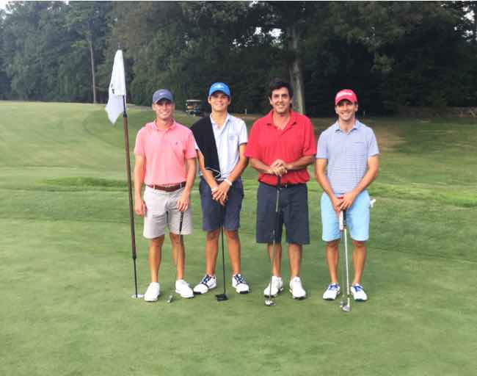
Athletics
Organize athletic events
Recruit & retain coaches and officials
Enforce league rules and bi-laws
Supervise events
Facility Management
  Field maintenance
    Marking
    Dragging
  Field Rentals
    Tennis Courts
    Soccer Fields
    Softball Fields
    Open Space
Liaison
  Tournaments
  School
  Outside Organizations
  League
  General Public

Slide 7
Aquatics
Swimming Pools
Swimming Lanes
Diving boards
Zero Depth Entry Pools
Splashpads
Water Slide
Lazy River
Water Playground

Slide 8
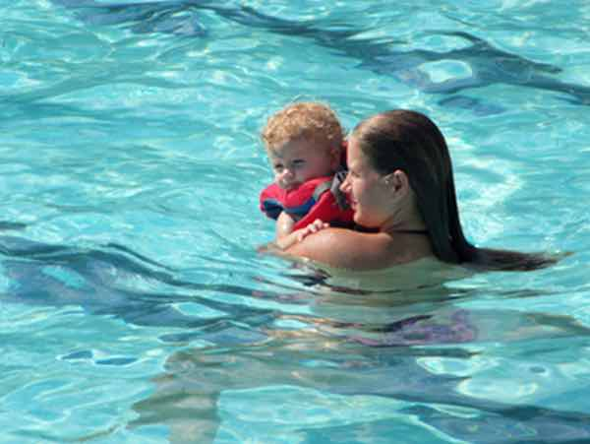
Aquatics
Programs
FREE swim lessons
  Babes in Arms
  Ages 6+
  Aquabilities
  Adult
Swim Teams
Diving Instructions
Water Aerobics

Slide 9
Aquatics
Splash Pads
Water playgrounds
Fixtures & fountains spray water
Turned on with a push of a button
Water is active for 15 minutes
No standing water
Operate April - October

Slide 10
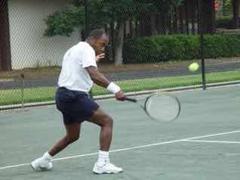
Tennis
Joe White Tennis Center
  Located within Hanes Park
  Managed by Flex Tennis, LLC
    Lessons
    Clinics
    Leagues
    Tournaments
  20 lighted courts
    14 clay
    6 hard courts
  Managed by Flex Tennis, LLC
Public Courts
  109 throughout City
    Parks
    School
  Leagues
  Tournaments
  Lessons

Slide 11
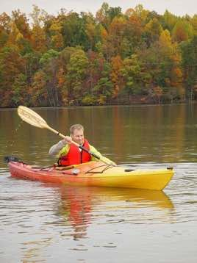
Recreational Lakes
Winston Lake
Salem Lake
  Boating
  Kayaking
  Rowing
  Fishing
  Picnicking
  Hiking

Slide 12
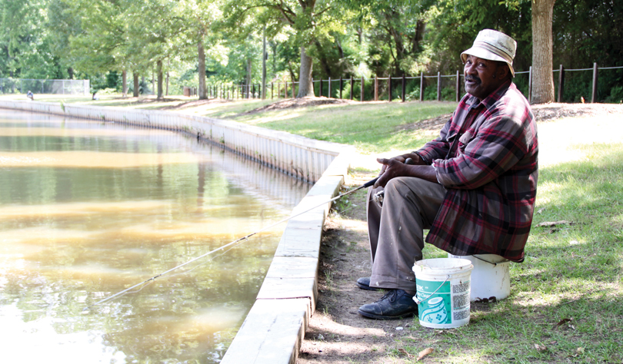
Winston Lake
Located in Winston Lake Park
Twenty (20) Acre Lake
Partner with Community Fishing Program with the North Carolina Wildlife Resources Commission
Periodically stocked with Catfish
Currently undergoing renovations

Slide 13
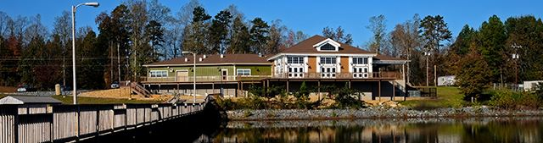
Salem Lake
1,465 acre park
365 acre lake
  Watershed
Bait Shop
Marina
Programs
Seven (7) mile multipurpose trail
  Biking
  Running
  Horse Riding

Slide 14
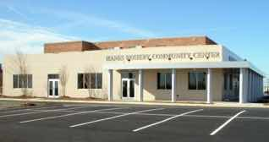
Recreation Centers
  Neighborhood Centers (6)
    Smaller Facilities
    Kitchens
    Ballrooms
    Computer Labs
  Community Centers (11)
    Larger Facilities
    Kitchens
    Multiple Meeting Rooms
    Computer Labs
    Gymnasiums

Slide 15
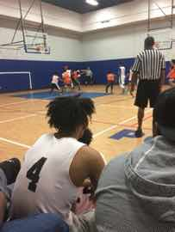
Recreation Centers
Programming
Community Meetings
Athletics
After-School
Summer Camps
Special Camps
Support Groups
Leisure Activities
Rentals
Aerobics
Social Clubs

Slide 16
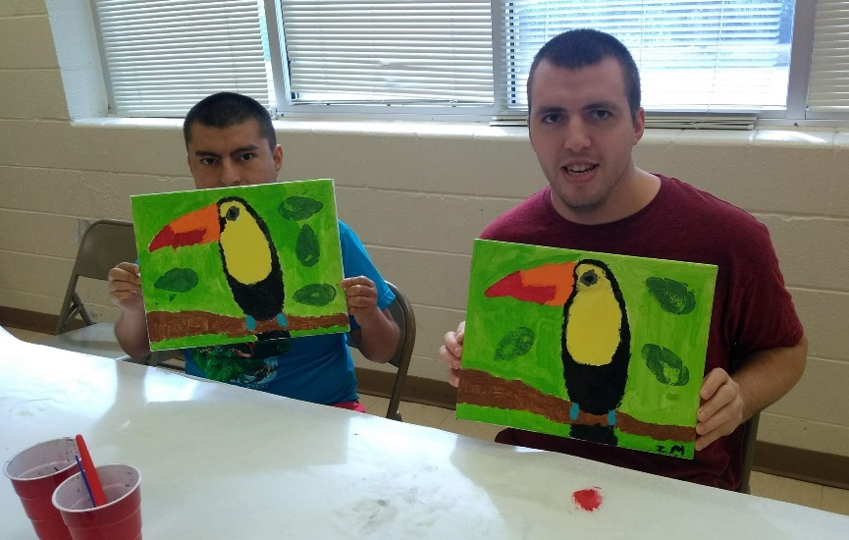
Therapeutic Recreation
The Therapeutic Recreation Unit offers specialized recreation services to individuals with intellectual, developmental, and physical disabilities year-round. We are also home of the Piedmont Plus Senior Games and Special Olympics Forsyth County. Our outlook as professionals in this field and department is to provide greater opportunities to the community members we serve through programs, fundraisers, camps, and so much more!
Programming for individuals with disabilities
Special Olympics Forsyth County
Camp Discovery
Aquabitilies
Community Outreach

Slide 17
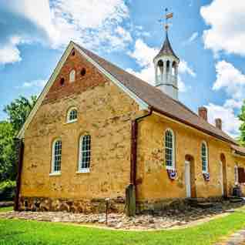
Historic Bethabara Park
Managed by City of Winston-Salem
Supported by Historic Bethabara Park Inc, a 501c(3) nonprofit organization
Incorporated as a nonprofit museum in 1970
National Historic Landmark, founded 1753
183 acres of preserved wildlife
Historic Buildings & Grounds
Medicinal Garden

Slide 18
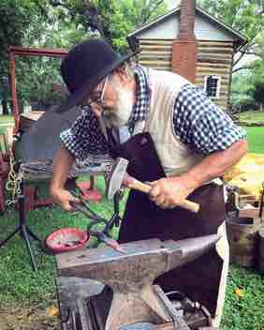
Historic Bethabara Park
Programs
Guided Tours
Field Trips
Spring Festival
Highland Games
Apple Festival
Dark in the Park

Slide 19
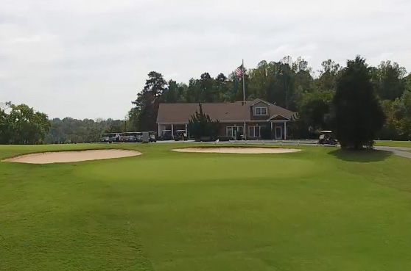
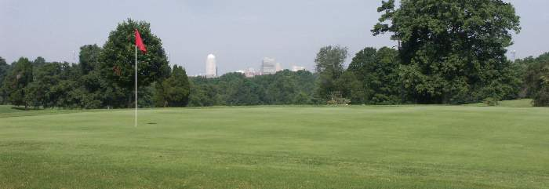
Golf Courses
The City of Winston-Salem owns two 18 hole golf courses with amenities such as pro shops, practice greens, driving ranges, cart and club rentals and lockers.
Winston Lake
  Unique and picturesque challenge
  City-owned and operated
Reynolds Park
  Fun and family oriented
  Contract management
    (T-Square Corporation)

Slide 20
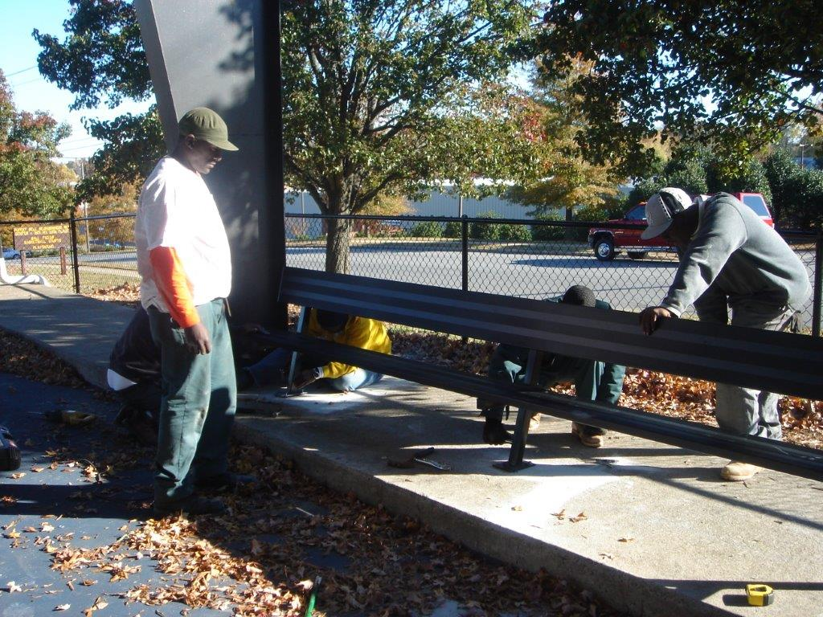
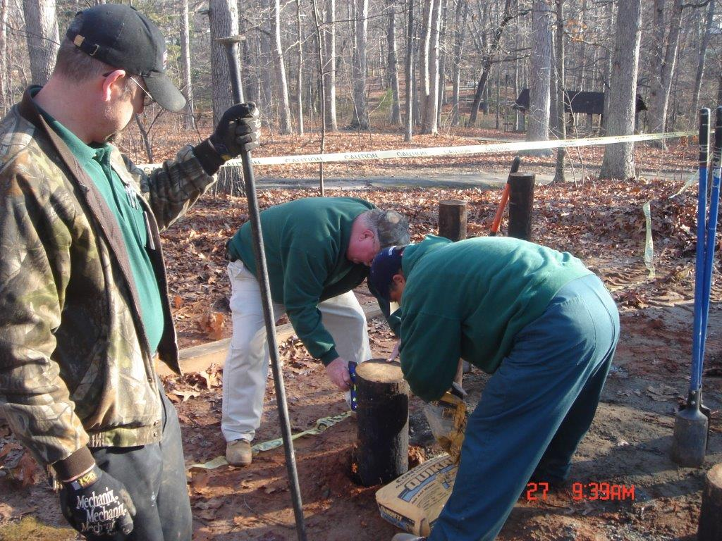
Parks Maintenance
Maintains approximately
3800+ acres, that includes:
80 parks
48 playgrounds
10 greenways (26 miles)
51 shelters
43 soccer fields
and much more…

Slide 21
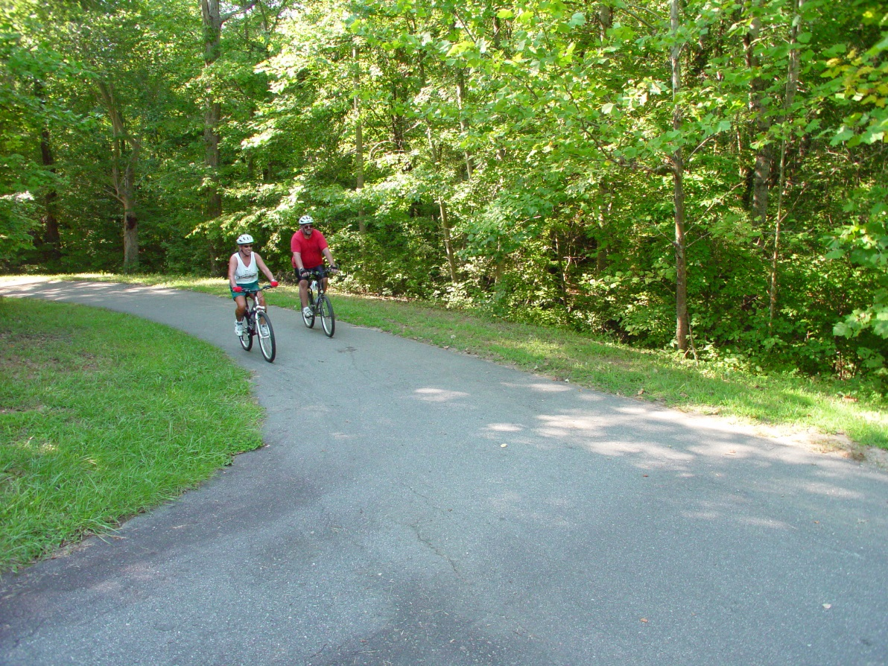
Park Maintenance
Parks range in size from small neighborhood parks like Granville Park to large Regional Parks like Salem Lake, Quarry at Grant Park, and Winston Lake Park.

Slide 22
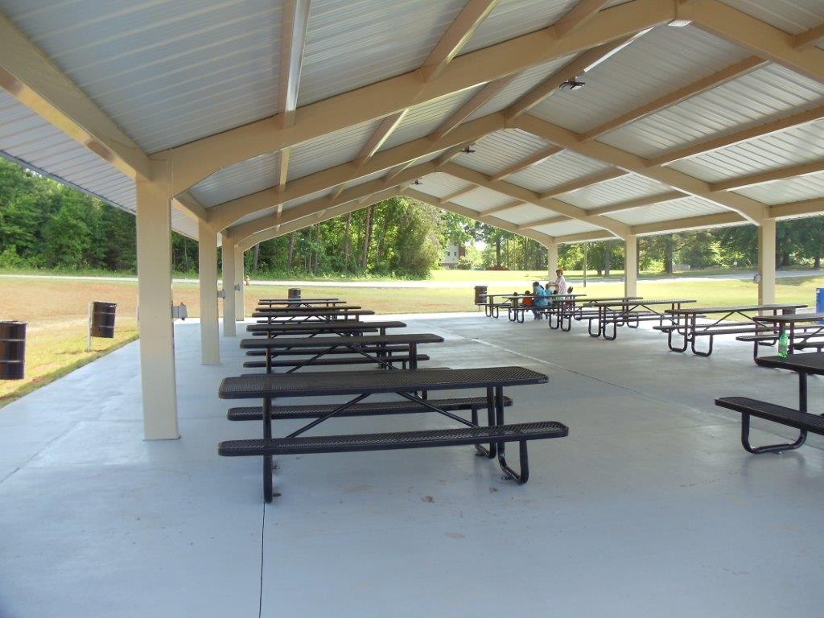
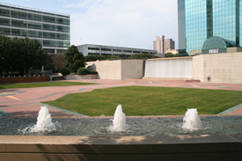
Recreation Administration
Provides direction and supervision for all Recreation & Parks programs
Administers financial functions of the department
Provides community education, website design, coordinate reservations of City-operated picnic shelters and other recreation and park facilities

Slide 23
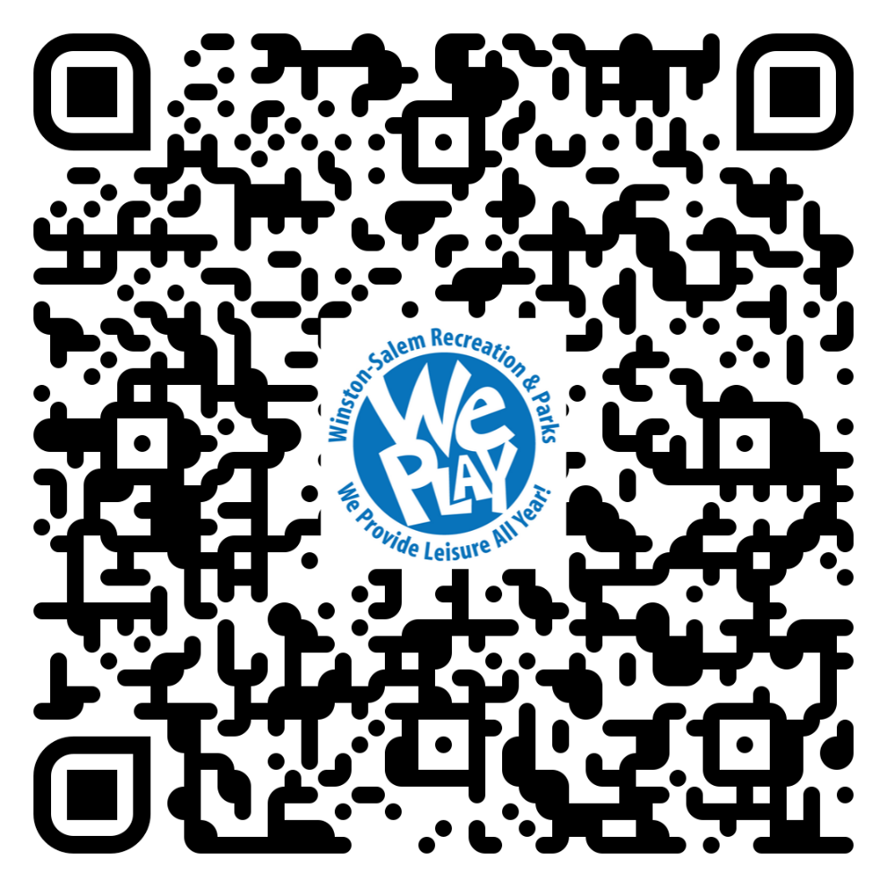
Upcoming Activities and
Events QR Code

Slide 24
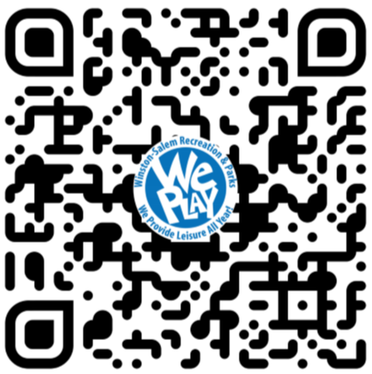
Monthly Update Emails
QR Code

Slide 25
WePLAYevents@cityofws.org
www.WePLAY.ws

