Slide 1
Welcome!
City of Winston-Salem University
Sanitation Division
October 1, 2021

Slide 2
Sanitation/Solid Waste Mission
To protect the public health and environment through the safe and effective removal and disposal of solid wastes.

Slide 3
Sanitation Division Background
City of Winston-Salem’s most visible work unit
Landfill transferred to Utilities Division in 1989
Supported by General Fund (property taxes)

Slide 4
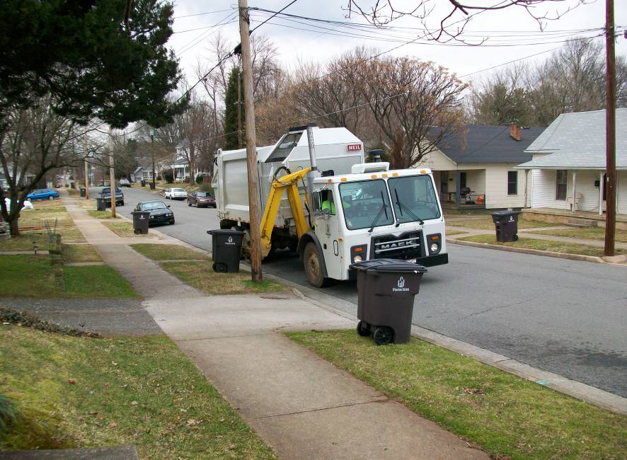
Residential Garbage
1X/Week service
69,373 tons in Fiscal Year 2021

Slide 5
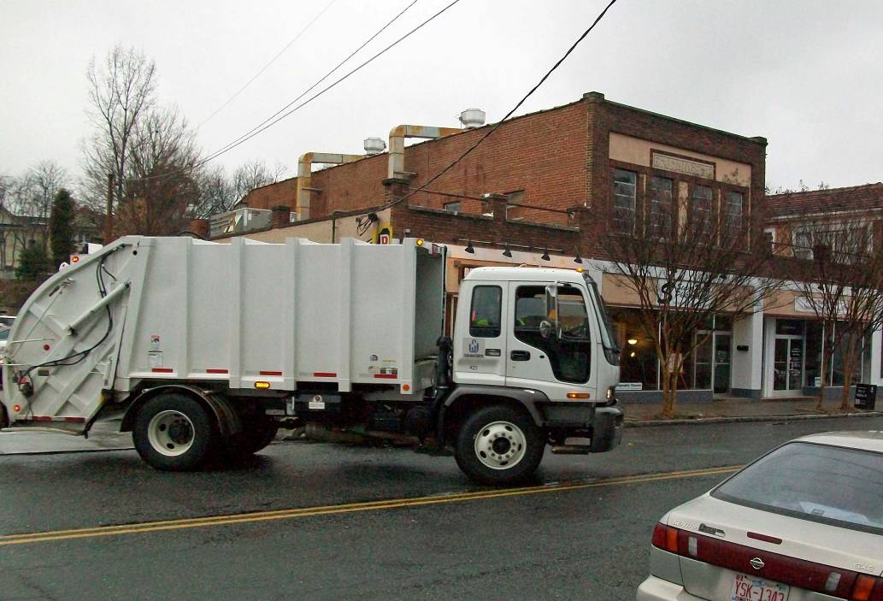
Central Business District (CBD) Garbage
6X/week
1,222 tons in Fiscal Year 2021

Slide 6
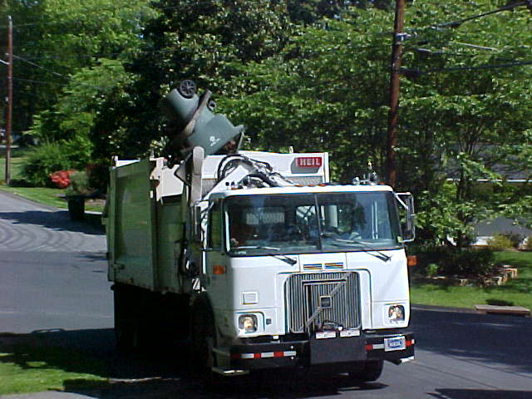
Yard Carts
1X/week
7,191 tons in Fiscal Year 2021

Slide 7
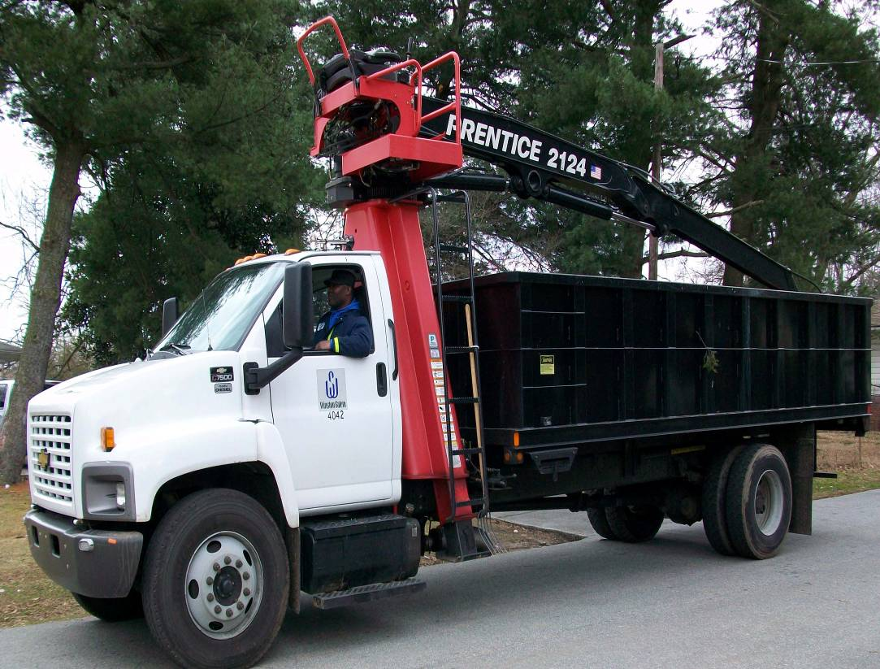
Brush
1X/21 working days
20,991 tons in Fiscal Year 2021

Slide 8
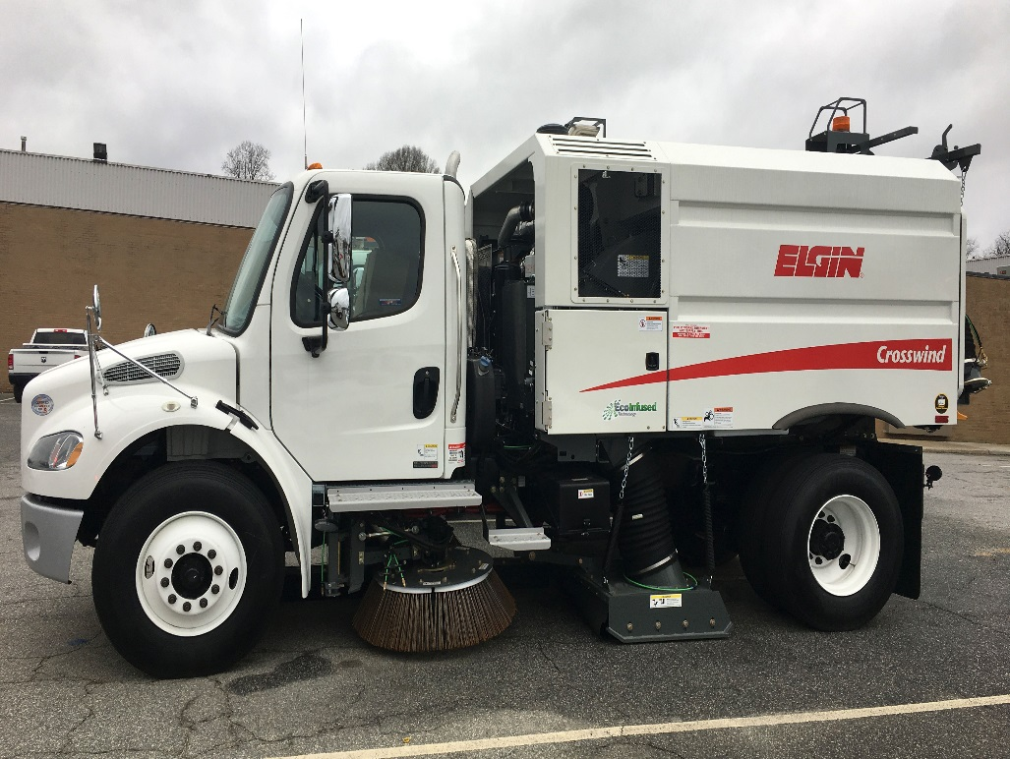
Street Sweeping
Streets, curbs, and gutters are swept as needed to collect and remove debris. Street sweeping keeps storm drains clean and improves the appearance of city streets.

Slide 9
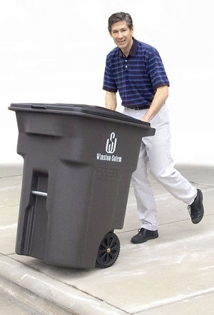
Cart Maintenance Program
Residents must roll their trash curbside
The City provides one free 96 gallon rollout
Over 82,000 carts have been delivered to residents of Winston-Salem

Slide 10


Seasonal Programs
Loose Leaf Collection
  Nov. – Jan.
  11,814 tons in 2021
Bulky Item Collection
  Mar. – Sept.
  3428 tons in 2021

Slide 11
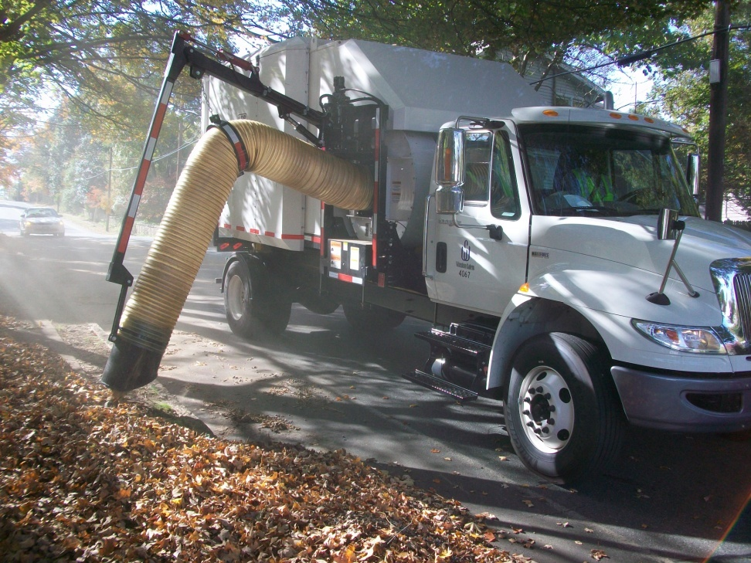
Automated Leaf Loader
Safe Operation
High Capacity
One operator

Slide 12
Recap of Collection Services Provided by Sanitation Division
Service Description | Frequency | Tons
Residential Garbage | 1X/week | 69,373
CBD Garbage | 6X/week | 1,222
Curbside Yard Cart | 1X/week | 7,191
Curbside Brush | 1X/21 working days | 20,991
Loose Leaf (seasonal) | Nov. – Jan./year | 11,814
Bulky Item (seasonal) | Mar-Sept./year | 3428
Total for FY 2021 |  | 114,019

Slide 13
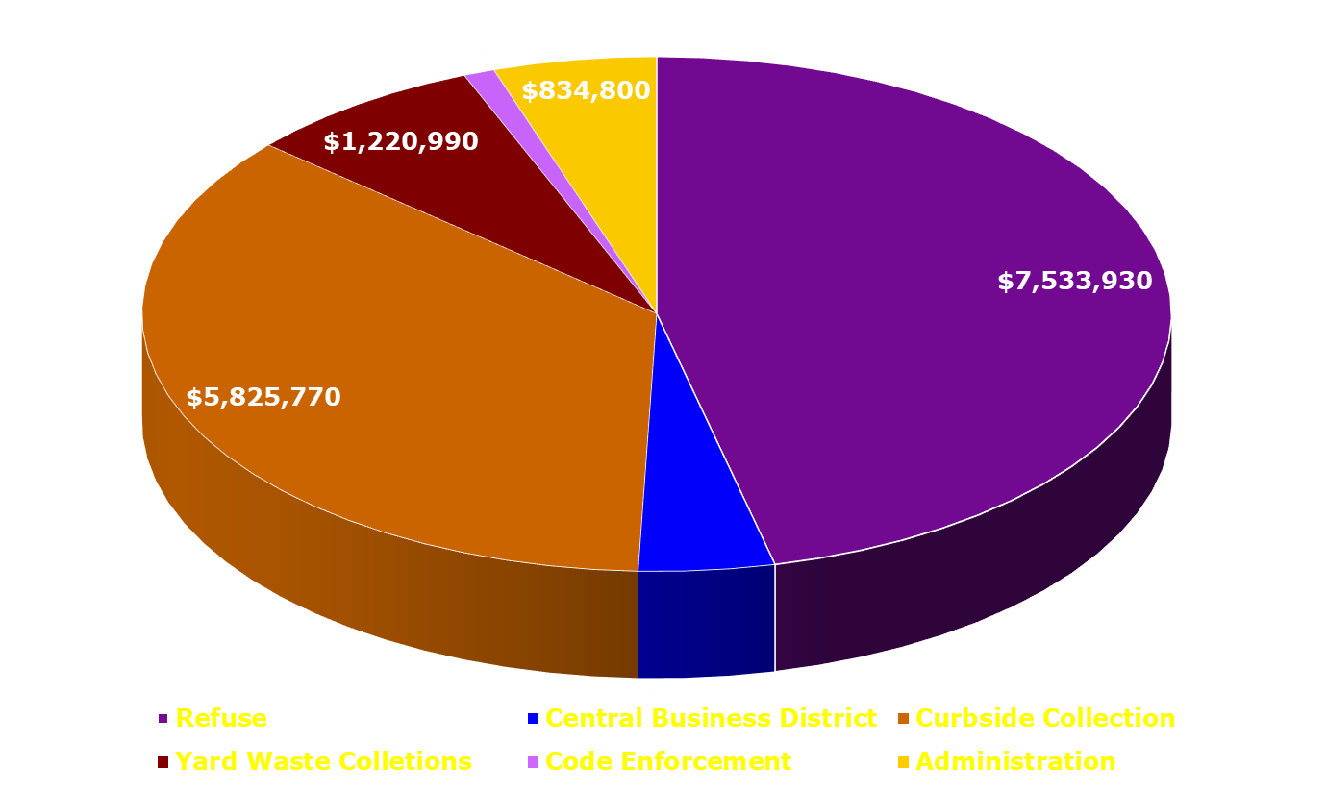
Sanitation Division Budget
(FY 2021)
Total Budget = $16,267,090

Slide 14
Sanitation Code Enforcement
Performs routine work enforcing the City’s Environmental Codes and Ordinances
Investigates complaints from various sources (citizens, CityLink, refuse crews, etc.)
Documents and records any Sanitation Division violations
Verifies violations have been corrected within 10 days
Makes sure any violations that are not Sanitation issues are forwarded to the proper department/division.

Slide 15
Funding Sources for
Sanitation Collection Programs
Most programs are funded through general fund revenues (property taxes)
Curbside Yard Cart service is funded primarily by user fees

Slide 16
Innovative Practices
The Sanitation Division utilizes a software solution to develop efficient routes for refuse and yard waste collections.
Mobile technology is used in the field to reduce extra trips to the yard and respond faster to service requests which are emailed directly to the supervisor in the field.
The Sanitation Division is using automated collection vehicles to increase efficiency and productivity.

Slide 17
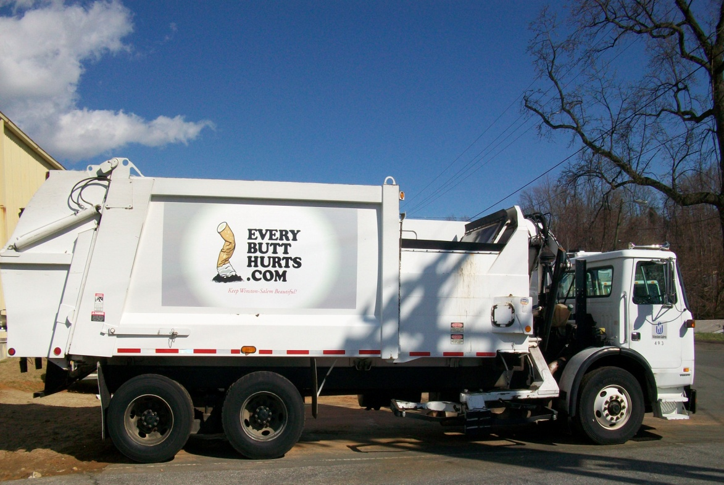
Innovative Practices
Selling of advertising space on collection trucks – An innovative way to generate more income

Slide 18
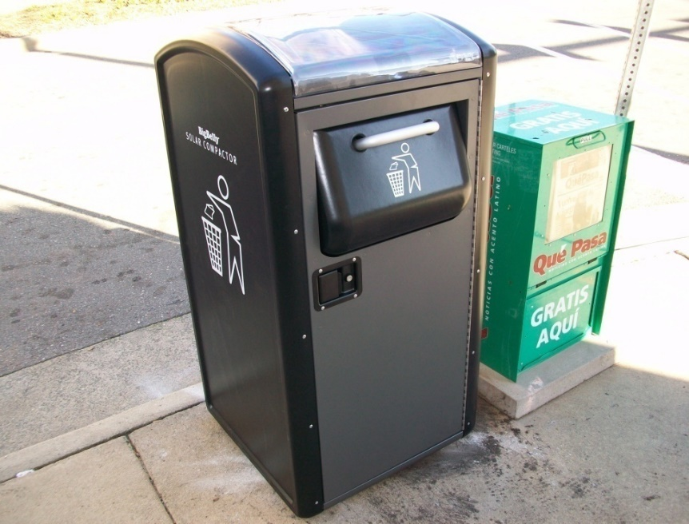
Innovative Practices
The solar powered trash compactor named, “BIG BELLY” , reduced Central Business District collection costs by 80 percent per site. Collection frequency decreased by 500 percent.

Slide 19
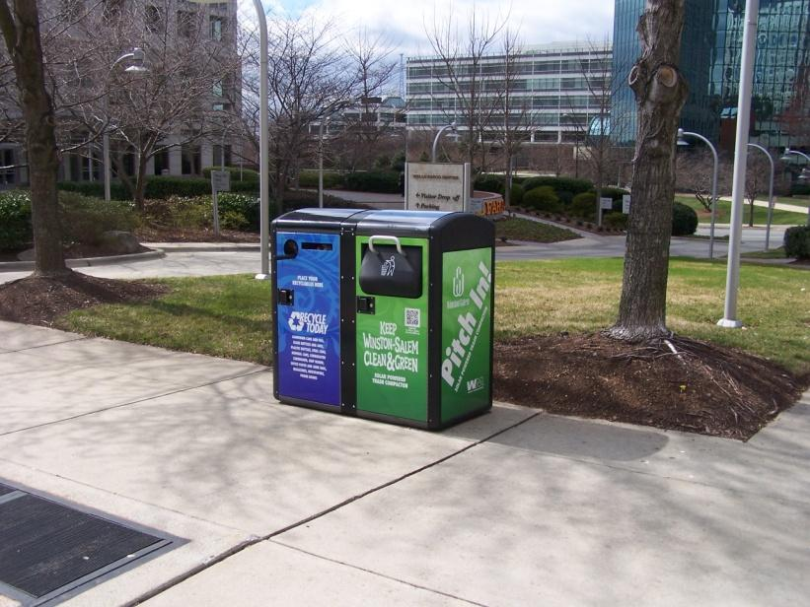
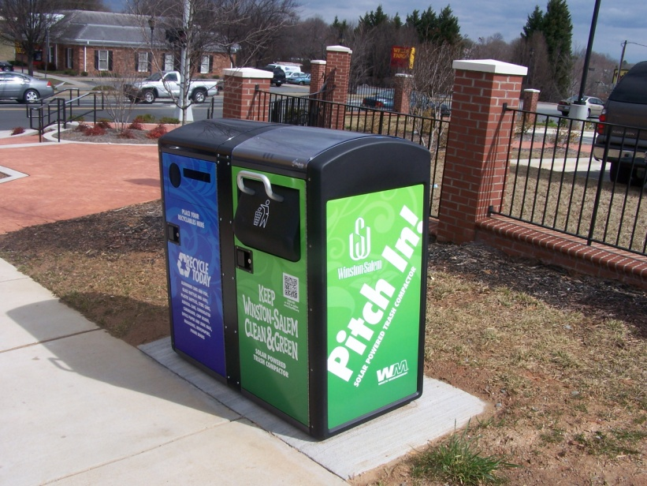
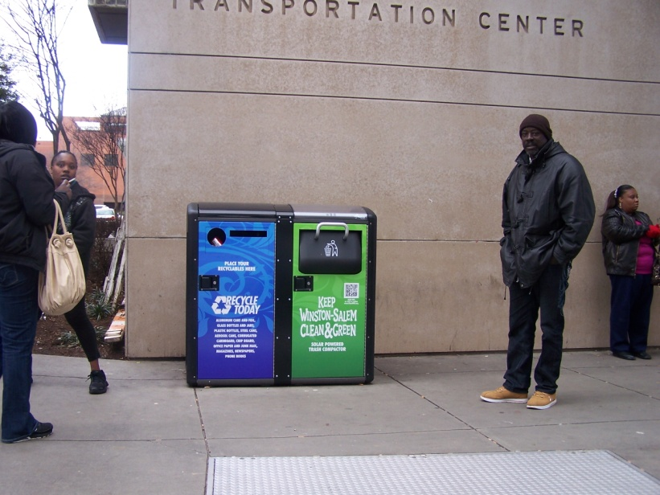
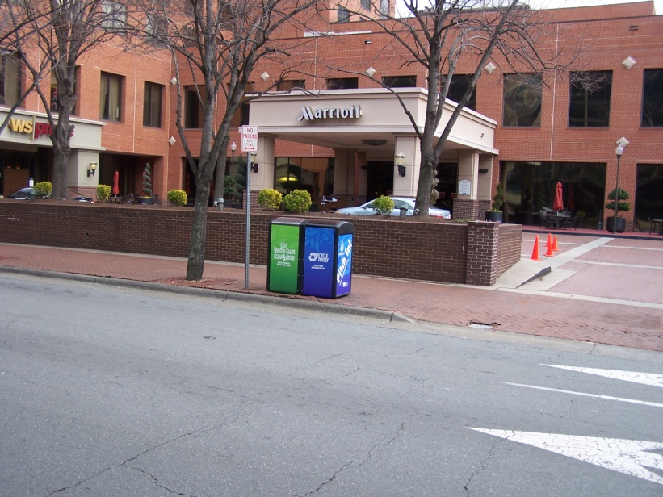
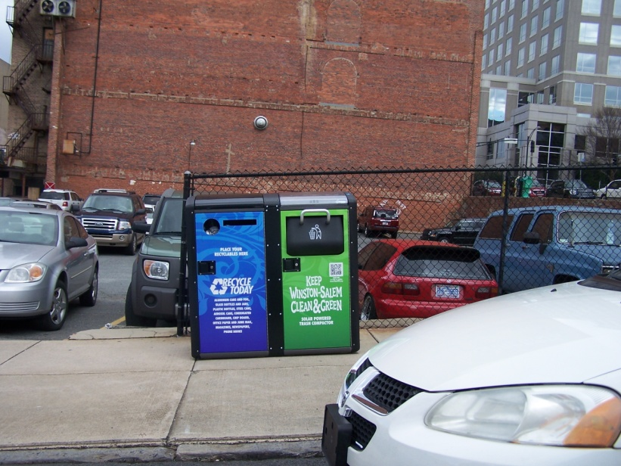
Innovative Practices

Slide 20
City Link
Have questions or concerns?
Call 727-8000
Open 24 hrs. a day, 7days a week

Slide 21
Thank you for your time!

