Slide 1
Vegetation Management
J. Keith Finch
Director

Slide 2
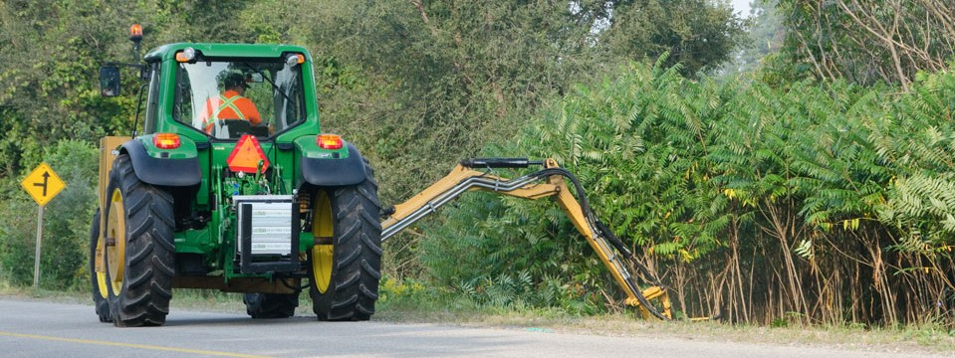
Vegetation Management
Division of Department of Property and Facilities Management
Created May, 2003
Division Mission: To maintain all landscapes, turf and trees on rights of way, parks and cemeteries

Slide 3

Sections
Administration
Grounds Maintenance
Landscape Maintenance
Urban Forestry
Cemeteries

Slide 4
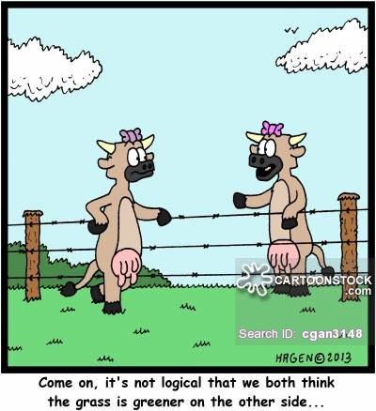
Grounds Maintenance
Responsible for turf management on rights of way and in parks (mowing, trimming, edging, etc.)
Litter control on rights of way - (community service workers)
Leaf removal
Contractual mowing
Snow removal
Annual Budget = $2.4 million
*Not in front of residences or businesses

Slide 5
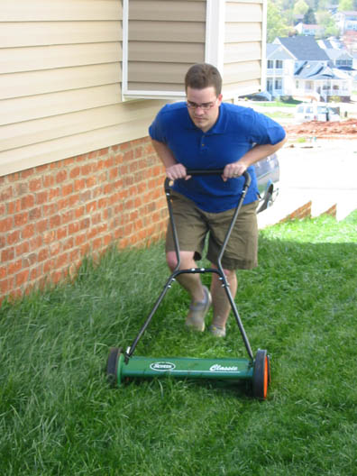
Mowing
400 miles of r/w mowed (over 725 acres)
400 acres of parks mowed
Mowing equivalent of 2250 ½ acre lots!

Slide 6
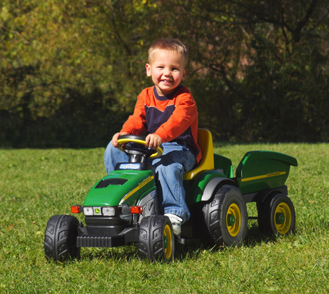
Grounds Maintenance
All mowing done bi-weekly
Both City staff and Contractors
  26 Full-Time employees
  12 Seasonal employees
  More than 25 separate mowing contracts
    $800,000 budgeted for contract mowing

Slide 7
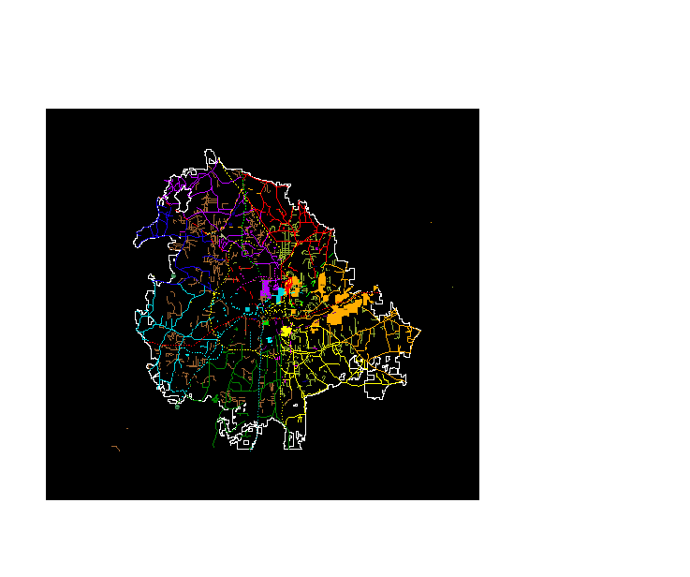
Road colors = different mowing routes
- - - - = Contract route
____ = City route

Slide 8
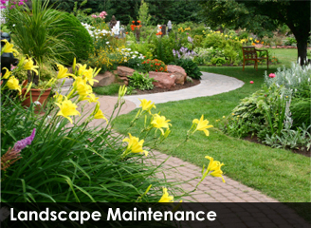
Landscape Maintenance
Responsibilities
  Maintenance of landscapes on rights of way
  and in parks
  Herbicide spraying
  Annual flowers and bulb
  planting
  Watering
  Special Projects
  Snow removal

Slide 9
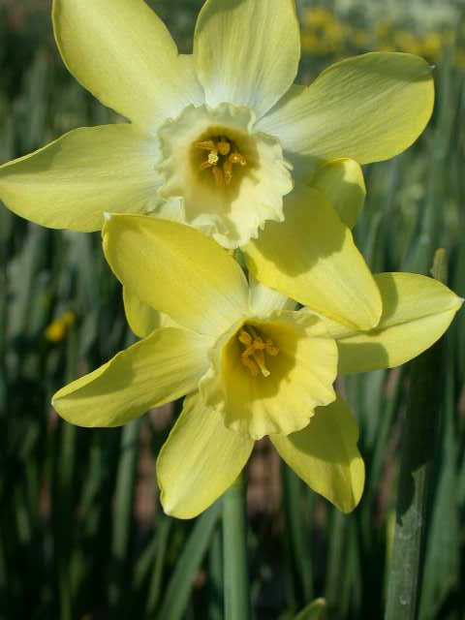
Landscape Maintenance
55 Landscaped Acres
plus 18 ac Hwy 52
Staff:
  25 Full-time employees
  6 Seasonal Employees
Annual Budget: $1.8 million

Slide 10
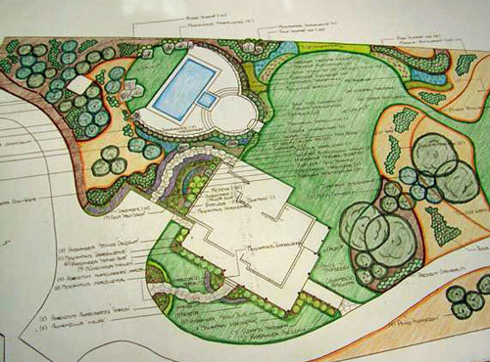
Landscape Maintenance
Last year, Landscape Maintenance personnel:
  Put out over 100,000 gallons of water
  Pruned over 3,000 shrubs
  Pruned over 20,000 flowers
  Planted over 750 flowers
  Planted over 400 shrubs

Slide 11
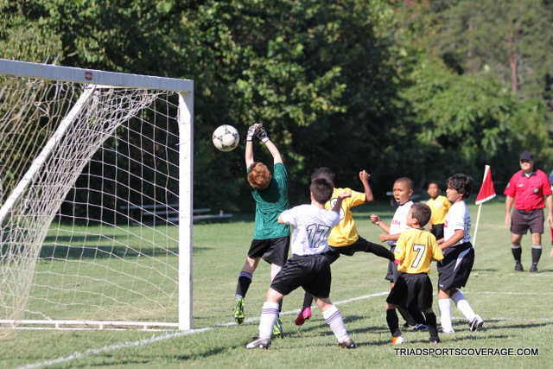


Landscape Maintenance
Soccer Field Maintenance
  11 fields at Sara Lee – Major Complex
  7 fields at Hine – Major Complex
  3 fields at Oak Summit

Slide 12
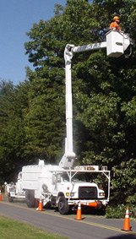
Urban Forestry
Responsibilities
  All maintenance on trees on ANY City property
  Planting trees on rights of way and in parks
  Herbicide spraying
  Storm Cleanup
  City Christmas Tree
13 Full-Time Employees
Annual Budget = $1.1 million

Slide 13
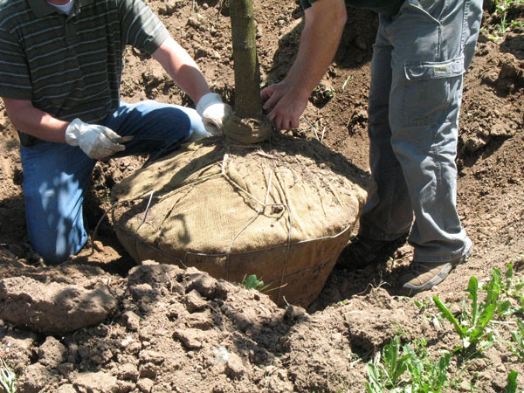
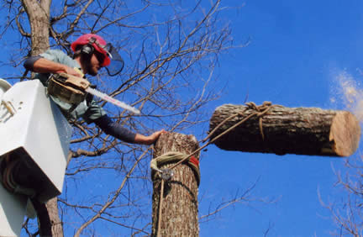
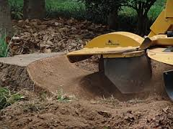
Urban Forestry
200 trees planted (not counting Community Roots Day)
500 trees removed
100 stumps ground
Cleaned up over 1,000 trees
from storms
Pruned over 4,000 trees

Slide 14
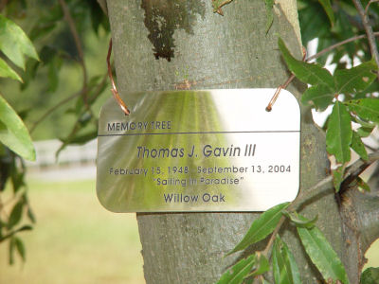
Urban Forestry
Memory Trees
  Planted in Parks
  “Purchased” by individuals
  Planted and maintained
  by Urban Forestry
  Currently, there are close to
  1250 Memory Trees in our
  inventory.

Slide 15
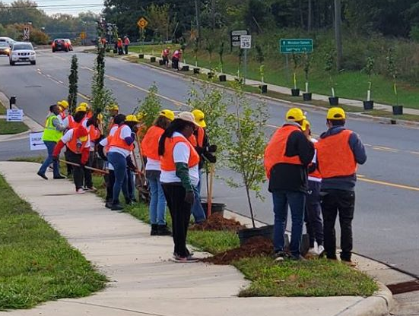
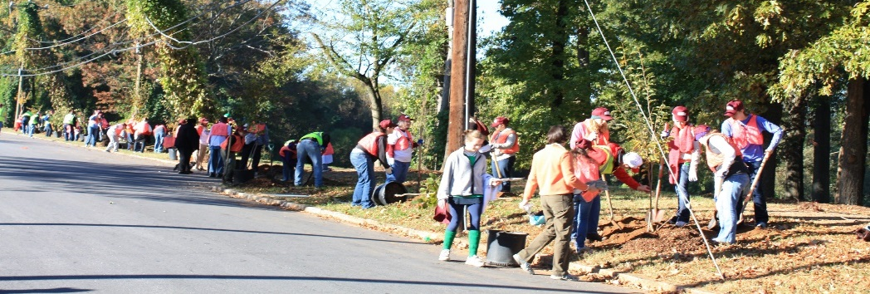
Urban Forestry
Community Roots Day – South Side 2019
  Volunteer Tree Planting Activity
  In 2019, 242 trees were planted
  by 400 volunteers in 2.5 hours
  In 2010, CRD was moved from
  the spring to the fall for logistical
  and arboricultural reasons

Slide 16
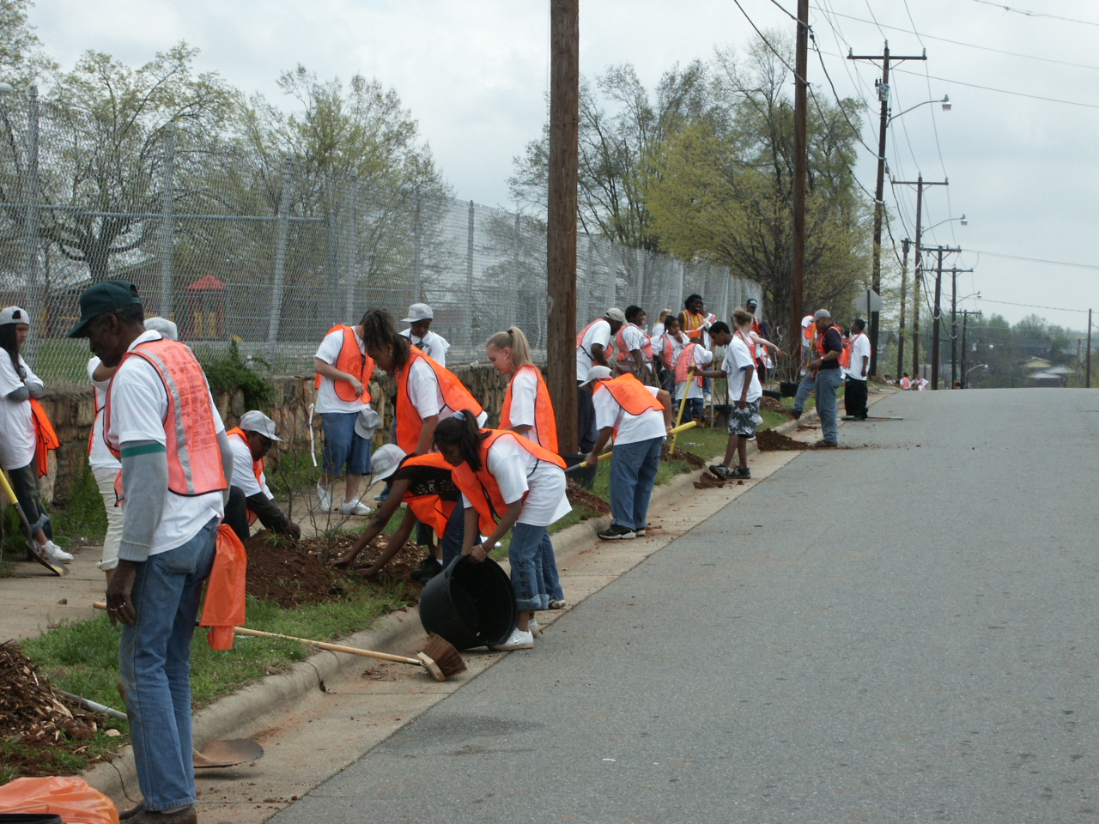

Slide 17
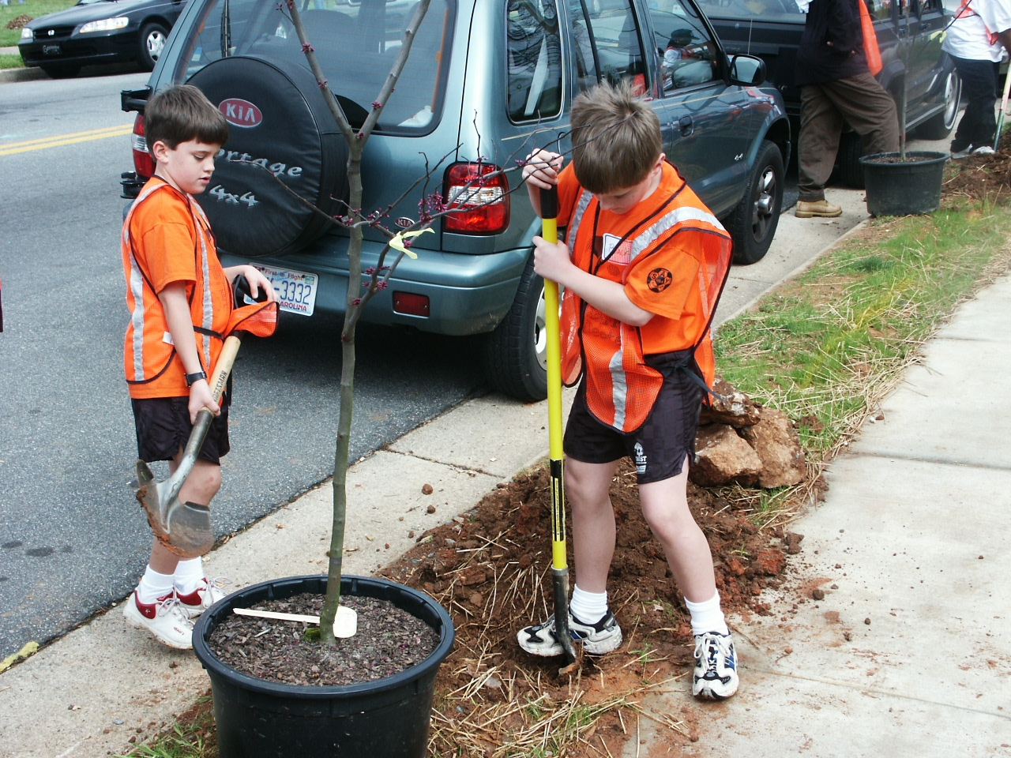

Slide 18
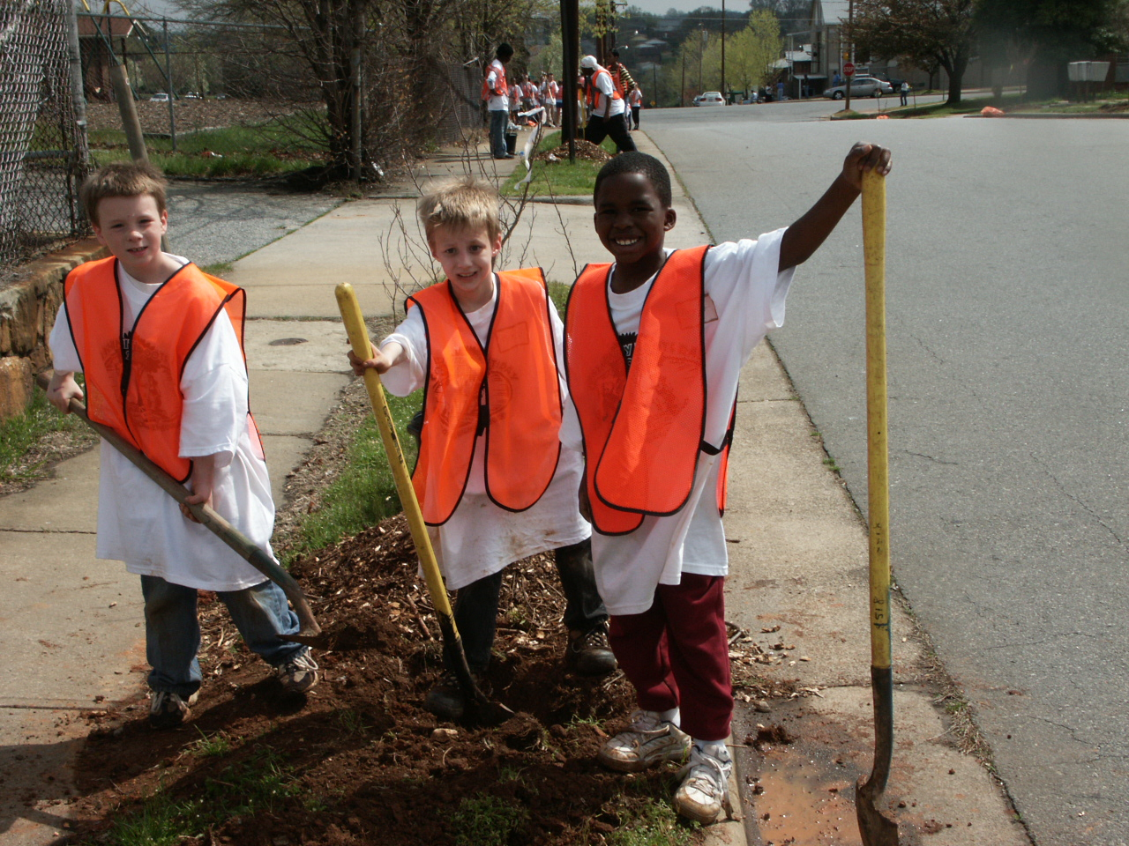

Slide 19
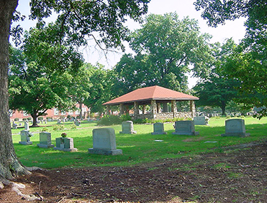
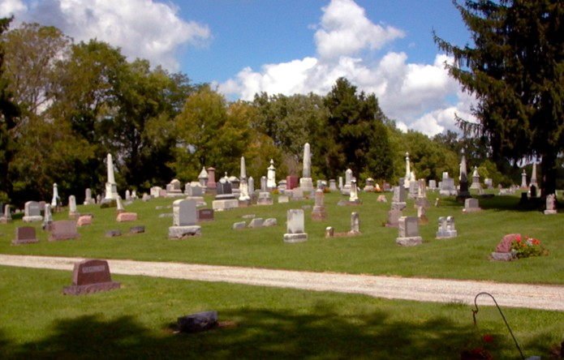
Cemetery Maintenance
Responsible for oversight of two municipal cemeteries – Evergreen and Woodland
Duties include sales of plots and markers, grave opening and closing, grounds maintenance
6 FTE, plus 4 seasonal employees

Slide 20
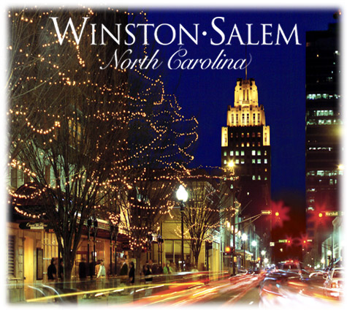
Vegetation Management
Our Goal: To provide a safe and beautiful City for residents of and visitors to Winston-Salem.

Slide 21
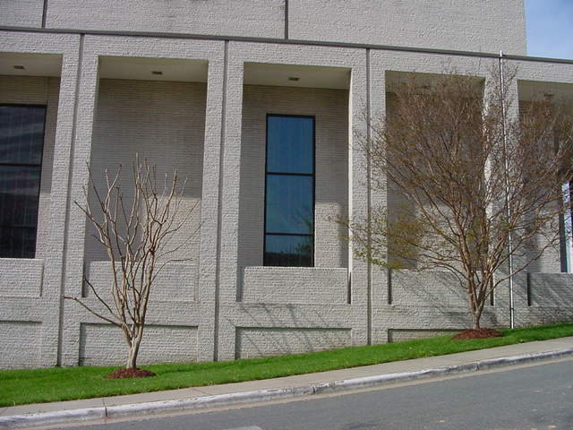

Slide 22
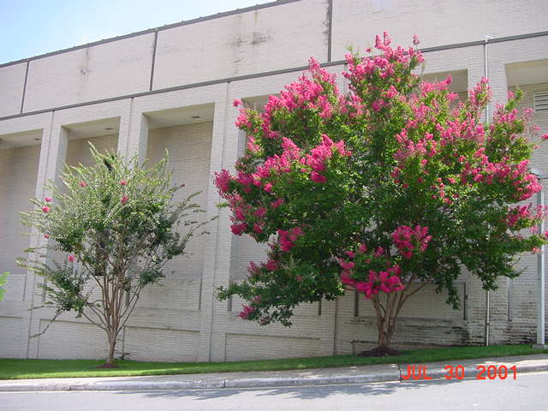

Slide 23
